Slide 1
Year 1 Spring Block 2 : Place Value within 50
Numbers to 50
NCLO:
Count to 50 forwards and backwards, beginning with 0 or 1, or from any number.
Count, read and write numbers to 50 in numerals.

Slide 2
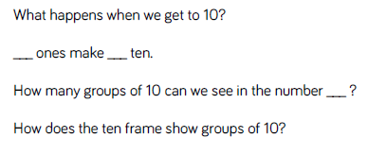
Key vocabulary and questions
Groups, Ten Frame, Number Track.

Slide 3
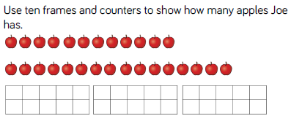
Fluency

Slide 4
Fluency

Slide 5
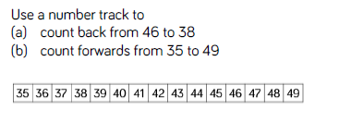
Fluency

Slide 6
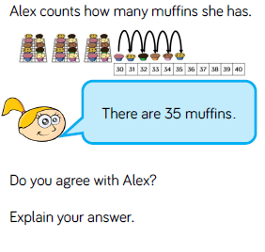
Reasoning and problem solving

Slide 7
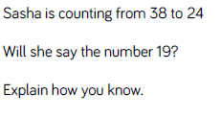
Reasoning and problem solving

Slide 8
Year 1 Spring Block 2 : Place Value within 50
Tens and ones
NCLO: Count, read and write numbers to 50 in numerals.

Slide 9
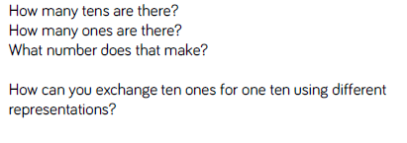
Key vocabulary and questions
Tens, ones, exchange.

Slide 10
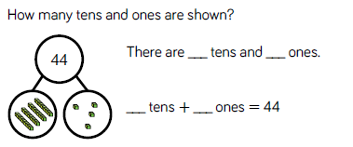
Fluency

Slide 11
Fluency

Slide 12
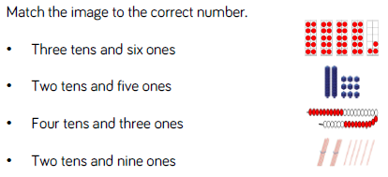
Fluency

Slide 13
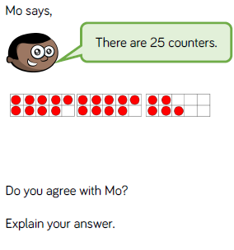
Reasoning and problem solving

Slide 14
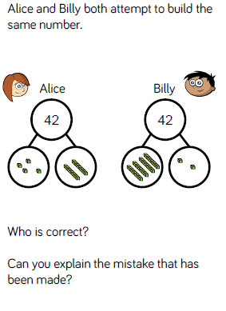
Reasoning and problem solving

Slide 15
Year 1 Spring Block 2 : Place Value within 50
Represent numbers to 50
NCLO: Count, read and write numbers to 50 in numerals.

Slide 16
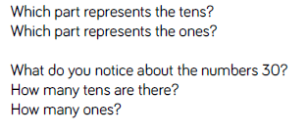
Key vocabulary and questions

Slide 17
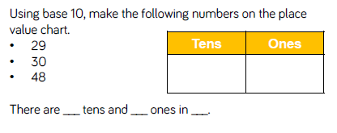
Fluency

Slide 18
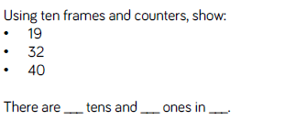
Fluency

Slide 19
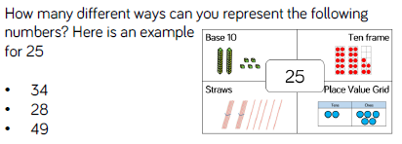
Fluency

Slide 20
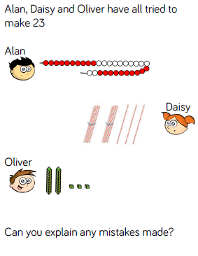
Reasoning and problem solving

Slide 21
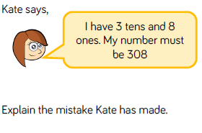
Reasoning and problem solving

Slide 22
Year 1 Spring Block 2 : Place Value within 50
One more, one less
NCLO: given a number, identify one more or one less.

Slide 23
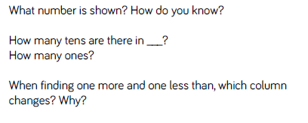
Key vocabulary and questions
One more, one less

Slide 24
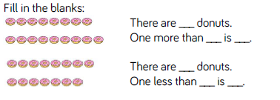
Fluency

Slide 25
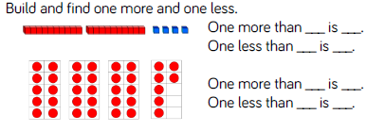
Fluency

Slide 26
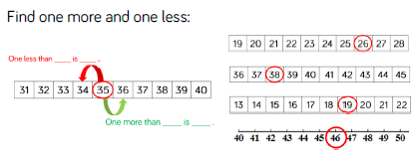
Fluency

Slide 27
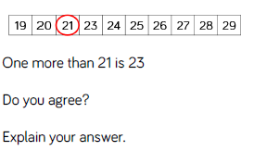
Reasoning and problem solving

Slide 28
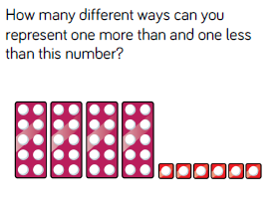
Reasoning and problem solving

Slide 29
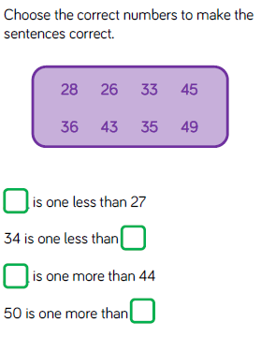
Reasoning and problem solving

Slide 30
Year 1 Spring Block 2 : Place Value within 50
Compare objects within 50
NCLO: Identify and represent numbers using objects and pictorial representations including the number line, and use of language

Slide 31
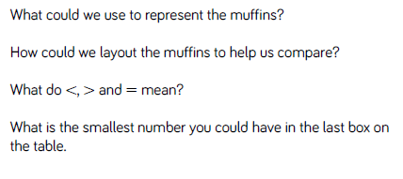
Key vocabulary and questions
Equal to, more than, less than, fewer, most, least

Slide 32
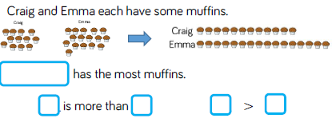
Fluency

Slide 33
Fluency

Slide 34
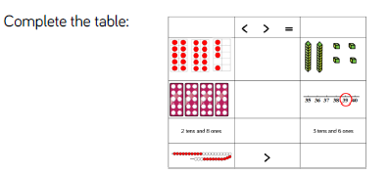
Fluency

Slide 35
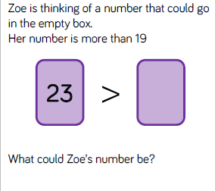
Reasoning and problem solving

Slide 36
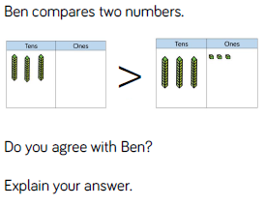
Reasoning and problem solving

Slide 37
Year 1 Spring Block 2 : Place Value within 50
Compare numbers within 50
NCLO: Identify and represent numbers using objects and pictorial representations including the number line, and use of language

Slide 38
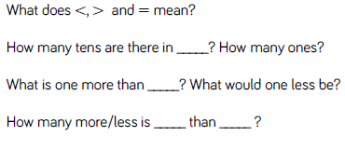
Key vocabulary and questions

Slide 39
Fluency

Slide 40
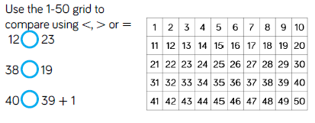
Fluency

Slide 41
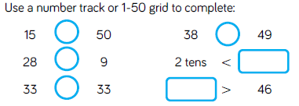
Fluency

Slide 42
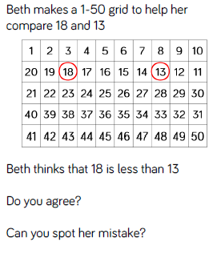
Reasoning and problem solving

Slide 43
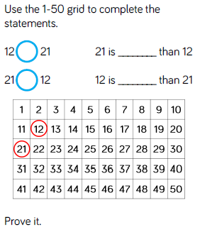
Reasoning and problem solving

Slide 44
Year 1 Spring Block 2 : Place Value within 50
Order numbers within 50
NCLO:Identify and represent numbers using objects and pictorial representations including the number line, and use of language. Count in multiples of twos, fives and tens.

Slide 45
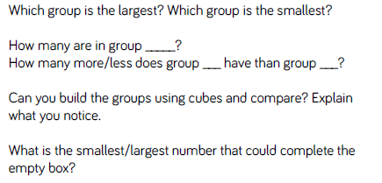
Key vocabulary and questions
Largest, smallest, compare

Slide 46
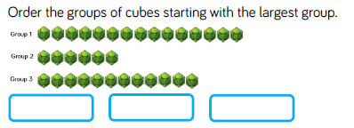
Fluency

Slide 47
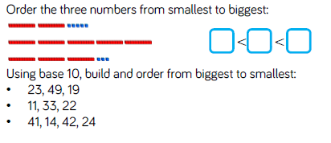
Fluency

Slide 48
Fluency

Slide 49
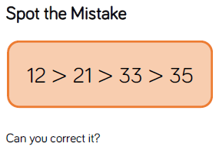
Reasoning and problem solving

Slide 50
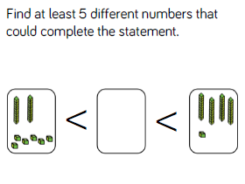
Reasoning and problem solving

Slide 51
Year 1 Spring Block 2 : Place Value within 50
Count in twos NCLO:
Count in multiples of twos, fives and tens.

Slide 52
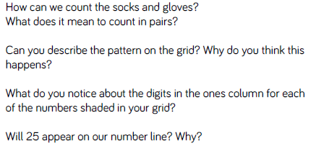
Key vocabulary and questions
Pairs, pattern, digits

Slide 53
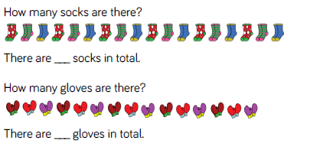
Fluency

Slide 54
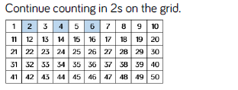
Fluency

Slide 55
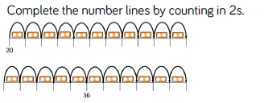
Fluency

Slide 56
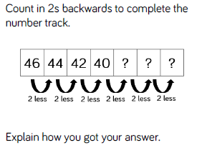
Reasoning and problem solving

Slide 57
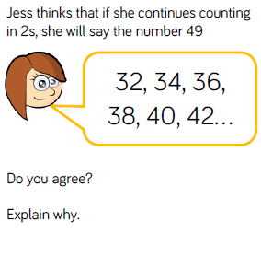
Reasoning and problem solving

Slide 58
Year 1 Spring Block 2 : Place Value within 50
Count in fives
NCLO: Count in multiples of twos, fives and tens.

Slide 59
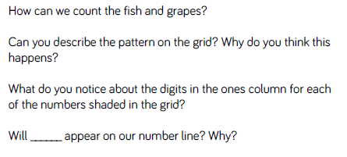
Key vocabulary and questions
Column, digits

Slide 60
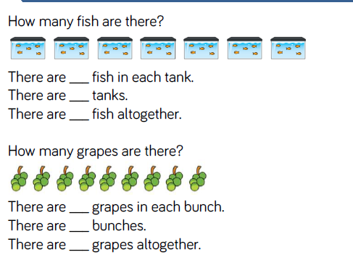
Fluency

Slide 61
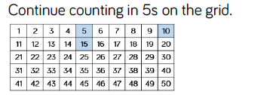
Fluency

Slide 62
Fluency

Slide 63
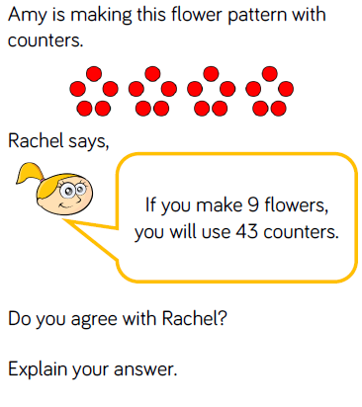
Reasoning and problem solving

Slide 64
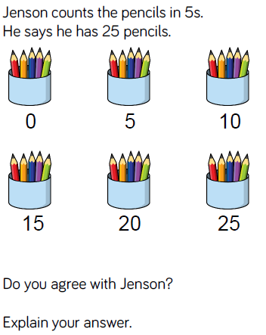
Reasoning and problem solving

