Slide 1
Year 3 Block 3 Multiplication and Division
Multiplication – equal groups
NCLO: Recall and use multiplication and division facts for 3, 4 and 8 multiplication tables.

Slide 2
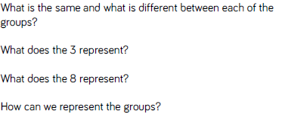
Key vocabulary and questions
Same, different, represent

Slide 3
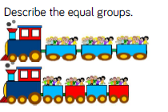
Fluency

Slide 4
Fluency

Slide 5
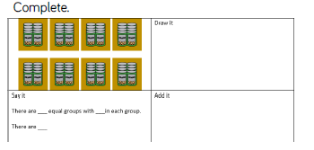
Fluency

Slide 6
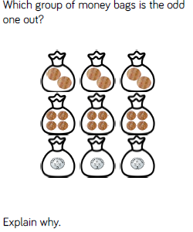
Reasoning and problem solving

Slide 7
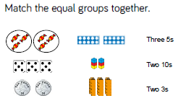
Reasoning and problem solving

Slide 8
Reasoning and problem solving

Slide 9
Year 3 Block 3 Multiplication and Division
Multiplying by 3
NCLO: Recall and use multiplication and division facts for 3, 4 and 8 multiplication tables.

Slide 10
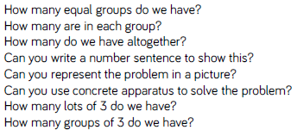
Key vocabulary and questions
altogether, group, lots, problem, solve

Slide 11
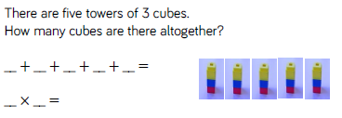
Fluency

Slide 12
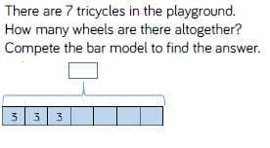
Fluency

Slide 13
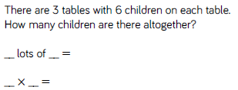
Fluency

Slide 14
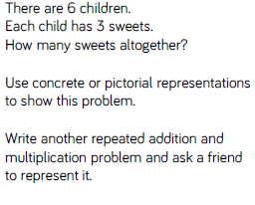
Reasoning and problem solving

Slide 15
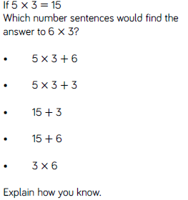
Reasoning and problem solving

Slide 16
Year 3 Block 3 Multiplication and Division
Dividing by 3
NCLO: Recall and use multiplication and division facts for 3, 4 and 8 multiplication tables.

Slide 17
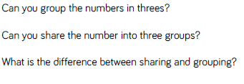
Key vocabulary and questions
group, share

Slide 18
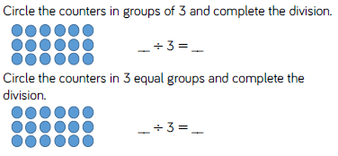
Fluency

Slide 19
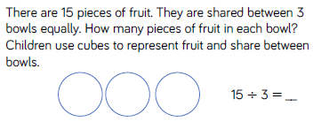
Fluency

Slide 20
Fluency

Slide 21
Reasoning and problem solving

Slide 22
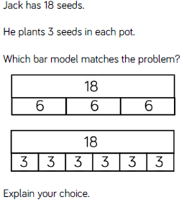
Reasoning and problem solving

Slide 23
Year 3 Block 3 Multiplication and Division
The 3 times-table
NCLO: Write and calculate statements for multiplication and division for the multiplication tables, including for two-digit numbers times one-digit numbers, using mental and progressing to formal written methods.

Slide 24
Key vocabulary and questions
known facts, tables, pattern

Slide 25
Fluency

Slide 26
Fluency

Slide 27
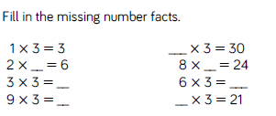
Fluency

Slide 28
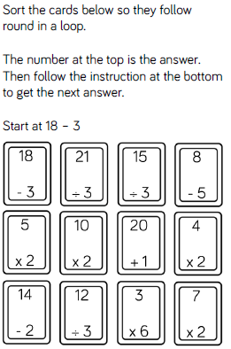
Reasoning and problem solving

Slide 29
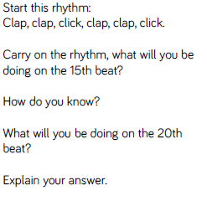
Reasoning and problem solving

Slide 30
Year 3 Block 3 Multiplication and Division
Multiplying by 4
NCLO: Recall and use multiplication and division facts for 3, 4 and 8 multiplication tables.

Slide 31
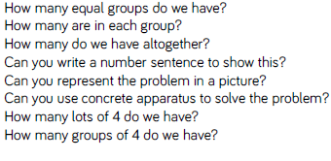
Key vocabulary and questions
repeated addition, doubling, group, altogether

Slide 32
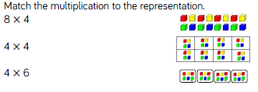
Fluency

Slide 33
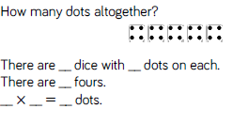
Fluency

Slide 34
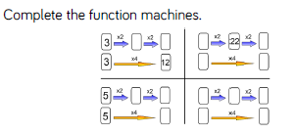
Fluency

Slide 35
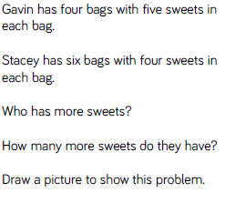
Reasoning and problem solving

Slide 36
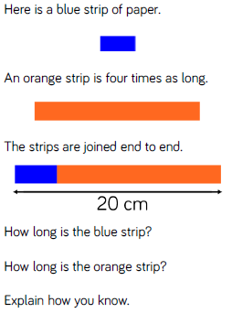
Reasoning and problem solving

Slide 37
Year 3 Block 3 Multiplication and Division
Dividing by 4
NCLO: Recall and use multiplication and division facts for 3, 4 and 8 multiplication tables.

Slide 38
Key vocabulary and questions
groups, share, difference

Slide 39
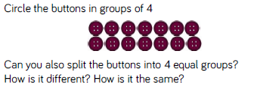
Fluency

Slide 40
Fluency

Slide 41
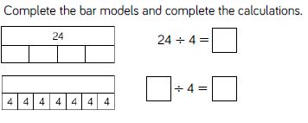
Fluency

Slide 42
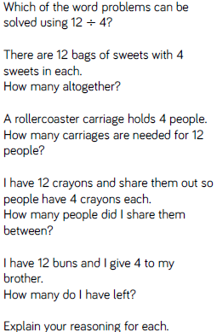
Reasoning and problem solving

Slide 43
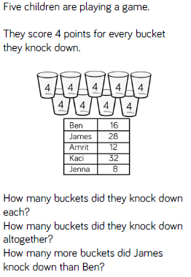
Reasoning and problem solving

Slide 44
Year 3 Block 3 Multiplication and Division
The 4 times-table
NCLO: Write and calculate statements for multiplication and division for the multiplication tables, including for two-digit numbers times one-digit numbers, using mental and progressing to formal written methods.

Slide 45
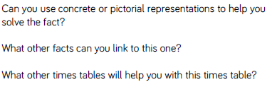
Key vocabulary and questions
represent, times tables, know facts

Slide 46
Fluency

Slide 47
Fluency

Slide 48
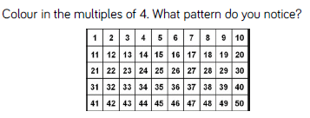
Fluency

Slide 49
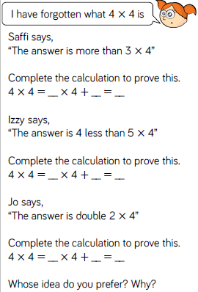
Reasoning and problem solving

Slide 50
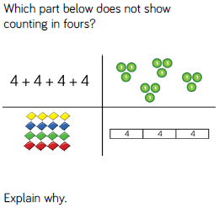
Reasoning and problem solving

Slide 51
Year 3 Block 3 Multiplying and Dividing
Multiplying by 8
NCLO: Recall and use multiplication and division facts for 3, 4 and 8 multiplication tables.

Slide 52
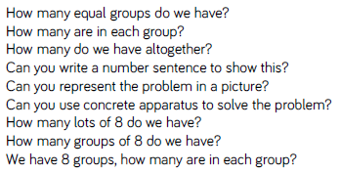
Key vocabulary and questions
group, altogether, equal group

Slide 53
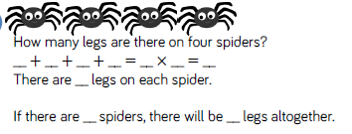
Fluency

Slide 54
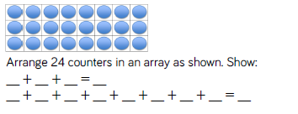
Fluency

Slide 55
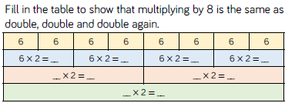
Fluency

Slide 56
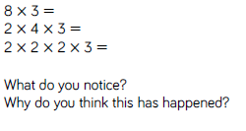
Reasoning and problem solving

Slide 57
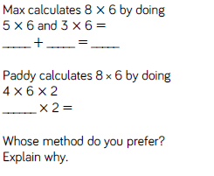
Reasoning and problem solving

Slide 58
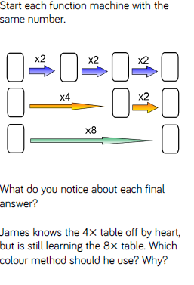
Reasoning and problem solving

Slide 59
Year 3 Block 3 Multiplication and Division
Dividing by 8
NCLO: Recall and use multiplication and division facts for 3, 4 and 8 multiplication tables.

Slide 60
Key vocabulary and questions
group, share,

Slide 61
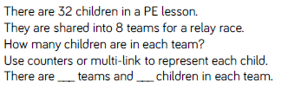
Fluency

Slide 62
Fluency

Slide 63
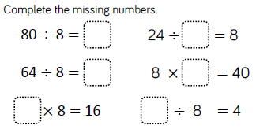
Fluency

Slide 64
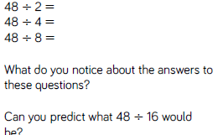
Reasoning and problem solving

Slide 65
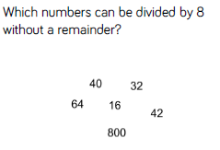
Reasoning and problem solving

Slide 66
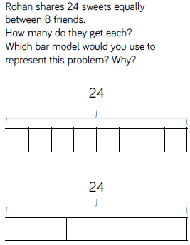
Reasoning and problem solving

Slide 67
Year 3 Block 3 Multiplication and Division
The 8 times-table
NCLO: Write and calculate statements for multiplication and division for the multiplication tables, including for two-digit numbers times one-digit numbers, using mental and progressing to formal written methods.

Slide 68
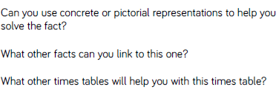
Key vocabulary and questions
facts, link, distributive law

Slide 69
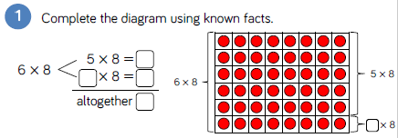
Fluency

Slide 70
Fluency

Slide 71
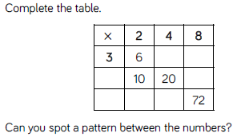
Fluency

Slide 72
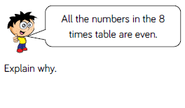
Reasoning and problem solving

Slide 73
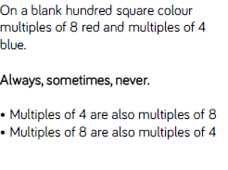
Reasoning and problem solving

Slide 74
Reasoning and problem solving

