Slide 1
Year 5 Block 1 Number: Place Value
Number to 10,000
NCLO: Read, write, order and compare numbers to at least 1,000,000 and determine the value of each digit.

Slide 2
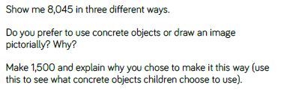
Key vocabulary and questions
Pictorial images, objects, represent

Slide 3
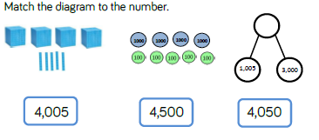
Fluency

Slide 4
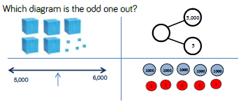
Fluency

Slide 5
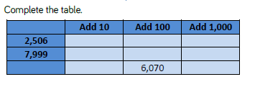
Fluency

Slide 6
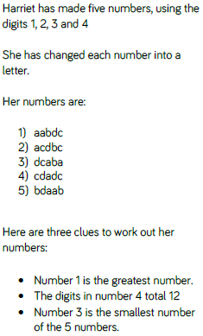
Reasoning and problem solving

Slide 7
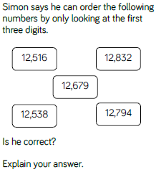
Reasoning and problem solving

Slide 8
Year 5 Block 1 Number: Place Value
Roman numerals to 1,000
NCLO: Read Roman numerals to 1000 (M) and recognise years written in Roman numerals

Slide 9
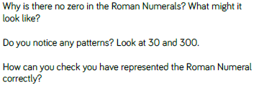
Key vocabulary and questions
Pattern, Representation, Number system

Slide 10
Fluency

Slide 11
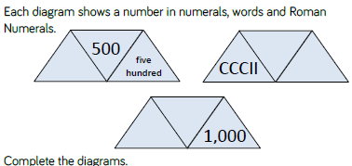
Fluency

Slide 12
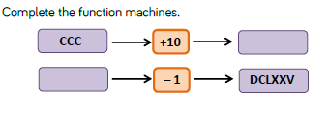
Fluency

Slide 13
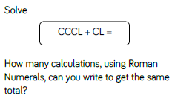
Reasoning and problem solving

Slide 14
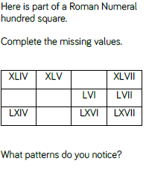
Reasoning and problem solving

Slide 15
Year 5 Block 1 Number: Place Value
Round to the nearest 10, 100 and 1,000
NCLO: Round any number up to 1,000,000 to the nearest 10, 100, 1,000, 10,000 and 100,000

Slide 16
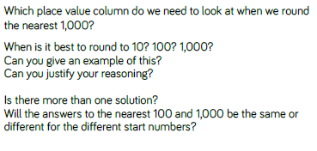
Key vocabulary and questions
Same, different, round

Slide 17
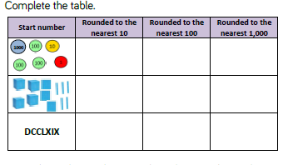
Fluency

Slide 18
Fluency

Slide 19
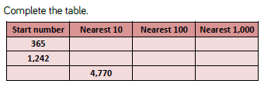
Fluency

Slide 20
Reasoning and problem solving

Slide 21
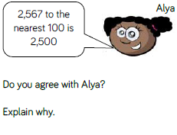
Reasoning and problem solving

Slide 22
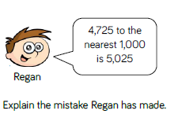
Reasoning and problem solving

Slide 23
Year 5 Block 1 Number: Place Value
Numbers to 100,000
NCLO: Read, write, order and compare numbers to at least 1,000,000 and determine the value of each digit.

Slide 24
Key vocabulary and questions
estimate, number sequence, forwards, backwards

Slide 25
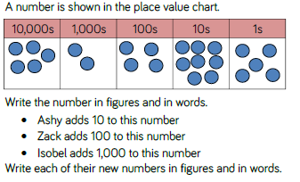
Fluency

Slide 26
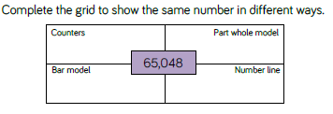
Fluency

Slide 27
Fluency

Slide 28
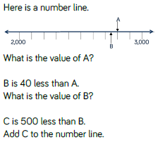
Reasoning and problem solving

Slide 29
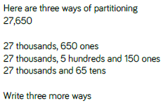
Reasoning and problem solving

Slide 30
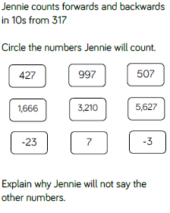
Reasoning and problem solving

Slide 31
Year 5 Block 1 Number: Place Value
Compare and order numbers to 100,000
NCLO: Read, write, order and compare numbers to at least 1,000,000 and determine the value of each digit.

Slide 32
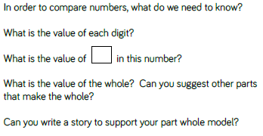
Key vocabulary and questions
value, whole, part whole

Slide 33
Fluency

Slide 34
Fluency

Slide 35
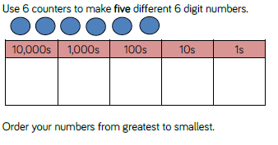
Fluency

Slide 36
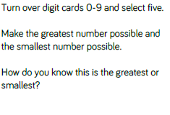
Reasoning and problem solving

Slide 37
Reasoning and problem solving

Slide 38
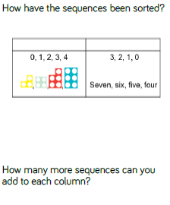
Reasoning and problem solving

Slide 39
Year 5 Block 1 Number: Place Value
Round numbers within 100,000
NCLO: Round any number up to 1,000,000 to the nearest 10, 100, 1,000, 10,000 and 100,000

Slide 40
Key vocabulary and questions
multiples, round, justify, explain

Slide 41
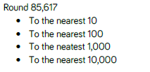
Fluency

Slide 42
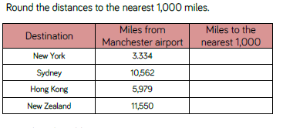
Fluency

Slide 43
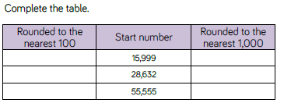
Fluency

Slide 44
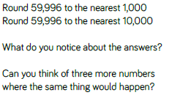
Reasoning and problem solving

Slide 45
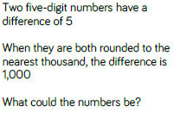
Reasoning and problem solving

Slide 46
Year 5 Block 1 Number: Place Value
Numbers to a million
NCLO: Read, write, order and compare numbers to at least 1,000,000 and determine the value of each digit.

Slide 47
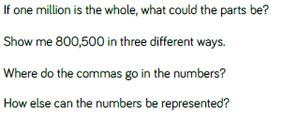
Key vocabulary and questions
represent

Slide 48
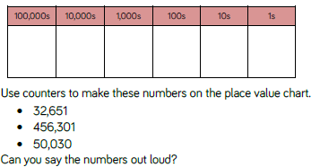
Fluency

Slide 49
Fluency

Slide 50
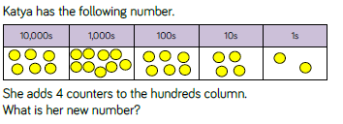
Fluency

Slide 51
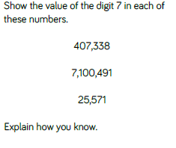
Reasoning and problem solving

Slide 52
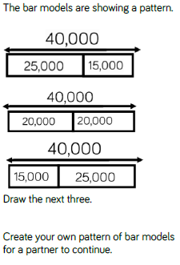
Reasoning and problem solving

Slide 53
Year 5 Block 1 Number: Place Value
Counting in 10s, 100s, 1,000s, 10,000s and 100,000s
NCLO: Count forwards or backwards in steps of powers of 10 for any given number up to 1,000,000

Slide 54
Key vocabulary and questions
rule, sequence, negative, rule

Slide 55
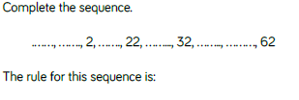
Fluency

Slide 56
Fluency

Slide 57
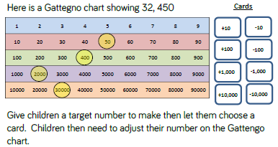
Fluency

Slide 58
Reasoning and problem solving

Slide 59
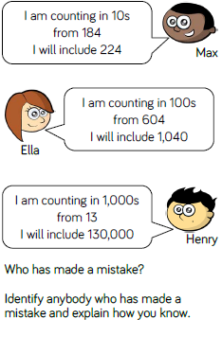
Reasoning and problem solving

Slide 60
Year 5 Block 1 Number: Place Value
Compare and order numbers to a million
NCLO: Read, write, order and compare numbers to at least 1,000,000 and determine the value of each digit.

Slide 61
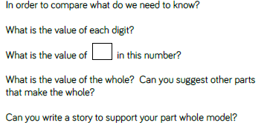
Key vocabulary and questions
whole, part whole, compare, place value

Slide 62
Fluency

Slide 63
Fluency

Slide 64
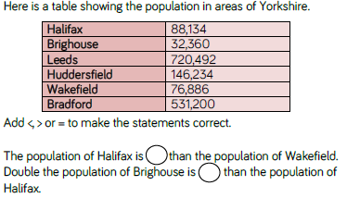
Fluency

Slide 65
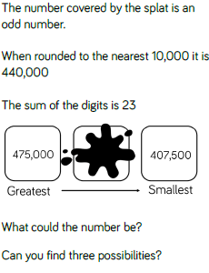
Reasoning and problem solving

Slide 66
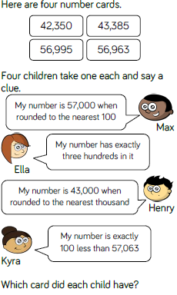
Reasoning and problem solving

Slide 67
Year 5 Block 1 Number: Place Value
Round numbers to a million
NCLO: Round any number up to 1,000,000 to the nearest 10, 100, 1,000, 10,000 and 100,000

Slide 68
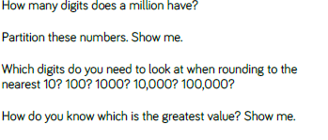
Key vocabulary and questions
rule, rounding

Slide 69
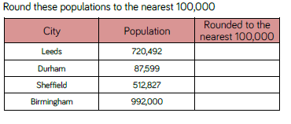
Fluency

Slide 70
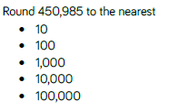
Fluency

Slide 71
Fluency

Slide 72
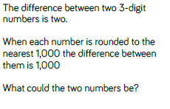
Reasoning and problem solving

Slide 73
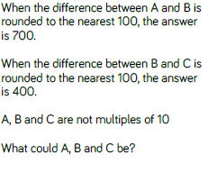
Reasoning and problem solving

Slide 74
Year 5 Block 1 Number: Place Value
Negative numbers
NCLO: Interpret negative numbers in context, count forwards and backwards with positive and negative whole numbers including through zero.

Slide 75
Key vocabulary and questions
forwards, backwards, negative, warmest, coldest

Slide 76
Fluency

Slide 77
Fluency

Slide 78
Fluency

Slide 79
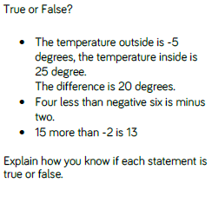
Reasoning and problem solving

Slide 80
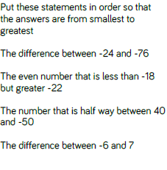
Reasoning and problem solving

