Slide 1
Year 6 Block 1 Geometry: Small steps 1-6
Measure with a protractor
NCLO: Compare and classify geometric shapes based on their properties and sizes and find unknown angles in any triangles, quadrilaterals and regular polygons.

Slide 2
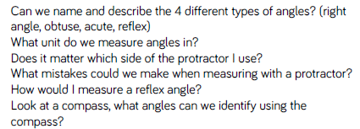
Key vocabulary and questions
angles, reflex, obtuse, acute, measure

Slide 3
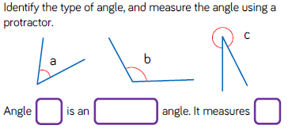
Fluency

Slide 4
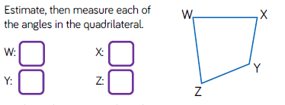
Fluency

Slide 5
Fluency

Slide 6
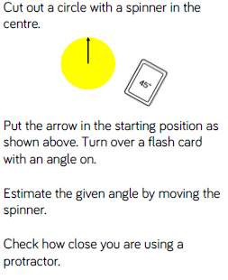
Reasoning and problem solving

Slide 7
Reasoning and problem solving

Slide 8
Year 6 Block 1 Geometry: Small steps 1-6
Introduce angles
NCLO: Recognise angles where they meet at a point, are on a straight line, or are vertically opposite and find missing angles.

Slide 9
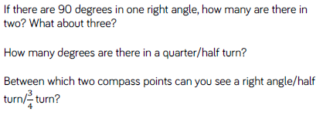
Key vocabulary and questions
angles, reflex, obtuse, acute, measure

Slide 10
Fluency

Slide 11
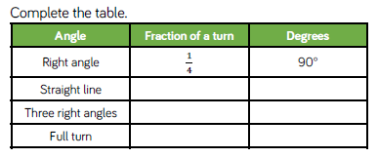
Fluency

Slide 12
Fluency

Slide 13
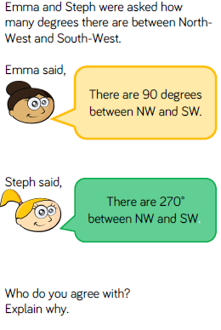
Reasoning and problem solving

Slide 14
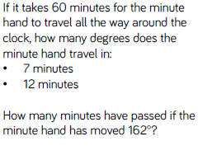
Reasoning and problem solving

Slide 15
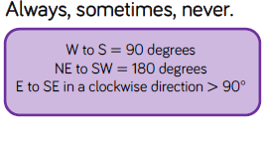
Reasoning and problem solving

Slide 16
Year 6 Block 1 Geometry: Small steps 1-6
Calculate angles
NCLO: Recognise angles where they meet at a point, are on a straight line, or are vertically opposite and find missing angles.

Slide 17
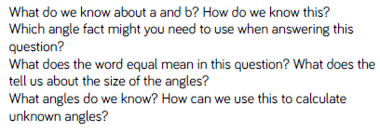
Key vocabulary and questions
angles, reflex, obtuse, acute, measure

Slide 18
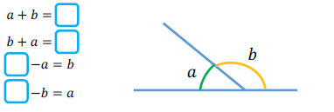
Fluency

Slide 19
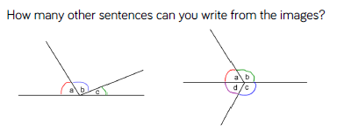
Fluency

Slide 20
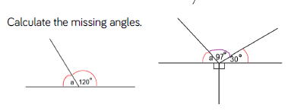
Fluency

Slide 21
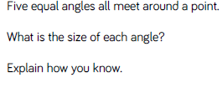
Reasoning and problem solving

Slide 22
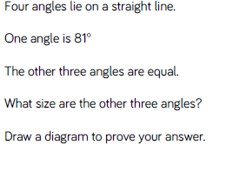
Reasoning and problem solving

Slide 23
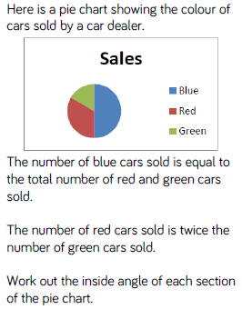
Reasoning and problem solving

Slide 24
Year 6 Block 1 Geometry: Small steps 1-6
Vertically opposite angles
NCLO: Recognise angles where they meet at a point, are on a straight line, or are vertically opposite and find missing angles.

Slide 25
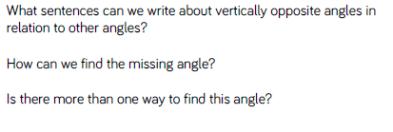
Key vocabulary and questions
angles, reflex, obtuse, acute, measure

Slide 26
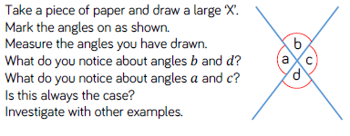
Fluency

Slide 27
Fluency

Slide 28
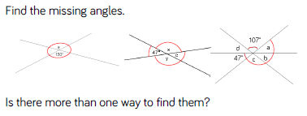
Fluency

Slide 29
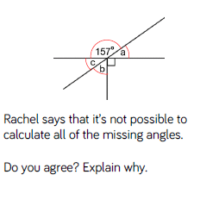
Reasoning and problem solving

Slide 30
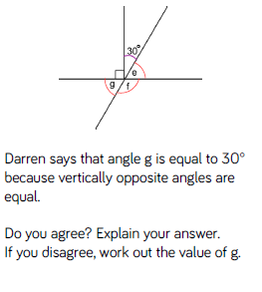
Reasoning and problem solving

Slide 31
Year 6 Block 1 Geometry: Small steps 1-6
Angles in a triangle
NCLO: Recognise angles where they meet at a point, are on a straight line, or are vertically opposite and find missing angles.

Slide 32
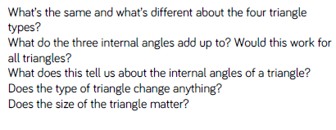
Key vocabulary and questions
angles, reflex, obtuse, acute, measure

Slide 33
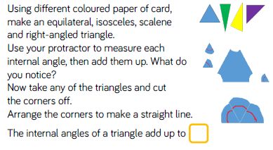
Fluency

Slide 34
Fluency

Slide 35
Fluency

Slide 36
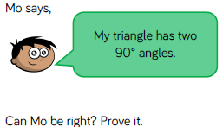
Reasoning and problem solving

Slide 37
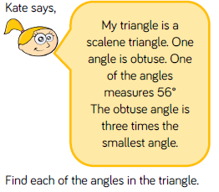
Reasoning and problem solving

Slide 38
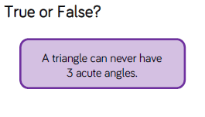
Reasoning and problem solving

Slide 39
Year 6 Block 1 Geometry: Small steps 1-6
Angles in a triangle – special cases
NCLO: Recognise angles where they meet at a point, are on a straight line, or are vertically opposite and find missing angles.

Slide 40
Key vocabulary and questions
angles, reflex, obtuse, acute, measure

Slide 41
Fluency

Slide 42
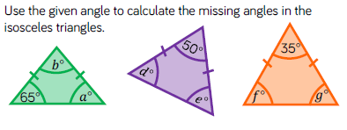
Fluency

Slide 43
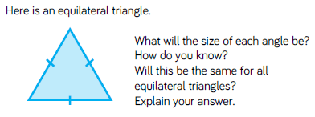
Fluency

Slide 44
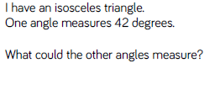
Reasoning and problem solving

Slide 45
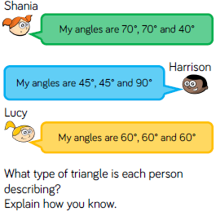
Reasoning and problem solving

Slide 46
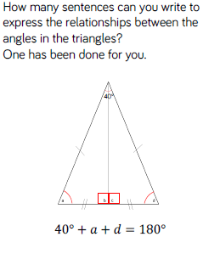
Reasoning and problem solving

