Slide 1
Year 6 Block 5 Perimeter, Area and Volume: Small steps 1-4
Shapes – same area
NCLO: Recognise that shapes with the same areas can have different perimeters and vice versa

Slide 2
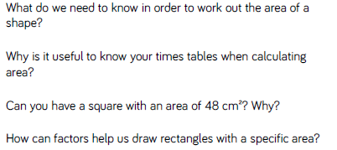
Key vocabulary and questions
Area, perimeter

Slide 3
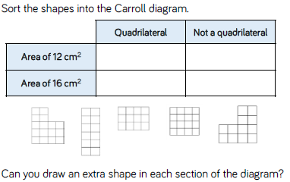
Fluency

Slide 4
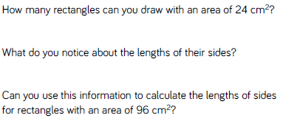
Fluency

Slide 5
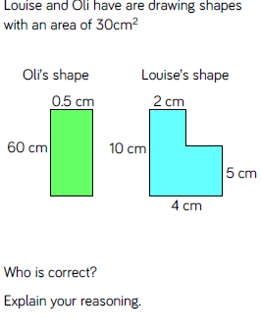
Reasoning and problem solving

Slide 6
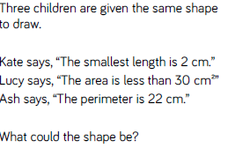
Reasoning and problem solving

Slide 7
Year 6 Block 5 Perimeter, Area and Volume: Small steps 1-4
Area and perimeter
NCLO: Recognise that shapes with the same areas can have different perimeters and vice versa

Slide 8
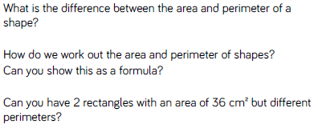
Key vocabulary and questions
Area, perimeter

Slide 9
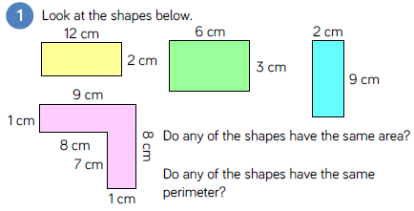
Fluency

Slide 10
Fluency

Slide 11
Fluency

Slide 12
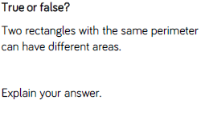
Reasoning and problem solving

Slide 13
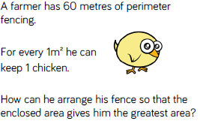
Reasoning and problem solving

Slide 14
Year 6 Block 5 Perimeter, Area and Volume: Small steps 1-4
Area of a triangle (1)
NCLO: Calculate the area of parallelograms and triangles

Slide 15
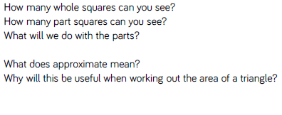
Key vocabulary and questions
triangle, base, height, formula

Slide 16
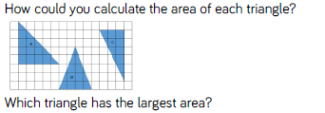
Fluency

Slide 17
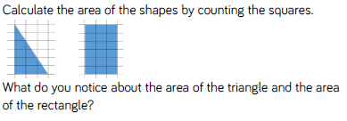
Fluency

Slide 18
Fluency

Slide 19
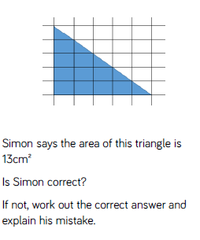
Reasoning and problem solving

Slide 20
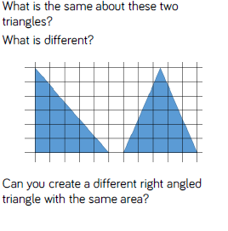
Reasoning and problem solving

Slide 21
Year 6 Block 5 Perimeter, Area and Volume: Small steps 1-4
Area of a triangle (2)
NCLO: Calculate the area of parallelograms and triangles

Slide 22
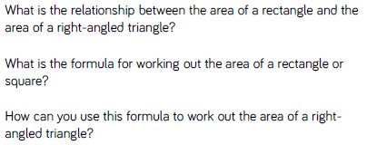
Key vocabulary and questions
triangle, base, height, formula

Slide 23
Fluency

Slide 24
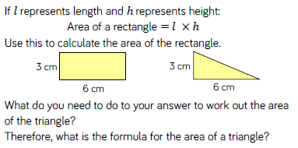
Fluency

Slide 25
Fluency

Slide 26
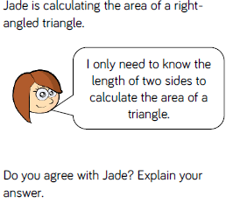
Reasoning and problem solving

Slide 27
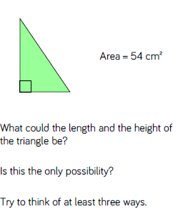
Reasoning and problem solving

