Slide 1
Year 4 Autumn Block 3: Measurement, Length & Perimeter
Kilometres
NCLO: Convert between different units of measure (for example, kilometre to metre)

Slide 2
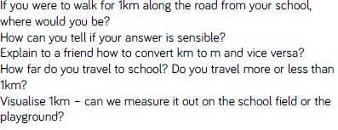
Key vocabulary and questions
km, m

Slide 3
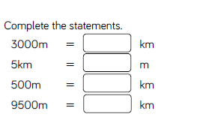
Fluency

Slide 4
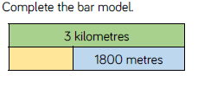
Fluency

Slide 5
Fluency

Slide 6
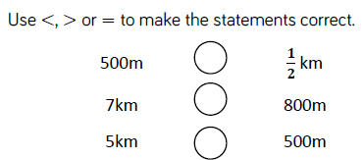
Fluency

Slide 7
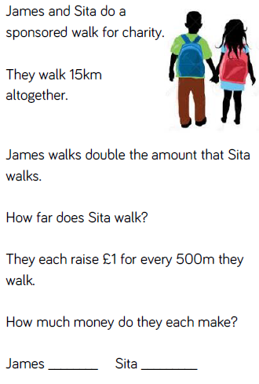
Reasoning and Problem Solving

Slide 8
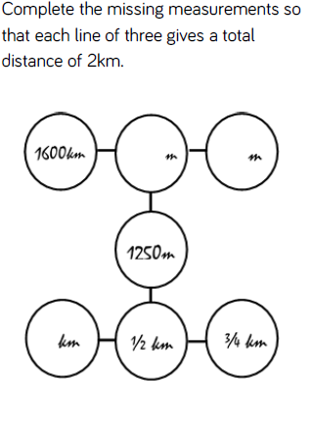
Reasoning and Problem Solving

Slide 9
Year 4 Autumn Block 3: Measurement, Length & Perimeter
Perimeter on a grid
NCLO: Measure and calculate the perimeter of a rectilinear figure (including squares) in centimetres and metres.

Slide 10
Key vocabulary and questions
Centimetres metres
Perimeter calculate
Measure

Slide 11
Fluency

Slide 12
Fluency

Slide 13
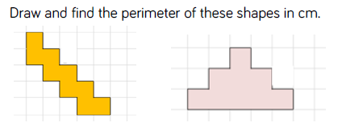
Fluency

Slide 14
Reasoning and problem solving

Slide 15
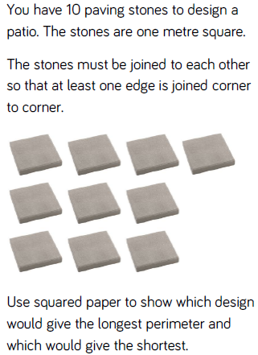
Reasoning and problem solving

Slide 16
Year 4 Autumn Block 3: Measurement, Length & Perimeter
Perimeter of a rectangle
NCLO: Measure and calculate the perimeter of a rectilinear figure (including squares) in centimetres and metres.

Slide 17
Key vocabulary and questions
Perimeter, Calculate, Value

Slide 18
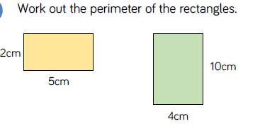
Fluency

Slide 19
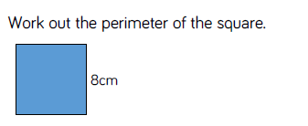
Fluency

Slide 20
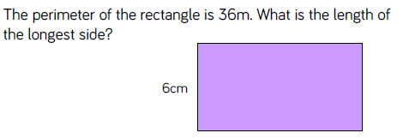
Fluency

Slide 21
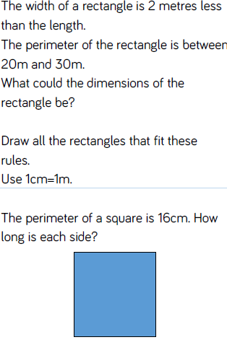
Reasoning and problem solving

Slide 22
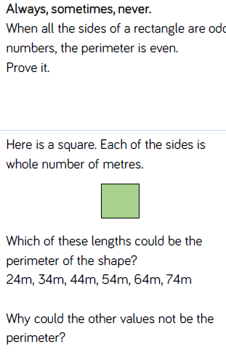
Reasoning and problem solving

Slide 23
Year 4 Autumn Block 3: Measurement, Length & Perimeter
Perimeter of rectilinear shapes
NCLO: Measure and calculate the perimeter of a rectilinear figure (including squares) in centimetres and metres.

Slide 24
Key vocabulary and questions
Perimeter, Calculate, Value

Slide 25
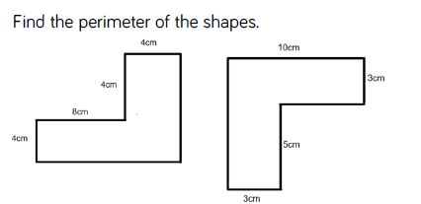
Fluency

Slide 26
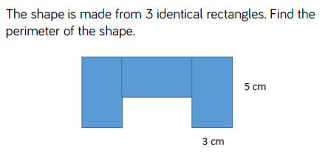
Fluency

Slide 27
Fluency

Slide 28
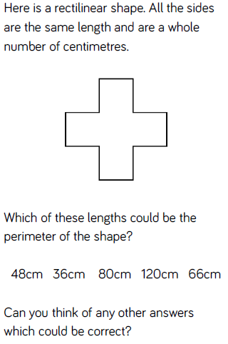
Reasoning and problem solving

Slide 29
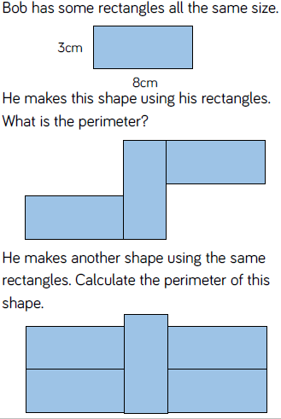
Reasoning and problem solving

