Slide 1
Year 2 Autumn Maths
Number: Place Value
Count objects to 100 and read and write numbers in numerals and words
NCLO: Read and write numbers to at
least 100 in numerals and in
words.

Slide 2
Key vocabulary and questions
digits
numerals less teen numbers
words more
Images largest tens numbers
How can you count the cars? Do you have a strategy?
What is one more/one less?
Which is the largest number?
Which number is tricky to write in words?
Which numbers sound similar?
How are 17 and 70 different? Can you show me?

Slide 3
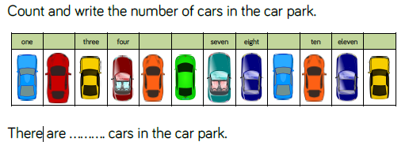
Fluency

Slide 4
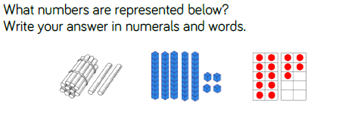
Fluency

Slide 5
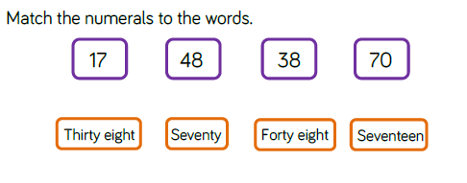
Fluency

Slide 6
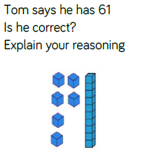
Reasoning and problem solving
Notes:
Children sorted into boys and girls.
Children sorted into wearing white, wearing red.
Children sorted into white shoes, non-white shoes.

Slide 7
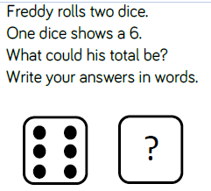

Reasoning and problem solving
Challenge:
How many dots on one die?
How did you count the dots?
How many dots on a nine sided die?

Slide 8
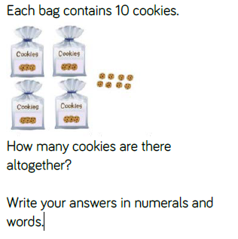
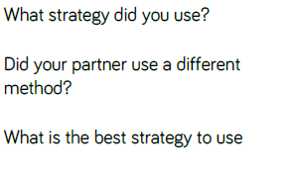
Reasoning and problem solving

Slide 9
Year 2 Autumn Maths
Number: Place Value
Represent numbers to 100
NCLO: Read and write numbers to at
least 100 in numerals and in
words.

Slide 10
Key vocabulary and questions
ones
tens
digit
numeral
How have the beads been grouped? How does this help you
count?
Which part of the resource represents tens/ones?
Which resource do you prefer to use for larger numbers? Which
is quickest? Which would take a long time?

Slide 11
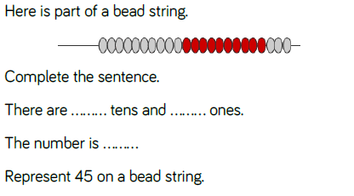
Fluency

Slide 12
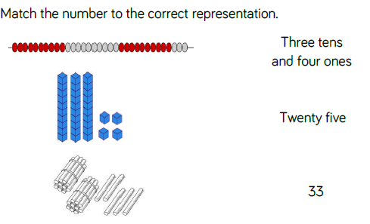
Fluency

Slide 13

Fluency

Slide 14
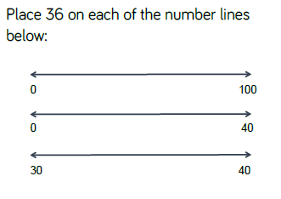
Reasoning and problem solving

Slide 15
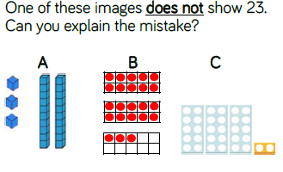
Reasoning and problem solving

Slide 16
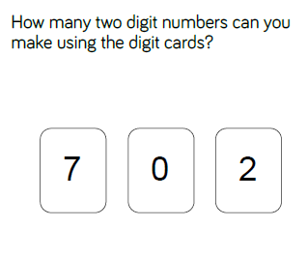
Reasoning and problem solving
Challenge: What is the largest number?
Prove it by using concrete resources.
What is the smallest number?
Prove it by using concrete resources.
Why can’t the 0 be used as a tens number?

Slide 17
Year 2 Autumn Maths
Number: Place Value
Tens and ones with a part whole model
NCLO: Recognise the place value of
each digit in a two digit number
(tens, ones)

Slide 18
Key vocabulary and questions
tens digit part whole model
ones digit tens frame partition
Which part do we know? How can we use the whole and part to work out the missing part?
Can you use concrete materials/draw something to help you
partition?
How can you rearrange the counters to help you count the
lemon and strawberry cupcakes?

Slide 19
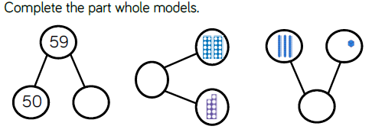
Fluency

Slide 20
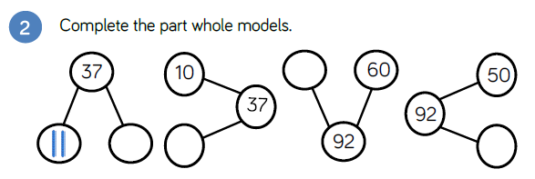
Fluency

Slide 21
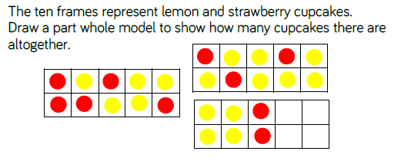
Fluency

Slide 22
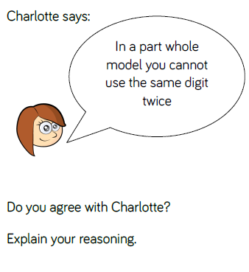
Reasoning and problem solving

Slide 23
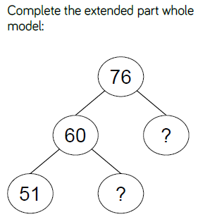
Reasoning and problem solving

Slide 24
Year 2 Autumn Maths
Number: Place Value
Tens and ones with a part whole model
NCLO: Recognise the place value of
each digit in a two digit number
(tens, ones)

Slide 25
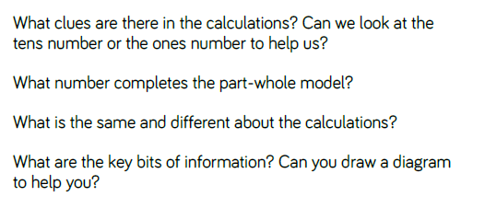
Key vocabulary and questions
tens digit part whole model total
ones digit partition

Slide 26
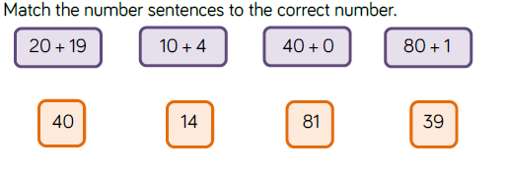
Fluency

Slide 27
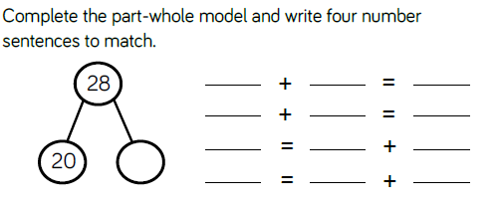
Fluency

Slide 28
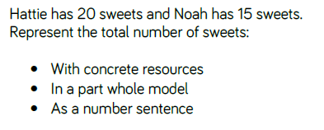
Fluency

Slide 29
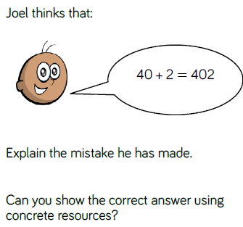
Reasoning and problem solving

Slide 30
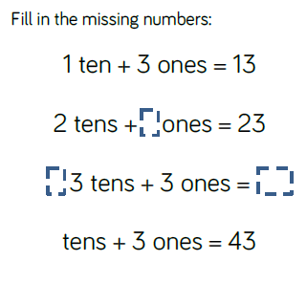
Reasoning and problem solving
Challenge: What would the next number in the
pattern be?

Slide 31
Year 2 Autumn Maths
Number: Place Value
Use a place value chart
NCLO: Recognise the place value of
each digit in a two digit number
(tens, ones)

Slide 32
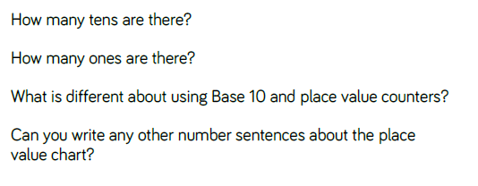
Key vocabulary and questions
tens digit place value
ones digit place value chart

Slide 33
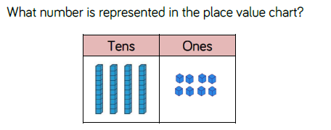
Fluency

Slide 34
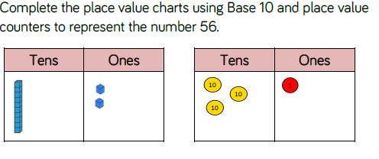
Fluency

Slide 35
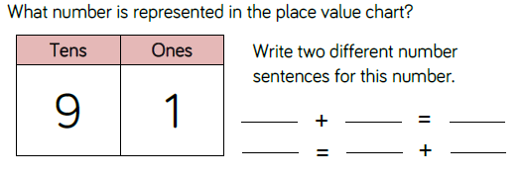
Fluency

Slide 36
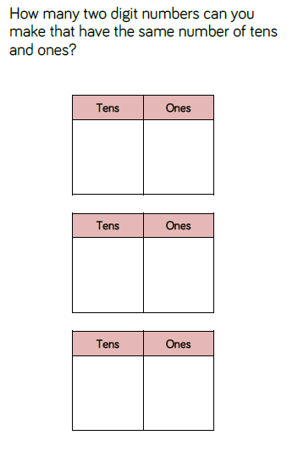
Reasoning and problem solving

Slide 37
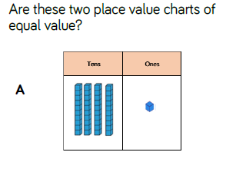
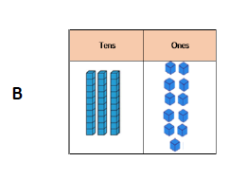

Reasoning and problem solving

Slide 38
Year 2 Autumn Maths
Number: Place Value
Comparing objects
NCLO: Compare and order numbers
from 0 up to 100; use <, > and =
signs.

Slide 39
Key vocabulary and questions
more than
less then < >
equal to
How can you arrange the objects to make them easy to compare?
Do groups of ten help you count? Why?

Slide 40
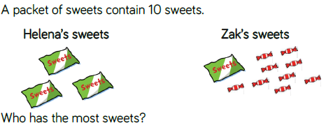
Fluency

Slide 41
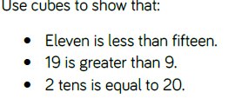
Fluency

Slide 42
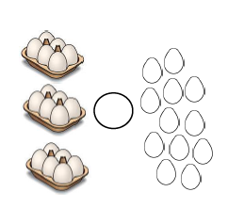
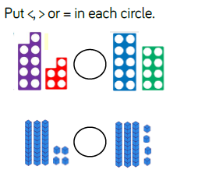
Fluency

Slide 43
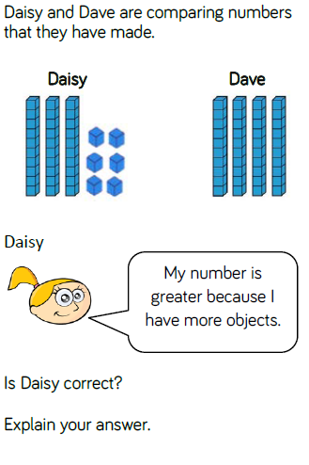
Reasoning and problem solving

Slide 44
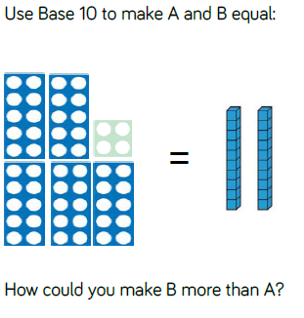
Reasoning and problem solving

Slide 45
Year 2 Autumn Maths
Number: Place Value
Comparing numbers
NCLO: Compare and order numbers
from 0 up to 100; use <, > and =
signs.

Slide 46
Key vocabulary and questions
greater than, less than, more than, fewer, most, least , equal to.
Use the symbols <, > and = to write number
sentences.
Can you prove your answers using concrete resources?
Can you prove your answers by drawing a diagram?
Is there more than one answer?
Do you need to work the number sentences out to decide which is greater?

Slide 47
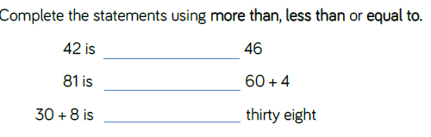
Fluency

Slide 48
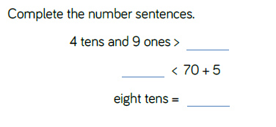
Fluency

Slide 49
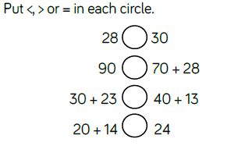
Fluency

Slide 50
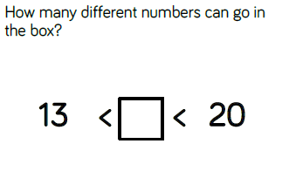
Reasoning and problem solving

Slide 51
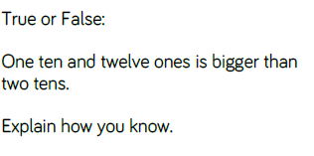
Reasoning and problem solving

Slide 52

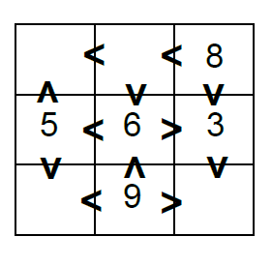
Reasoning and problem solving

Slide 53
Year 2 Autumn Maths
Number: Place Value
Order objects and numbers
NCLO: Compare and order numbers
from 0 up to 100; use <, > and =
signs.

Slide 54
Key vocabulary and questions
smallest greatest
use the symbols < and > to order numbers
number line
How does the number line help you order the numbers?
How does Base 10 prove that your order is correct?

Slide 55
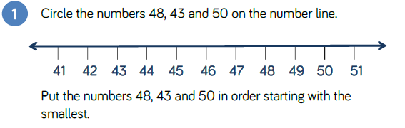
Fluency

Slide 56

Fluency

Slide 57
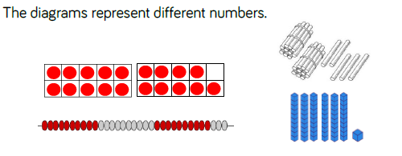
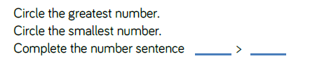
Fluency

Slide 58
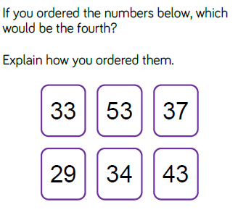
Reasoning and problem solving

Slide 59
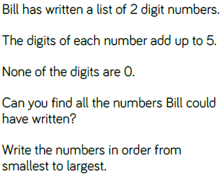
Reasoning and problem solving

Slide 60
Reasoning and problem solving

Slide 61
Year 2 Autumn Maths
Number: Place Value
Count in 2s, 5s and 10s
NCLO: Count in steps of 2, and 5
from 0, and in tens from any
number, forward and backward.

Slide 62
Key vocabulary and questions
twos multiple
fives zero
tens patterns
What do you notice? Are the numbers getting larger or smaller?
Are the numbers getting bigger or smaller each time? By how
much?
Can you spot a pattern?
Why is it the odd one out? Can you correct the mistake?

Slide 63
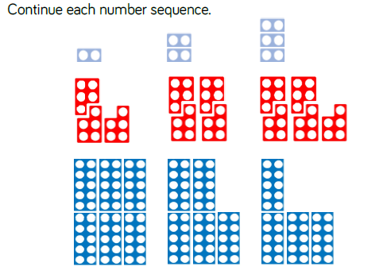
Fluency

Slide 64
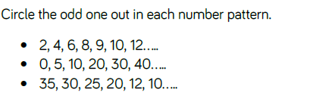
Fluency

Slide 65

Fluency

Slide 66
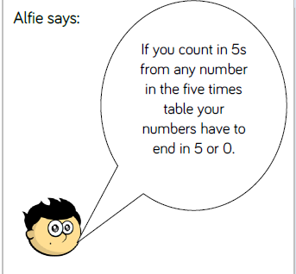

Reasoning and problem solving

Slide 67



Reasoning and problem solving

Slide 68
Year 2 Autumn Maths
Number: Place Value
Count in 3s
NCLO: Count in steps of 3, from any
number, forward and backward.

Slide 69
Key vocabulary and questions
threes multiple
patterns backwards forwards
What do you notice?
Are the numbers getting larger or smaller?
Can you spot a pattern?

Slide 70

Fluency

Slide 71

Fluency

Slide 72

Fluency

Slide 73

Reasoning and problem solving

Slide 74


Reasoning and problem solving

