Slide 1
Year 2 Autumn Block 2 Addition and Subtraction
Fact families
NCLO: To know addition and subtraction bonds to 20

Slide 2
Key vocabulary and questions
addition + bar model
subtraction – part whole model
equals =

Slide 3
Fluency

Slide 4
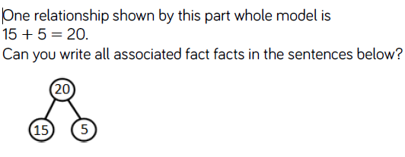
Fluency

Slide 5
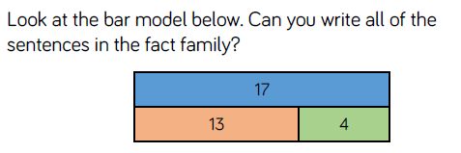
Fluency

Slide 6
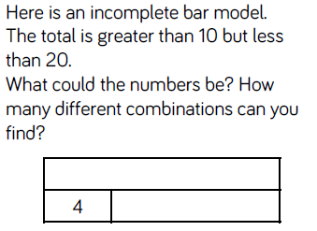
Reasoning and problem solving
Notes:
Children sorted into boys and girls.
Children sorted into wearing white, wearing red.
Children sorted into white shoes, non-white shoes.

Slide 7
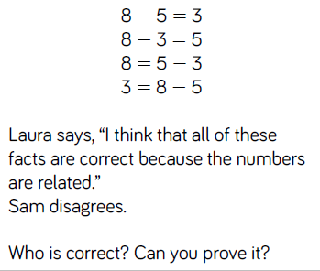
Reasoning and problem solving

Slide 8
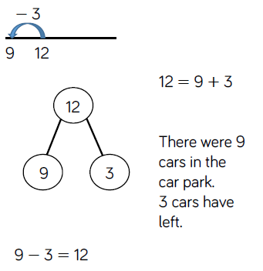
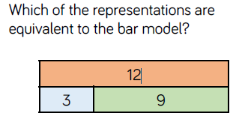
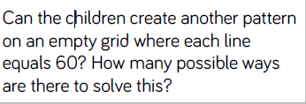
Reasoning and problem solving

Slide 9
Year 2 Autumn Block 2 Addition and Subtraction
Check calculations, to know addition and subtraction bonds to 20
NCLO: Recognise and use the inverse relationship between addition and subtraction and use this to check calculations and solve missing number problems.

Slide 10
Key vocabulary and questions
calculations
inverse
estimate
addition subtraction
What resources could you use to check your calculation?
Can you check it in more than one way?
Why do we need to check our calculation?

Slide 11
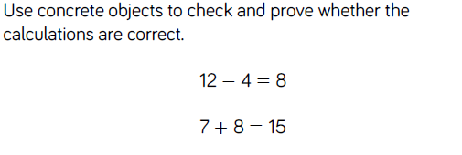
Fluency

Slide 12
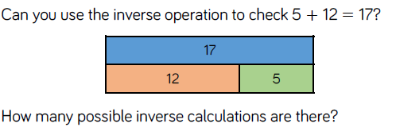
Fluency

Slide 13
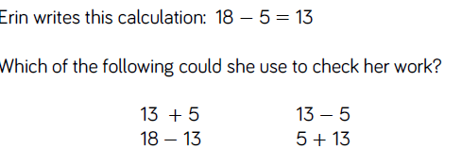
Fluency

Slide 14
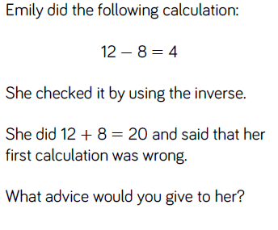
Reasoning and problem solving

Slide 15
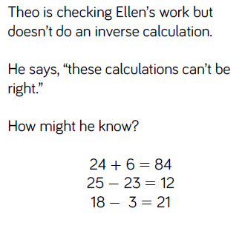
Reasoning and problem solving

Slide 16
Year 2 Autumn Block 2 Addition and Subtraction
Compare number sentences
NCLO: To show that addition can be done in any order and subtraction can not.

Slide 17
Key vocabulary and questions
number sentences missing values
Compare calculations greater than,
less than equals signs
What other numbers make the same total?
Do we need to calculate to find the answer?
Do you notice a pattern? What would come next?

Slide 18
Fluency

Slide 19
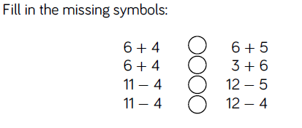
Fluency

Slide 20
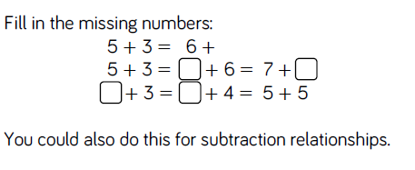
Fluency

Slide 21
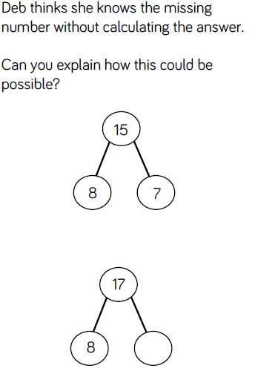
Reasoning and problem solving

Slide 22
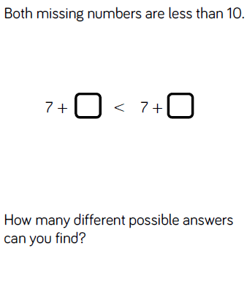
Reasoning and problem solving

Slide 23
Year 2 Autumn Block 2 Addition and Subtraction
Related facts
NCLO: Recognise and use the inverse relationship between addition and subtraction and use this to check calculations.

Slide 24
Key vocabulary and questions
tens subtraction
ones
digits
addition
What is the same?
What is different?

Slide 25
Fluency

Slide 26
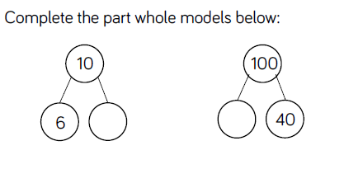
Fluency

Slide 27
Fluency

Slide 28
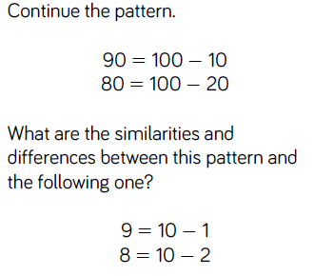
Reasoning and problem solving

Slide 29
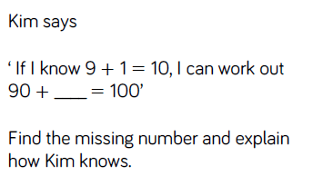
Reasoning and problem solving

Slide 30
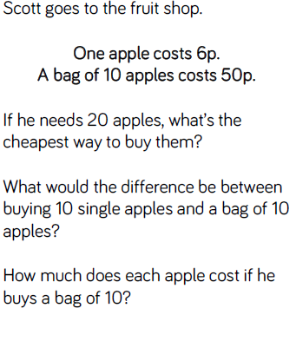
Reasoning and problem solving

Slide 31
Year 2 Autumn Block 2 Addition and Subtraction
Bonds to 100 (tens)
NCLO: Recall and use addition and subtraction facts to 100.

Slide 32
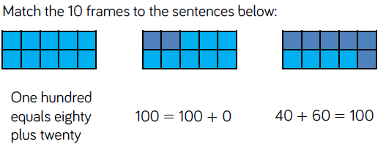
Fluency

Slide 33
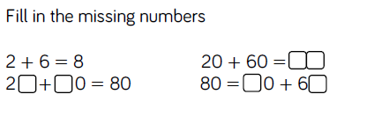
Fluency

Slide 34
Fluency

Slide 35
Reasoning and problem solving

Slide 36
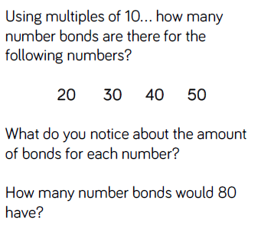
Reasoning and problem solving

Slide 37
Year 2 Autumn Block 2 Addition and Subtraction
Add and subtract 1s
NCLO: To add and subtract 1s to/from a 2 –digit number using concrete objects, pictorial representations, and mental arithmetic strategies.

Slide 38
Key vocabulary and questions
one more
more than
one less
less than

Slide 39
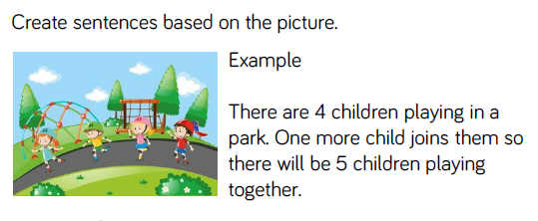
Fluency

Slide 40
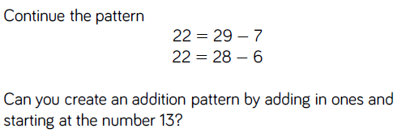
Fluency

Slide 41
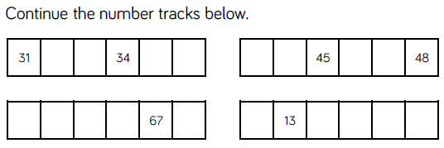
Fluency

Slide 42
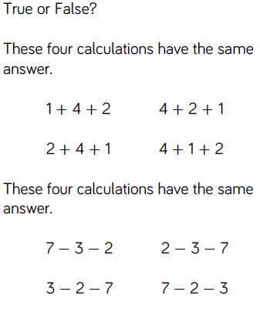
Reasoning and problem solving

Slide 43
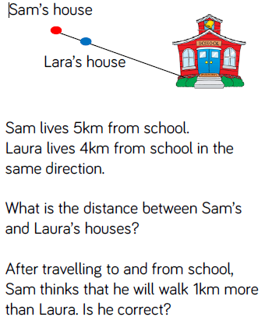
Reasoning and problem solving
Challenge: What will be the difference in distance walked to school after 2 days?

Slide 44
Year 2 Autumn Block 2 Addition and Subtraction
10 more and 10 less
NCLO: To find 10 more and 10 less than a 2-digit number

Slide 45
Key vocabulary and questions
tens digit
ones digit

Slide 46
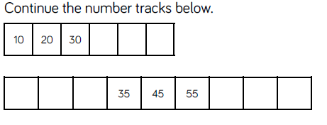
Fluency

Slide 47
Fluency

Slide 48
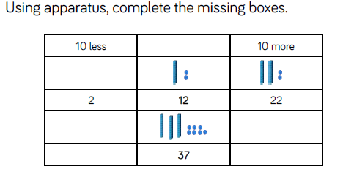
Fluency

Slide 49
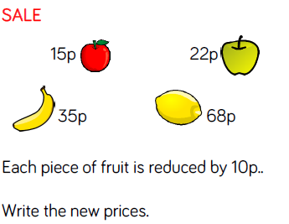
Reasoning and problem solving

Slide 50
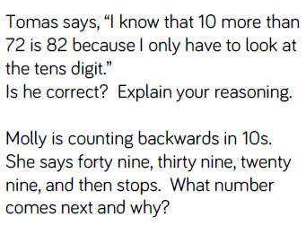
Reasoning and problem solving

Slide 51
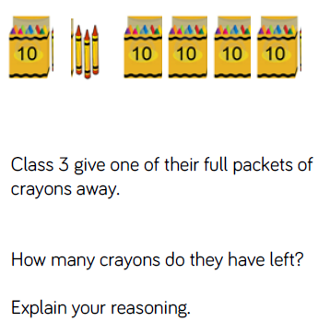
Reasoning and problem solving
Challenge: Can you record your findings in a part, part, whole model?
Can you record your findings in a bar model?

Slide 52
Year 2 Autumn Block 2 Addition and Subtraction
Add and subtract 10s
NCLO: To add and subtract 10s to/from a 2-digit number

Slide 53
Key vocabulary and questions
ones digit
tens digit
column

Slide 54
Fluency

Slide 55
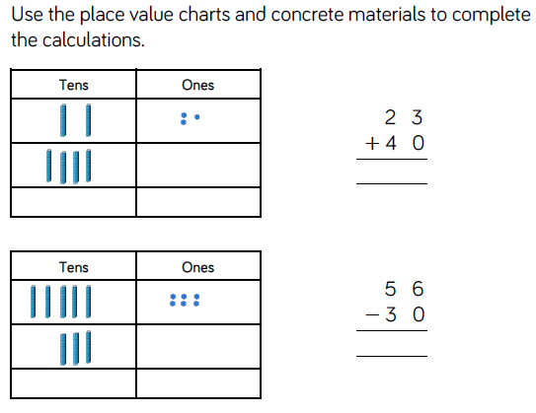
Fluency

Slide 56
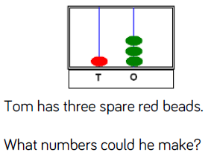
Reasoning and problem solving

Slide 57
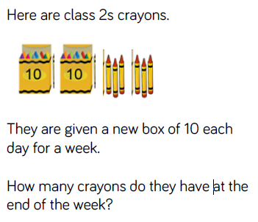
Reasoning and problem solving
Challenge: Can you record your findings in a bar model?
Can you record your findings as a number sentence?

Slide 58
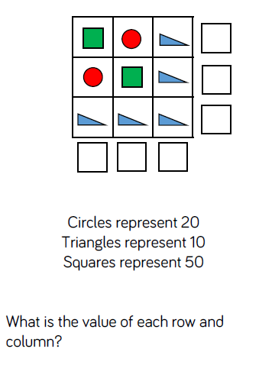
Reasoning and problem solving
Challenge: Change the values of the shapes to other multiples of 10s.
What is the new value of each row and column?

Slide 59
Year 2 Autumn Block 2 Addition and Subtraction
Bonds to 100
NCLO: To derive and use related addition and subtraction facts up to 100.

Slide 60
Key vocabulary and questions
digits
multiples
single digit bonds
tens bonds
What does this represent?
Why is it different to a normal ten frame?

Slide 61
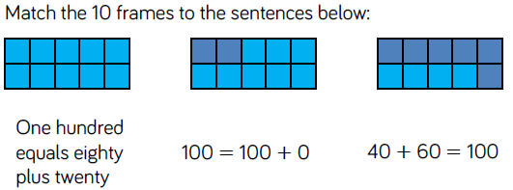
Fluency

Slide 62
Fluency

Slide 63
Fluency

Slide 64
Reasoning and problem solving
Notes:
Children sorted into boys and girls.
Children sorted into wearing white, wearing red.
Children sorted into white shoes, non-white shoes.

Slide 65
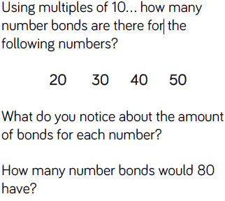
Reasoning and problem solving

Slide 66
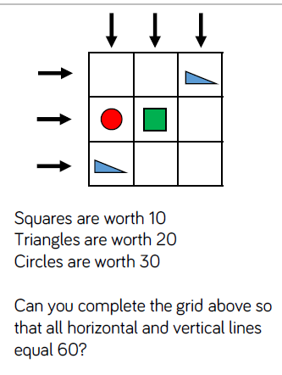
Reasoning and problem solving
Challenge: Can the children create another pattern on an empty grid where each line equals 60? How many possible ways are there to do this?

Slide 67
Year 2 Autumn Block 2 Addition and Subtraction
Add and subtract 1s
NCLO: To add and subtract 1s to/from a 2 –digit number using concrete objects, pictorial representations, and mental arithmetic strategies.

Slide 68
Key vocabulary and questions
one more
more than
one less
less than

Slide 69
Fluency

Slide 70
Fluency

Slide 71
Fluency

Slide 72
Reasoning and problem solving

Slide 73
Reasoning and problem solving
Challenge: What will be the difference in distance walked to school after 2 days?

Slide 74
Year 2 Autumn Block 2 Addition and Subtraction
10 more and 10 less
NCLO: To find 10 more and 10 less than a 2-digit number .

Slide 75
Key vocabulary and questions
tens digit
ones digit

Slide 76
Fluency

Slide 77
Fluency

Slide 78
Fluency

Slide 79
Reasoning and problem solving

Slide 80
Reasoning and problem solving

Slide 81
Reasoning and problem solving
Challenge: Can you record your findings in a part, part, whole model?
Can you record your findings in a bar model?

Slide 82
Year 2 Autumn Block 2 Addition and Subtraction
Add and subtract 10s
NCLO: To add and subtract 10s to/from a 2-digit number . Show that the addition of two numbers can be done in any order (commutative) and subtraction of one number from another cannot.

Slide 83
Key vocabulary and questions
ones digit
tens digit
column

Slide 84
Fluency

Slide 85
Fluency

Slide 86
Reasoning and problem solving

Slide 87
Reasoning and problem solving
Challenge: Can you record your findings in a bar model?
Can you record your findings as a number sentence?

Slide 88
Reasoning and problem solving
Challenge: Change the values of the shapes to other multiples of 10s.
What is the new value of each row and column?

Slide 89
Year 2 Autumn Block 2 Addition and Subtraction
Add a 2–digit and 1-digit number crossing 10
NCLO: Add and subtract numbers using concrete objects, pictorial representations, and mentally, including: a two-digit number and ones.

Slide 90
Key vocabulary and questions
partition two digit numbers
one digit number number line
tens smallest largest
Using Base 10, can you partition your numbers?
Can we exchange 10 ones for one ten?
How many ones do we have? How many tens do we have?
Can you draw the base 10 and show the addition pictorially?

Slide 91
Fluency

Slide 92
Fluency

Slide 93
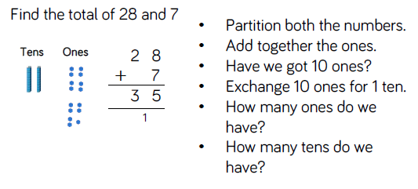
Fluency

Slide 94
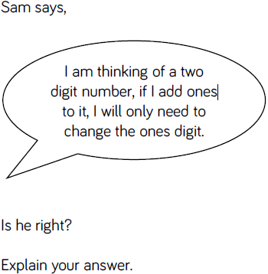
Reasoning and problem solving
Notes:
Children sorted into boys and girls.
Children sorted into wearing white, wearing red.
Children sorted into white shoes, non-white shoes.

Slide 95
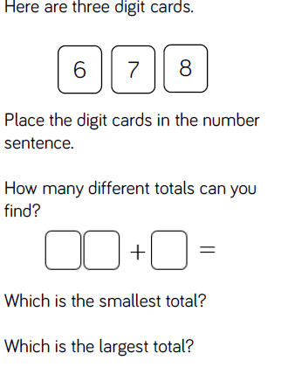
Reasoning and problem solving

Slide 96
Year 2 Autumn Block 2 Addition and Subtraction
Subtract a 1-digit number from a 2– digit number – crossing ten
NCLO: Subtract numbers using concrete
objects, pictorial representations, and
mentally, including: a two-digit number and ones.

Slide 97
Key vocabulary and questions
crossing the 10 place value subtract
partition 2-digit numbers columns
number line number bonds
Are we counting backwards or forwards on the number line?
Have we got enough ones to subtract?
Can we exchange a ten for ten ones?
How can we show the takeaway? Can we cross out the cubes?

Slide 98
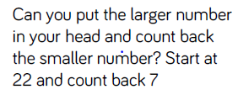
Fluency

Slide 99
Fluency

Slide 100
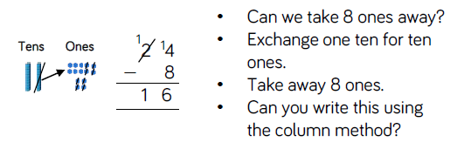
Fluency

Slide 101
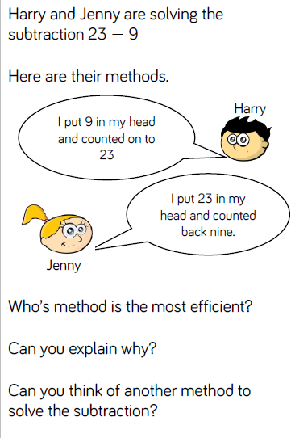
Reasoning and problem solving

Slide 102
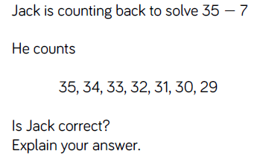
Reasoning and problem solving

Slide 103
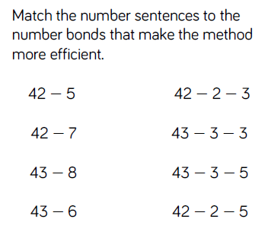
Reasoning and problem solving

Slide 104
Year 2 Autumn Block 2 Addition and Subtraction
Add two 2 –digit numbers – not crossing ten – add ones and add tens
NCLO: Recall and use addition facts to 20 fluently, and derive and use
related facts up to 100. Show that the addition of two numbers can be done in any order (commutative).

Slide 105
Key vocabulary and questions
ones partition
tens Base ten equipment
column method
Can you partition the number into tens and ones?
Can you count the ones? Can you count the tens?
Can you show your addition by drawing the base 10 to help?
Can you represent the problem?

Slide 106
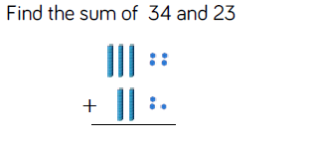
Fluency

Slide 107
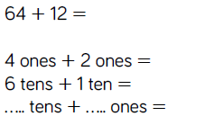
Fluency

Slide 108
Fluency

Slide 109
Reasoning and problem solving

Slide 110
Reasoning and problem solving

Slide 111
Year 2 Autumn Block 2 Addition and Subtraction
Add two 2 –digit numbers –crossing ten – add ones and add tens
NCLO: Recall and use addition facts to 20 fluently, and derive and use
related facts up to 100. Show that the addition of two numbers can be done in any order (commutative).

Slide 112
Key vocabulary and questions
ones partition
tens Base ten equipment
column method exchange

Slide 113
Fluency

Slide 114
Fluency

Slide 115
Fluency

Slide 116
Reasoning and problem solving

Slide 117
Reasoning and problem solving

Slide 118
Year 2 Autumn Block 2 Addition and Subtraction
Subtract a 2-digit number from a 2-digit number
NCLO: Recognise and use the inverse relationship between addition and subtraction and use this to check calculations and solve missing number problems.

Slide 119
Key vocabulary and questions
subtraction minus tens boundary
tens ones
Do we need to make both numbers in the subtraction before we take away?
Which number do we need to make? The larger number or the smaller?
What are the numbers worth? Tens or Ones?
What happens if we have nothing left in a column? Which number do we write?

Slide 120
Fluency

Slide 121
Fluency

Slide 122
Fluency

Slide 123
Reasoning and problem solving

Slide 124
Reasoning and problem solving

Slide 125
Year 2 Autumn Block 2 Addition and Subtraction
Subtract a 2-digit number from a 2-digit number – crossing ten – subtract ones and tens
NCLO: Recognise and use the inverse relationship between addition and subtraction and use this to check calculations and solve missing number problems.

Slide 126
Key vocabulary and questions
one ten is the same as ten ones
exchange crossing a ten
Subtraction take away difference column method
Have we got enough ones to take away?
Can we exchange one ten for ten ones?
How many have we got left?
What is the difference between the numbers?
Do we always need to subtract the ones first? Why do we always subtract the ones first?
Which method is the most efficient? Subtraction or counting on to find the difference?

Slide 127
Fluency

Slide 128
Fluency

Slide 129
Fluency

Slide 130
Reasoning and problem solving

Slide 131
Reasoning and problem solving

Slide 132
Reasoning and problem solving

Slide 133
Year 2 Autumn Block 2 Addition and Subtraction
Bonds to 100 (tens and ones)
NCLO: Recall and use addition and subtraction facts to 20 fluently, and derive and use related facts up to 100.

Slide 134
Key vocabulary and questions
number bonds to 10 and 20
number bonds to 100
tens and ones
exchange
How many more do we need to make 100?
How many tens are in 100?
If I have 35, do I need 7 tens and 5 ones to make 100? Explain why.
Can you make the number using Base 10? Can you add more Base 10 to the number to make 100?

Slide 135
Fluency

Slide 136
Fluency

Slide 137
Fluency

Slide 138
Reasoning and problem solving

Slide 139
Reasoning and problem solving

Slide 140
Reasoning and problem solving

Slide 141
Year 2 Autumn Block 2 Addition and Subtraction
Add three 1-digit numbers
NCLO: Add numbers using concrete objects, pictorial representations, and mentally add three one-digit numbers.
Show that the addition of two numbers can be done in any order (commutative).

Slide 142
Key vocabulary and questions
Commutative three one digit numbers tens frame
number bonds to 10
How many more do we need to make 100?
How many tens are in 100?
If I have 35, do I need 7 tens and 5 ones to make 100? Explain why.
Can you make the number using Base 10?
Can you add more Base 10 to the number to make 100?

Slide 143
Fluency

Slide 144
Fluency

Slide 145
Fluency

Slide 146
Reasoning and problem solving

Slide 147
Reasoning and problem solving

Slide 148
Reasoning and problem solving

