Slide 1
Year 2 Spring Block 4 Fractions
Make equal parts
NCLO:
To recognise, find, name and write fractions ½, 1/3, ¼, 2/4, and ¾ of length, shape, set of objects or quantity.

Slide 2
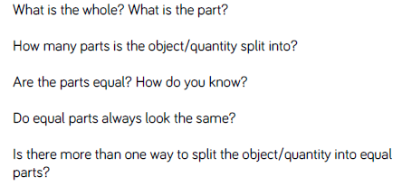
Key vocabulary and questions
Whole, part, fraction, equal, split, quantity

Slide 3
Fluency

Slide 4
Fluency

Slide 5
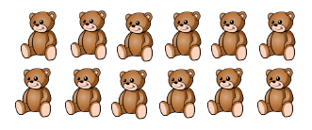
Fluency

Slide 6
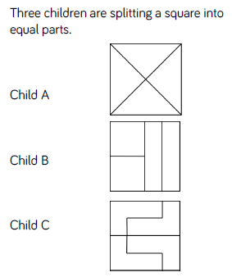
Reasoning and problem solving

Slide 7
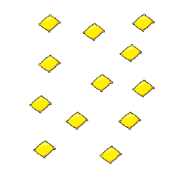
Reasoning and problem solving

Slide 8
Year 2 Spring Block 4 Fractions
Recognise a half
NCLO:
To recognise, find, name and write fractions ½ of length, shape, set of objects or quantity.

Slide 9
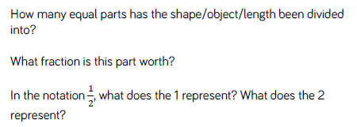
Key vocabulary and questions
Whole, part, fraction, equal, split, quantity, half

Slide 10
Fluency

Slide 11
Fluency

Slide 12
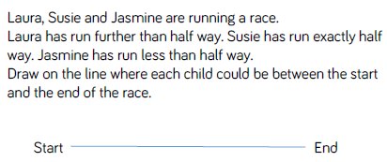
Fluency

Slide 13
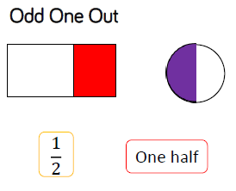
Reasoning and problem solving

Slide 14
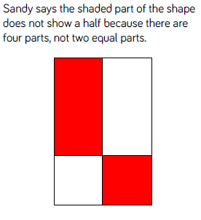
Reasoning and problem solving

Slide 15
Year 2 Spring Block 4 Fractions
NCLO: To Find a half
To recognise, find, name and write fractions ½ of length, shape, set of objects or quantity.

Slide 16
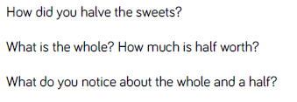
Key vocabulary and questions
Whole, part, fraction, equal, split, quantity, half

Slide 17
Fluency

Slide 18
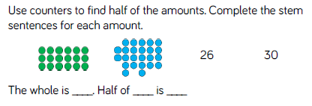
Fluency

Slide 19
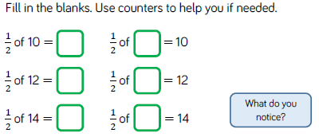
Fluency

Slide 20
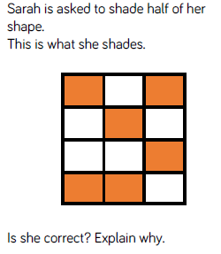
Reasoning and problem solving

Slide 21
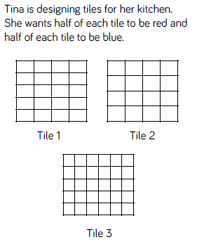
Reasoning and problem solving

Slide 22
Year 2 Spring Block 4 Fractions
NCLO: To recognise a quarter
To recognise, find, name and write fractions ¼ of length, shape, set of objects or quantity.

Slide 23
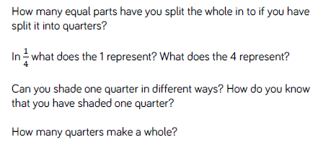
Key vocabulary and questions
Whole, part, fraction, equal, split, quantity, quarter

Slide 24
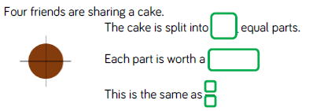
Fluency

Slide 25
Fluency

Slide 26
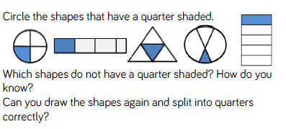
Fluency

Slide 27
Reasoning and problem solving

Slide 28
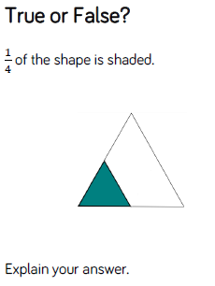
Reasoning and problem solving

Slide 29
Year 2 Spring Block 4 Fractions
NCLO: To find a quarter
To recognise, find, name and write fractions ¼ of length, shape, set of objects or quantity.

Slide 30
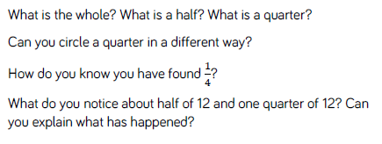
Key vocabulary and questions
Whole, part, fraction, equal, split, quantity, quarter, half

Slide 31
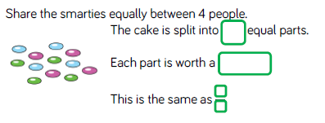
Fluency

Slide 32
Fluency

Slide 33
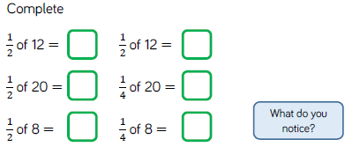
Fluency

Slide 34
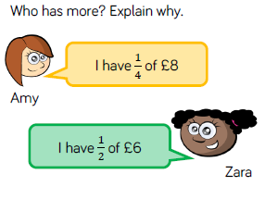
Reasoning and problem solving

Slide 35
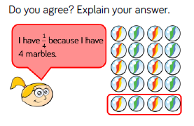
Reasoning and problem solving

Slide 36
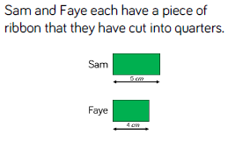
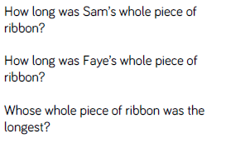
Reasoning and problem solving

Slide 37
Year 2 Spring Block 4 Fractions
NCLO: To recognise a third
To recognise, find, name and write fractions 1/3 of length, shape, set of objects or quantity.

Slide 38
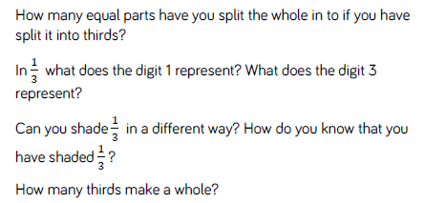
Key vocabulary and questions
Whole, part, fraction, equal, split, quantity, quarter, half, third

Slide 39
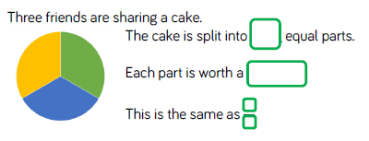
Fluency

Slide 40
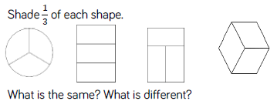
Fluency

Slide 41
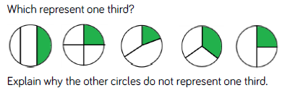
Fluency

Slide 42
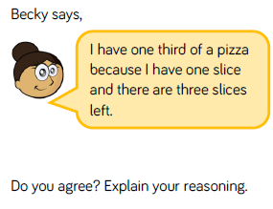
Reasoning and problem solving

Slide 43
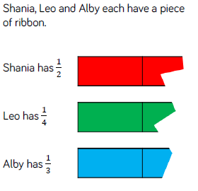
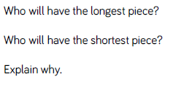
Reasoning and problem solving

Slide 44
Year 2 Spring Block 4 Fractions
Find A Third
NCLO:
To recognise, find, name and write fractions a third of a length, shape, set of objects or quantity.

Slide 45
Key vocabulary and questions

Slide 46
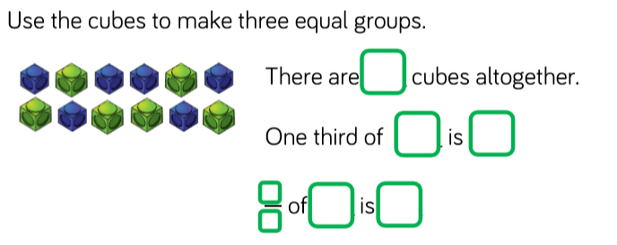
Fluency

Slide 47
Fluency

Slide 48
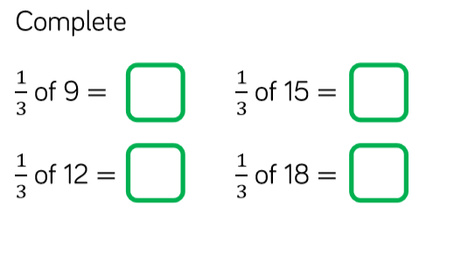
Fluency

Slide 49
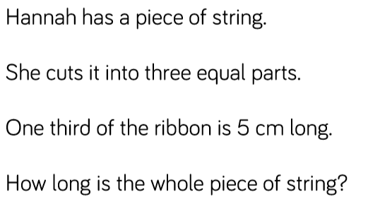
Reasoning and problem solving

Slide 50
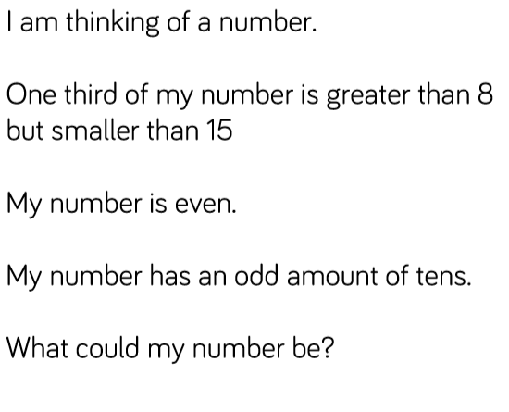
Reasoning and problem solving

Slide 51
Year 2 Spring Block 4 Fractions
Unit Fractions
NCLO:
To recognise, find, name and write fractions of a length, shape, set of objects or quantity.
Write simple fractions for and recognise the equivalence.

Slide 52
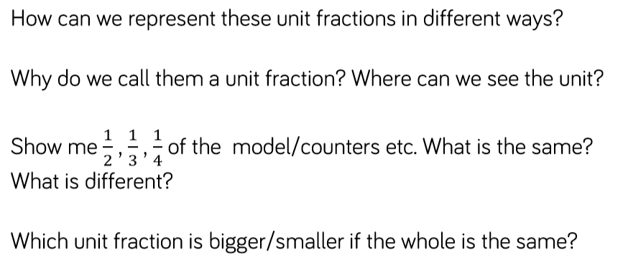
Key vocabulary and questions
Denominator, numerator, parts of

Slide 53
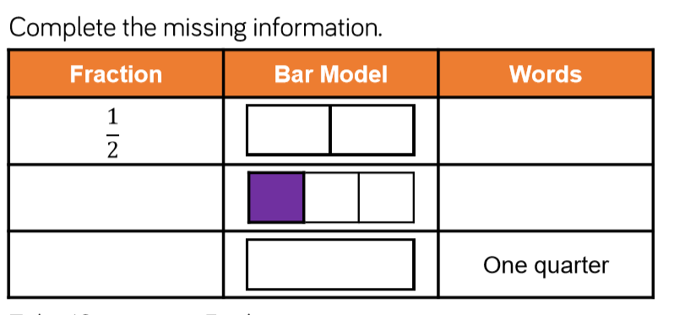
Fluency

Slide 54
Fluency

Slide 55
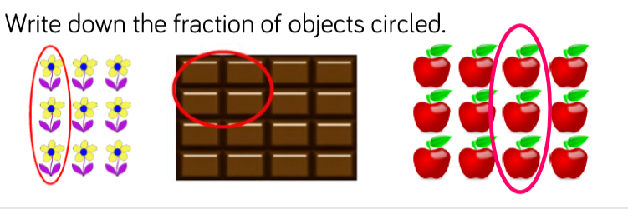
Fluency

Slide 56
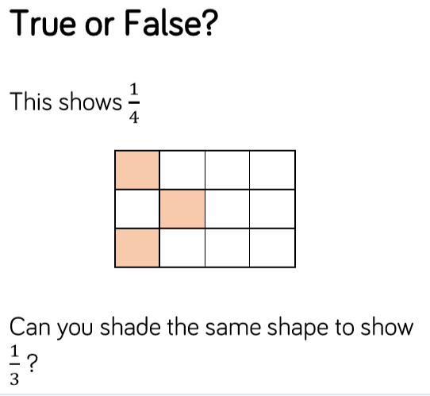
Reasoning and problem solving

Slide 57
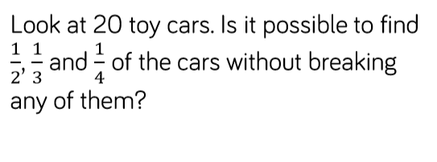
Reasoning and problem solving

Slide 58
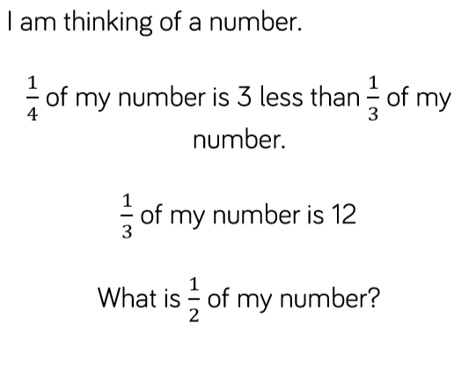
Reasoning and problem solving

Slide 59
Year 2 Spring Block 4 Fractions
Non Unit Fractions
NCLO:
To recognise, find, name and write fractions of a length, shape, set of objects or quantity.
Write simple fractions and recognise the equivalence of two quarters and half.

Slide 60
Key vocabulary and questions
Denominator, numerator, unit fraction, non unit fraction

Slide 61
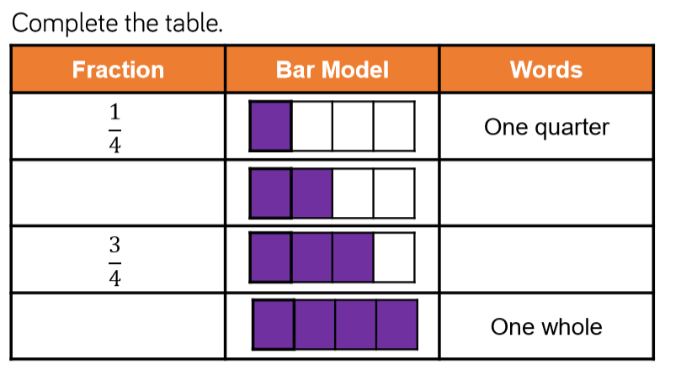
Fluency

Slide 62
Fluency

Slide 63
Fluency

Slide 64
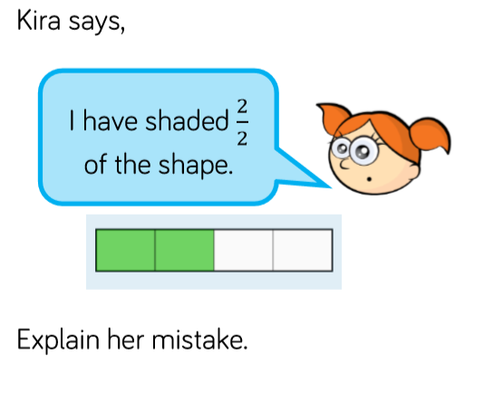
Reasoning and problem solving

Slide 65
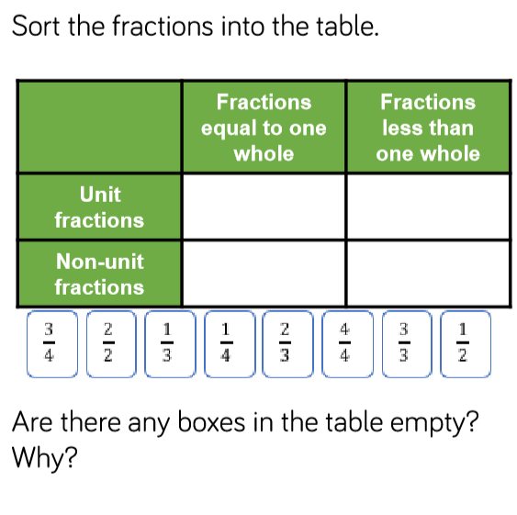
Reasoning and problem solving

Slide 66
Year 2 Spring Block 4 Fractions
Equivalence of two quarters and a half
NCLO:Recognise, find, name and write fractions of a length, shape, set of objects or quantity.
Write simple fractions and recognise the equivalence of two quarters and a half .

Slide 67
Key vocabulary and questions
Denominator, numerator, equivalence, unit, non unit

Slide 68
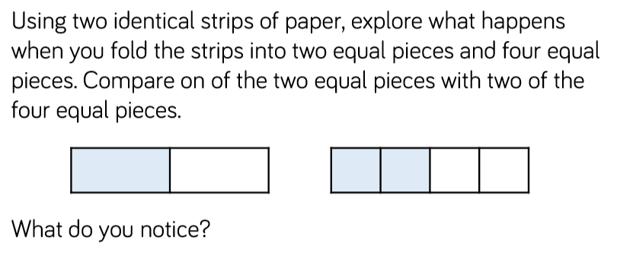
Fluency

Slide 69
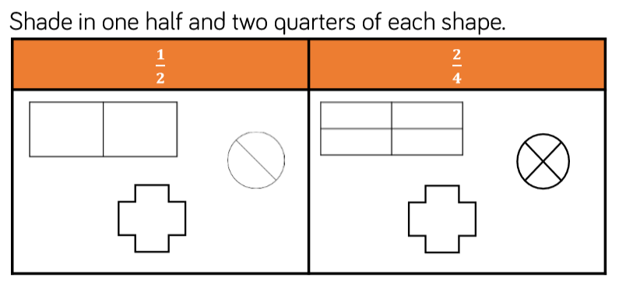
Fluency

Slide 70
Fluency

Slide 71
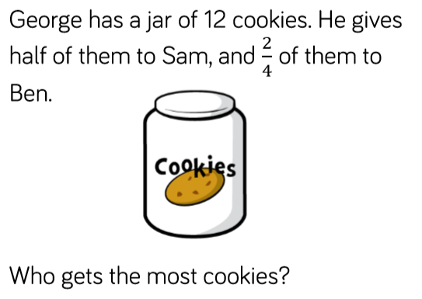
Reasoning and problem solving

Slide 72
Reasoning and problem solving

Slide 73
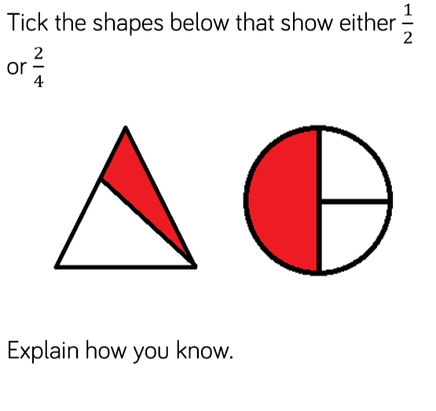
Reasoning and problem solving

Slide 74
Year 2 Spring Block 4 Fractions
Find Three Quarters
NCLO:
To recognise, find, name and write fractions of a length, shape, set of objects or quantity.
Write simple fractions and recognise the equivalence of two quarters and a half .

Slide 75
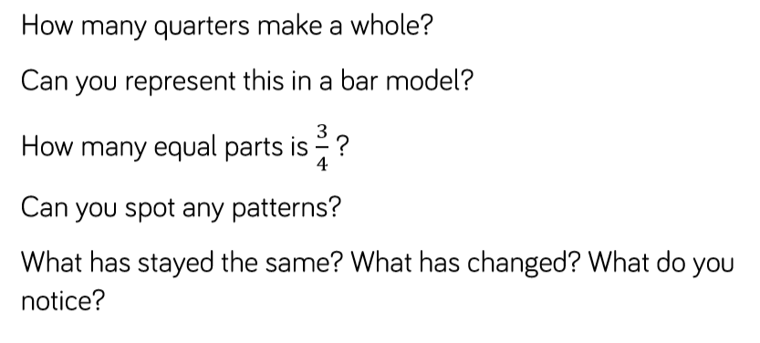
Key vocabulary and questions
Quarter, Half, Whole, Denominator, Numerator

Slide 76
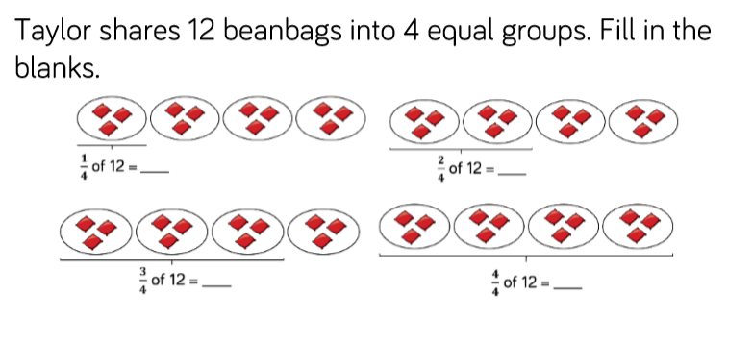
Fluency

Slide 77
Fluency

Slide 78
Fluency

Slide 79
Reasoning and problem solving

Slide 80
Reasoning and problem solving

Slide 81
Year 2 Spring Block 4 Fractions
Count In Fractions
NCLO:
To recognise, find, name and write fractions of a length, shape, set of objects or quantity.
Write simple fractions and recognise the equivalence of two quarters and a half .

Slide 82
Key vocabulary and questions
Quarter, Half, Whole, Denominator, Numerator

Slide 83
Fluency

Slide 84
Fluency

Slide 85
Fluency

Slide 86
Reasoning and problem solving

Slide 87
Reasoning and problem solving

