Slide 1
Year 4 Spring Week 1 Maths
11 and 12 Times Table
NCLO: Recall and use multiplication and
division facts for multiplication
tables up to 12 × 12.

Slide 2
Key vocabulary and questions
Multiple, division, product, lots of, calculation
Draw an image for the statement:
4 × 10 + 4 × 1 = ______ × ______
Can you write more of these statements for the 12 times tables?
Can you spot any patterns between the eleven and twelve times tables? Why do you think this happens?
Can you represent 88 ÷ 8 using a bar model? What’s the same and what’s different about this bar model and the one for 88 ÷ 11?

Slide 3
Fluency

Slide 4
Fluency

Slide 5
Reasoning and problem solving
Notes:
Children sorted into boys and girls.
Children sorted into wearing white, wearing red.
Children sorted into white shoes, non-white shoes.

Slide 6
Reasoning and problem solving

Slide 7
Year 4 Spring Term Week 1 Maths
Multiply 3 numbers
NCLO: Use place value, known and derived
facts to multiply and divide mentally,
including: multiplying by 0 and 1;
dividing by 1; multiplying together
three numbers.

Slide 8
Key vocabulary and questions
Associative Law, calculation

Slide 9
Fluency

Slide 10
Fluency

Slide 11
Reasoning and problem solving

Slide 12
Year 4 Spring Week 2 Maths
Factor Pairs
NCLO: To recognise and use factor pairs and commutativity in mental calculations.

Slide 13
Key vocabulary and questions
Factors, array, pairs.
Are there any other factor pairs for 12?
Can you prove this using arrays?
Do you notice a number that always appears when finding factor pairs?

Slide 14
Fluency

Slide 15
Fluency

Slide 16
Reasoning and problem solving

Slide 17
Reasoning and problem solving

Slide 18
Reasoning and problem solving

Slide 19
Year 4 Spring Week 2 Maths
Efficient Multiplication
NCLO: To use place value, known and derived
facts to multiply and divide mentally,
including: multiplying by 0 and 1;
dividing by 1; multiplying together

Slide 20
Key vocabulary and questions

Slide 21
Fluency

Slide 22
Fluency

Slide 23
Fluency

Slide 24
Reasoning and problem solving

Slide 25
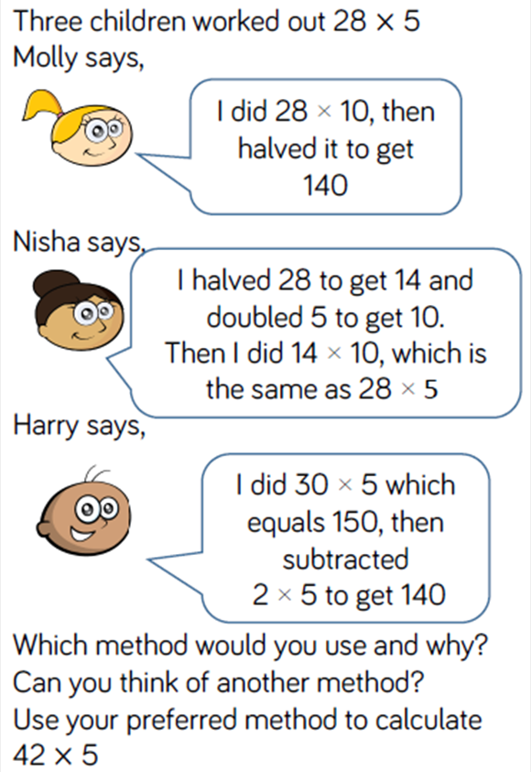
Reasoning and problem solving

Slide 26
Year 4 Spring Week 2 Maths
Written Methods
NCLO: To multiply two digit and three digit numbers by a one digit number using formal written layout.

Slide 27
Key vocabulary and questions
Concrete manipulatives, repeated addition, multiply, partitioning.

Slide 28
Key vocabulary and questions
Concrete manipulatives, repeated addition, multiply, partitioning.

Slide 29
Fluency

Slide 30
Fluency

Slide 31
Fluency

Slide 32
Reasoning and problem solving

Slide 33
Reasoning and problem solving

