Slide 1
Year 1 Autumn Block 2 Addition and Subtraction
Part whole model
NCLO: To represent and use number bonds and related subtraction facts within 10

Slide 2
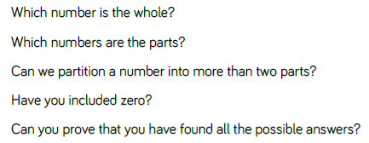
Key vocabulary and questions
Part, whole, numeral
Part, part, whole

Slide 3
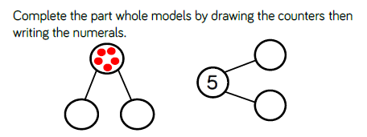
Fluency

Slide 4
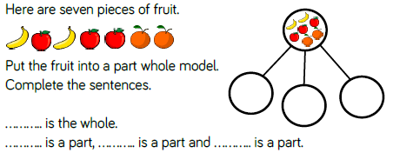
Fluency

Slide 5
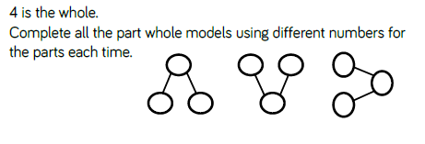
Fluency

Slide 6
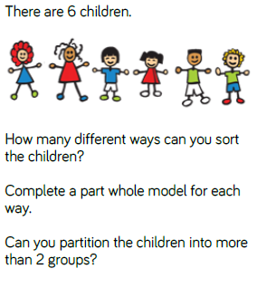
Reasoning and problem solving
Notes:
Children sorted into boys and girls.
Children sorted into wearing white, wearing red.
Children sorted into white shoes, non-white shoes.

Slide 7
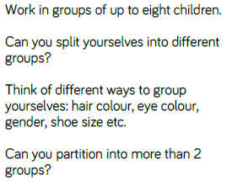
Reasoning and problem solving
Challenge: Can you record your findings in a part, part, whole model? Do you think you’ve found all the possibilities

Slide 8
Year 1 Autumn Block 2 Addition and Subtraction
The addition symbol
NCLO: To read, write and interpret mathematical statements involving addition (+) and equals (=) signs.

Slide 9
Key vocabulary and questions
Number sentence
Addition
Symbol

Slide 10
Fluency

Slide 11
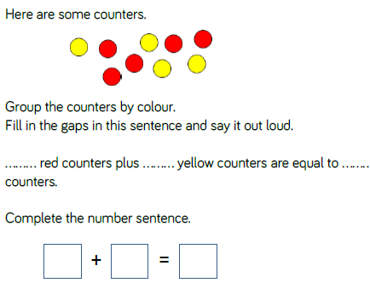
Fluency

Slide 12
Reasoning and problem solving

Slide 13
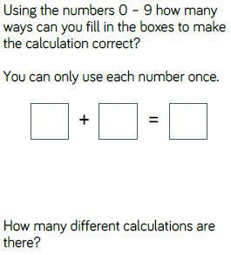
Reasoning and problem solving

Slide 14
Year 1 Autumn Block 2 Addition and Subtraction
Fact families: Addition
NCLO: To read, write and interpret mathematical statements involving addition (+) and equals (=) signs.

Slide 15
Key vocabulary and questions
Commutative
Fact families

Slide 16
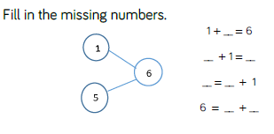
Fluency

Slide 17
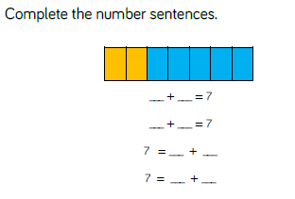
Fluency

Slide 18
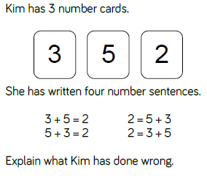
Reasoning and problem solving

Slide 19
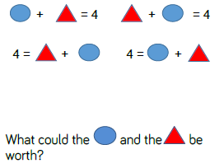
Reasoning and problem solving

Slide 20
Year 1 Autumn Block 2 Addition and Subtraction
Number bonds within 10
NCLO: To represent and use number bonds and related subtraction facts within 10

Slide 21
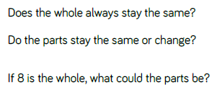
Key vocabulary and questions
Number bond

Slide 22
Fluency

Slide 23
Fluency

Slide 24
Fluency

Slide 25
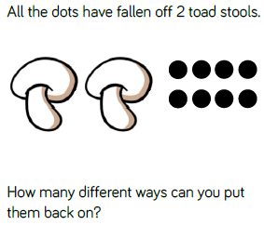
Reasoning and problem solving

Slide 26
Reasoning and problem solving
Is this sometimes true, always true or never true? Can you convince your partner your thinking is correct?

Slide 27
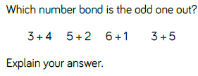
Reasoning and problem solving

Slide 28
Year 1 Autumn Block 2 Addition and Subtraction
Systematic number bonds:
NCLO: To represent and use number bonds within 10

Slide 29
Key vocabulary and questions
Systematic
Pattern

Slide 30
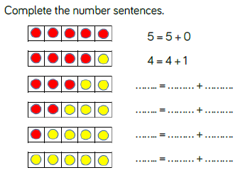
Fluency

Slide 31
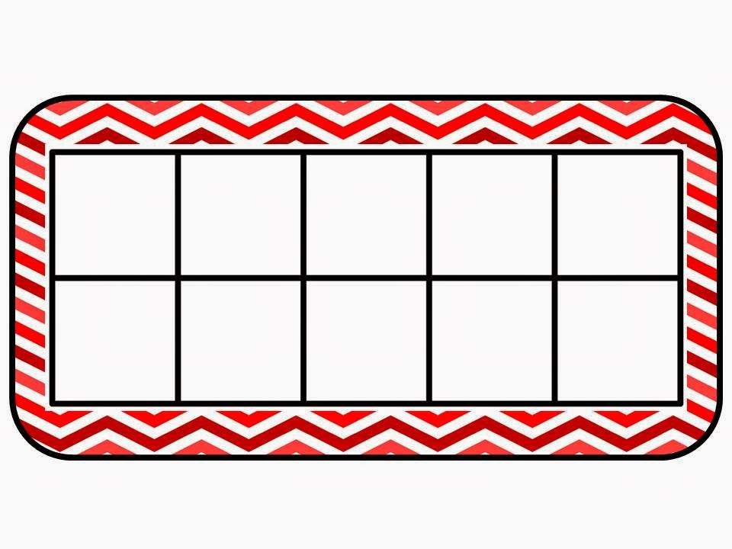
Fluency

Slide 32
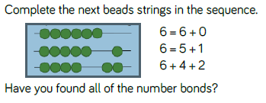
Fluency

Slide 33
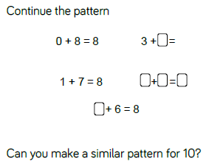
Reasoning and problem solving

Slide 34
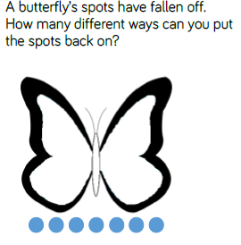
Reasoning and problem solving

Slide 35
Year 1 Autumn Block 2 Addition and Subtraction
Number bonds to 10
NCLO:Represent and use number bonds and related subtraction facts within 10

Slide 36
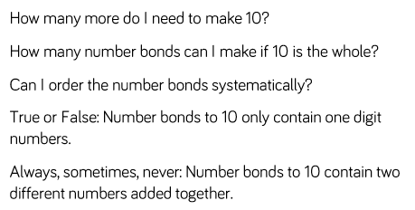
Key vocabulary and questions
Systematically
digit

Slide 37
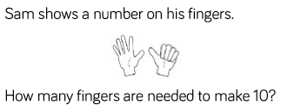
Fluency

Slide 38
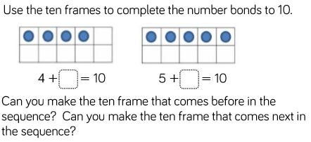
Fluency

Slide 39
Fluency

Slide 40
Reasoning and problem solving

Slide 41
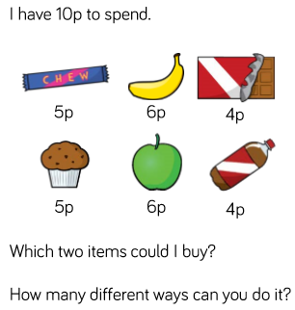
Reasoning and problem solving

Slide 42
Year 1 Autumn Block 2 Addition and Subtraction
Compare number bonds
NCLO: Represent and use number bonds and related subtraction facts within 10

Slide 43
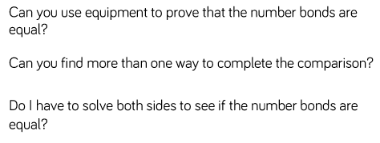
Key vocabulary and questions
Compare, equal, prove, greater than, less than

Slide 44
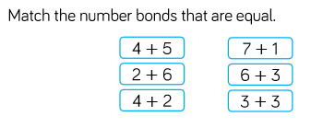
Fluency

Slide 45
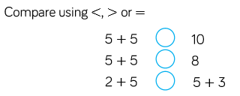
Fluency

Slide 46
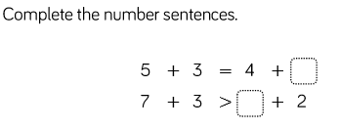
Fluency

Slide 47
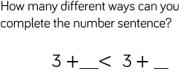
Reasoning and problem solving

Slide 48
Reasoning and problem solving

Slide 49
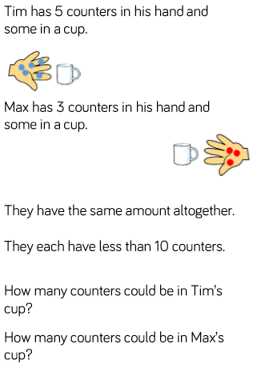
Reasoning and problem solving

Slide 50
Year 1 Autumn Block 2 Addition and Subtraction
Addition: adding together
NCLO: Read, write and interpret mathematical statements involving addition (+), subtraction (-) and equals (=) signs.

Slide 51
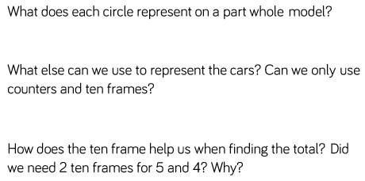
Key vocabulary and questions
Altogether, part, whole, total, represent

Slide 52
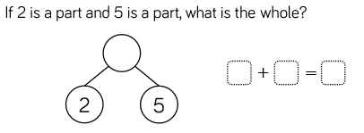
Fluency

Slide 53
Fluency

Slide 54
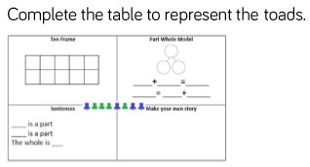
Fluency

Slide 55
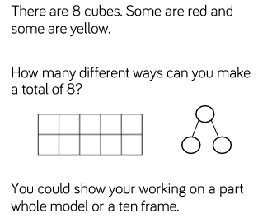
Reasoning and problem solving

Slide 56
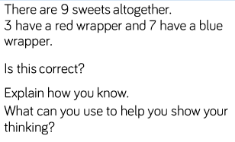
Reasoning and problem solving

Slide 57
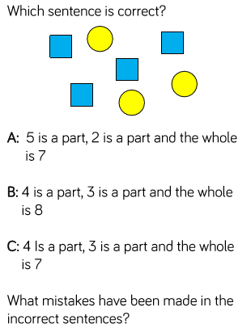
Reasoning and problem solving

Slide 58
Year 1 Autumn Block 2 Addition and Subtraction
Addition: adding more
NCLO: Read, write and interpret mathematical statements involving addition (+), subtraction (-) and equals (=) signs.

Slide 59
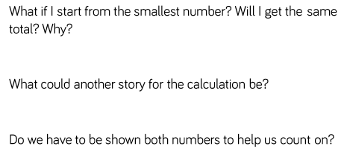
Key vocabulary and questions
Total, altogether, highest, lowest

Slide 60
Fluency

Slide 61
Fluency

Slide 62
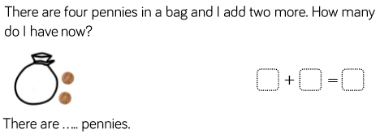
Fluency

Slide 63
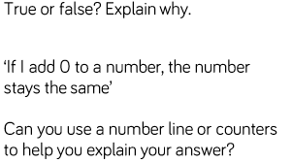
Reasoning and problem solving

Slide 64
Reasoning and problem solving

Slide 65
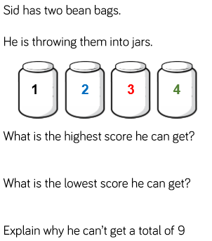
Reasoning and problem solving

Slide 66
Year 1 Autumn Block 2 Addition and Subtraction
Finding a part
NCLO:Read, write and interpret mathematical statements involving addition (+), subtraction (-) and equals (=) signs.

Slide 67
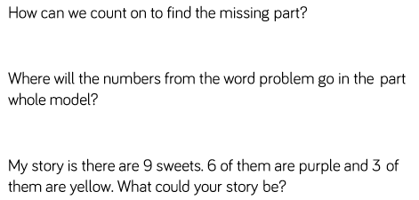
Key vocabulary and questions

Slide 68
Fluency

Slide 69
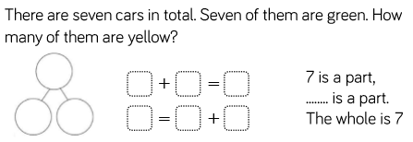
Fluency

Slide 70
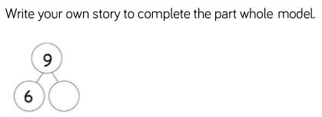
Fluency

Slide 71
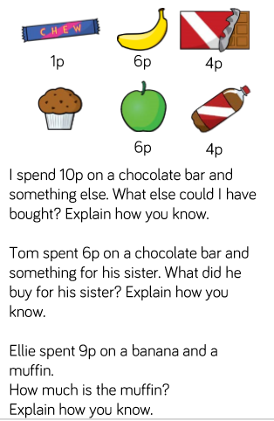
Reasoning and problem solving

Slide 72
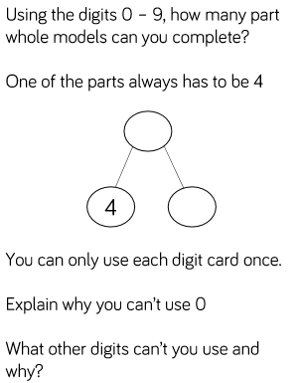
Reasoning and problem solving

Slide 73
Year 1 Autumn Block 2 Addition and Subtraction
Subtraction – Taking away, how many left? Crossing out.
NCLO: Add and subtract one digit numbers to 10, including zero.

Slide 74
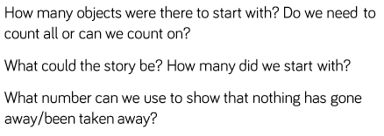
Key vocabulary and questions
At first, then, now

Slide 75
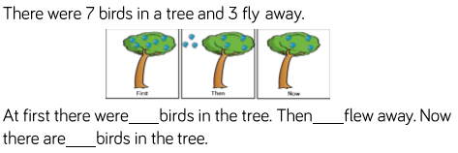
Fluency

Slide 76
Fluency

Slide 77
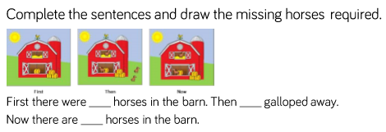
Fluency

Slide 78
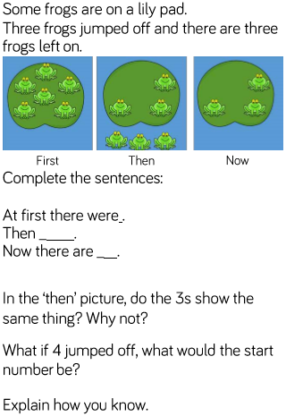
Reasoning and problem solving

Slide 79
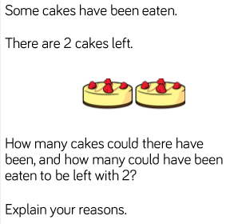
Reasoning and problem solving

Slide 80
Year 1 Autumn Block 2 Addition and Subtraction
Subtraction – take away, how many left? Introducing the subtraction symbol
NCLO:Read, write and interpret mathematical statements involving addition (+), subtraction (-) and equals (=) signs.

Slide 81
Key vocabulary and questions

Slide 82
Fluency

Slide 83
Fluency

Slide 84
Fluency

Slide 85
Reasoning and problem solving

Slide 86
Reasoning and problem solving

Slide 87
Reasoning and problem solving

Slide 88
Year 1 Autumn Block 2 Addition and Subtraction
Subtraction: finding a part, breaking apart
NCLO: Solve one step problems that involve addition and subtraction, using concrete objects and pictorial representations and missing number problems.

Slide 89
Key vocabulary and questions

Slide 90
Fluency

Slide 91
Fluency

Slide 92
Fluency

Slide 93
Reasoning and problem solving

Slide 94
Reasoning and problem solving

Slide 95
Year 1 Autumn Block 2 Addition and Subtraction
Fact families – the 8 facts
Solve one step problems that involve addition and subtraction, using concrete objects and pictorial representations and missing number problems.

Slide 96
Key vocabulary and questions

Slide 97
Fluency

Slide 98
Fluency

Slide 99
Fluency

Slide 100
Reasoning and problem solving

Slide 101
Reasoning and problem solving

Slide 102
Year 1 Autumn Block 2 Addition and Subtraction
Subtraction – counting back
NCLO: Add and subtract one digit numbers to 10, including zero.

Slide 103
Key vocabulary and questions

Slide 104
Fluency

Slide 105
Fluency

Slide 106
Fluency

Slide 107
Reasoning and problem solving

Slide 108
Reasoning and problem solving

Slide 109
Reasoning and problem solving

Slide 110
Year 1 Autumn Block 2 Addition and Subtraction
Subtraction – finding the difference
NCLO:Add and subtract one digit numbers to 10, including zero.

Slide 111
Key vocabulary and questions

Slide 112
Fluency

Slide 113
Fluency

Slide 114
Fluency

Slide 115
Reasoning and problem solving

Slide 116
Reasoning and problem solving

Slide 117
Year 1 Autumn Block 2 Addition and Subtraction
Comparing addition and subtraction statements a+b>c
NCLO: Solve one step problems that involve addition and subtraction, using concrete objects and pictorial representations and missing number problems.

Slide 118
Key vocabulary and questions

Slide 119
Fluency

Slide 120
Fluency

Slide 121
Fluency

Slide 122
Reasoning and problem solving

Slide 123
Reasoning and problem solving

Slide 124
Reasoning and problem solving

Slide 125
Year 1 Autumn Block 2 Addition and Subtraction
Comparing addition and subtraction statements a+b>c
NCLO: Solve one step problems that involve addition and subtraction, using concrete objects and pictorial representations and missing number problems.

Slide 126
Key vocabulary and questions

Slide 127
Fluency

Slide 128
Fluency

Slide 129
Fluency

Slide 130
Reasoning and problem solving

