Slide 1
Year 1 Autumn Block 3 Geometry Shape
Recognise and name 3D shapes
NCLO:Recognise and name common 3-D shapes, including: (for example, cuboids (including cubes), pyramids and spheres.)

Slide 2
Key vocabulary and questions
Cube, cylinder, cuboid, pyramid, cone, sphere

Slide 3
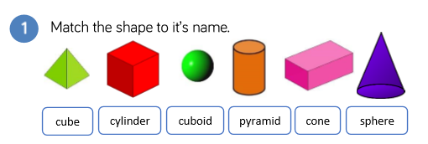
Fluency

Slide 4
Fluency

Slide 5
Fluency

Slide 6
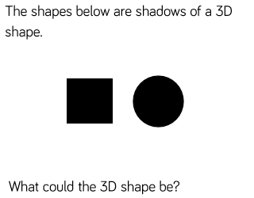
Reasoning and problem solving

Slide 7
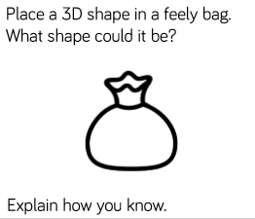
Reasoning and problem solving

Slide 8
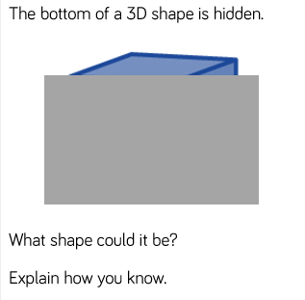
Reasoning and problem solving

Slide 9
Year 1 Autumn Block 3 Geometry Shape
Sort 3D shapes
NCLO:Recognise and name common 3-D shapes, including: (for example, cuboids (including cubes), pyramids and spheres.)

Slide 10
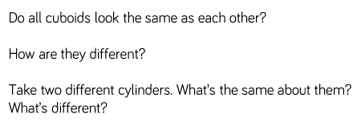
Key vocabulary and questions
Cube, cylinder, cuboid, pyramid, cone, sphere

Slide 11
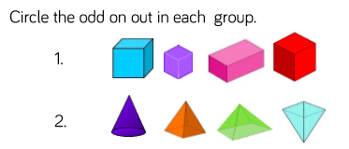
Fluency

Slide 12
Fluency

Slide 13
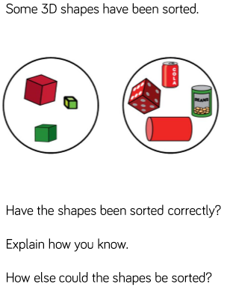
Reasoning and problem solving

Slide 14
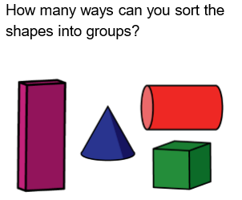
Reasoning and problem solving

Slide 15
Year 1 Autumn Block 3
Recognise and name 2D shapes
NCLO:Recognise and name common 2-D shapes, including: (for example, rectangles (including squares), circles and triangles)

Slide 16
Key vocabulary and questions
Square, rectangle, circle, triangle

Slide 17
Fluency

Slide 18
Fluency

Slide 19
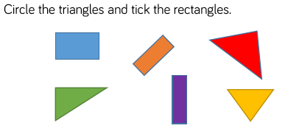
Fluency

Slide 20
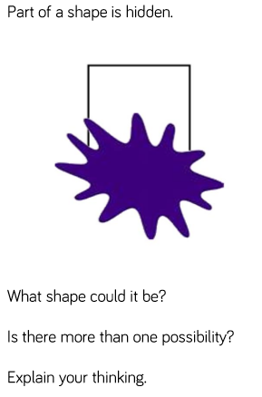
Reasoning and problem solving

Slide 21
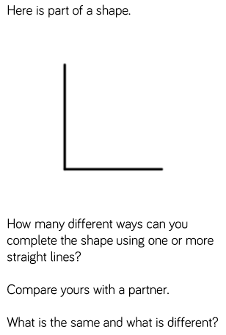
Reasoning and problem solving

Slide 22
Year 1 Autumn Block 3 Geometry Shape
Patterns with 3D and 2D shapes
NCLO: Recognise and name common 2-D and 3-D shapes

Slide 23
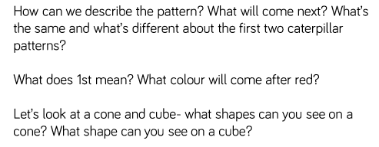
Key vocabulary and questions

Slide 24
Fluency

Slide 25
Fluency

Slide 26
Fluency

Slide 27
Reasoning and problem solving

Slide 28
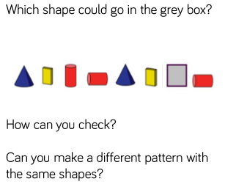
Reasoning and problem solving

