Slide 1
Year 1 Autumn Block 4 Number – place value within 20
Count forwards and backwards and write numbers to 20 in numerals and words
NCLO: Count to twenty, forwards and backwards, beginning with 0 or 1, from any given number.
Count, read and write numbers to 20 in numerals and words.

Slide 2
Key vocabulary and questions
Numerals
Odd one out

Slide 3
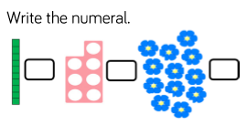
Fluency

Slide 4
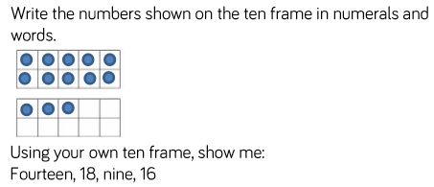
Fluency

Slide 5
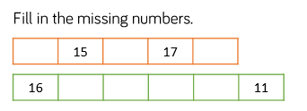
Fluency

Slide 6
Reasoning and problem solving

Slide 7
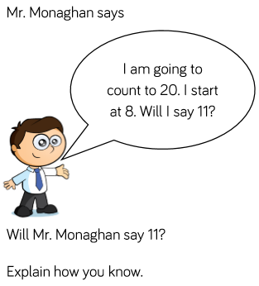
Reasoning and problem solving

Slide 8
Year 1 Autumn Block 4 Number -place value numbers to 20
Numbers from 11 to 20
NCLO:Identify and represent numbers using objects and pictorial representations including the number line, and use the language of: equal to, more than, less than (fewer), most, least.

Slide 9
Key vocabulary and questions
Represent
Match
Odd one out

Slide 10
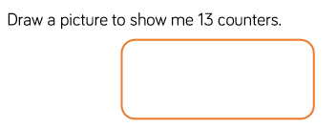
Fluency

Slide 11
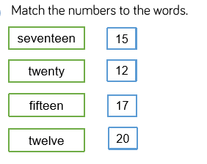
Fluency

Slide 12
Fluency

Slide 13
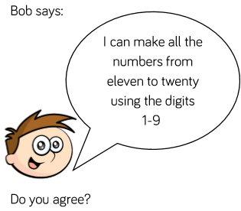
Reasoning and problem solving

Slide 14
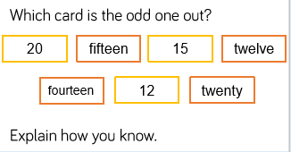
Reasoning and problem solving

Slide 15
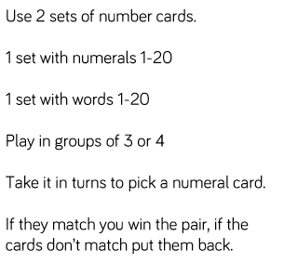
Reasoning and problem solving

Slide 16
Year 1 Autumn Block 4 Number --place value numbers to 20
Tens and ones
NCLO:Identify and represent numbers using objects and pictorial representations including the number line, and use the language of: equal to, more than, less than (fewer), most, least.

Slide 17
Key vocabulary and questions
Which is greater 1 ten or 1 one? How do you know?
Can you swap tens for ones? Will it change the amount? Explain.

Slide 18
Fluency

Slide 19
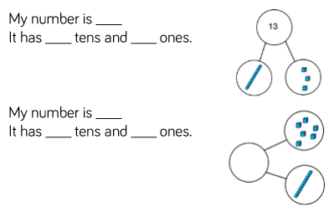
Fluency

Slide 20
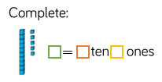
Fluency

Slide 21
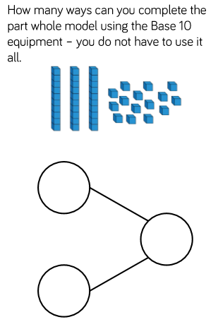
Reasoning and problem solving

Slide 22
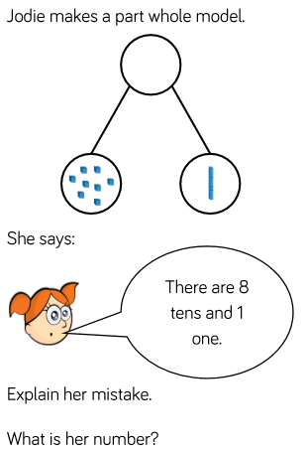
Reasoning and problem solving

Slide 23
Year 1 Autumn Block 4 Number -place value numbers to 20
Count one more and one less
NCLO:Given a number, identify one more or one less.

Slide 24
Key vocabulary and questions
More
Less
Digit

Slide 25
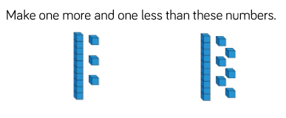
Fluency

Slide 26
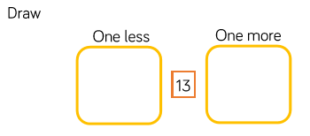
Fluency

Slide 27
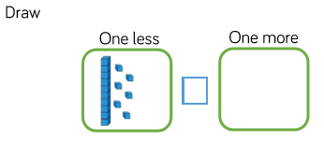
Fluency

Slide 28
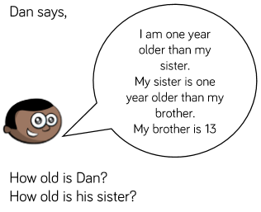
Reasoning and problem solving

Slide 29
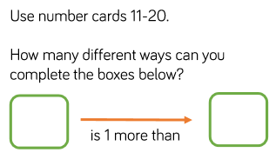
Reasoning and problem solving

Slide 30
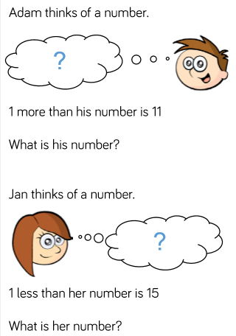
Reasoning and problem solving

Slide 31
Year 1 Autumn Block 4 Number -place value numbers to 20
Compare groups of objects
NCLO:Identify and represent numbers using objects and pictorial representations including the number line, and use the language of: equal to, more than, less than (fewer), most, least.

Slide 32
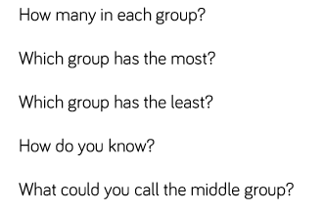
Key vocabulary and questions
More than, less than, equal to, compare

Slide 33
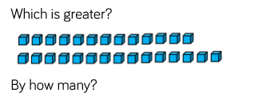
Fluency

Slide 34
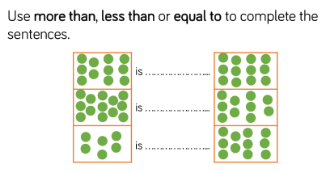
Fluency

Slide 35
Fluency

Slide 36
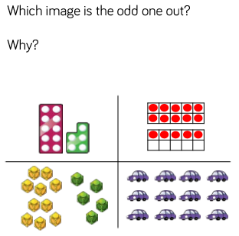
Reasoning and problem solving

Slide 37
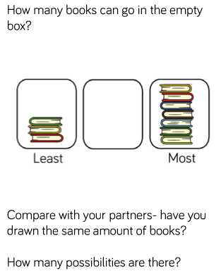
Reasoning and problem solving

Slide 38
Year 1 Autumn Block 4 Number -place value numbers to 20
Compare numbers
NCLO:Identify and represent numbers using objects and pictorial representations including the number line, and use the language of: equal to, more than, less than (fewer), most, least.

Slide 39
Key vocabulary and questions
Greater, smaller, less than, more than

Slide 40
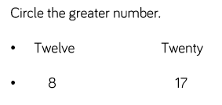
Fluency

Slide 41
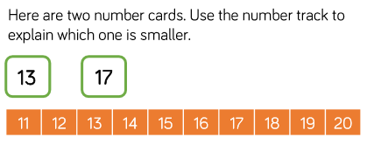
Fluency

Slide 42
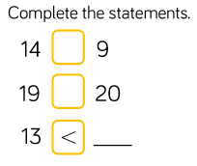
Fluency

Slide 43
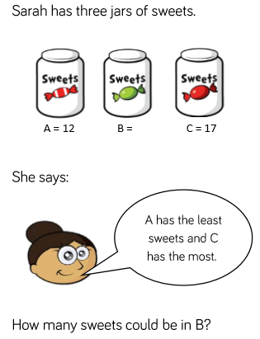
Reasoning and problem solving

Slide 44
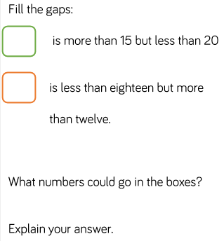
Reasoning and problem solving

Slide 45
Year 1 Autumn Block 4 Number -place value numbers to 20
Order groups of objects
NCLO:Identify and represent numbers using objects and pictorial representations including the number line, and use the language of: equal to, more than, less than (fewer), most, least.

Slide 46
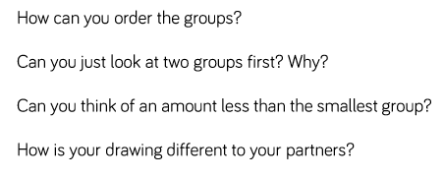
Key vocabulary and questions
Order, smallest, less than, more than

Slide 47
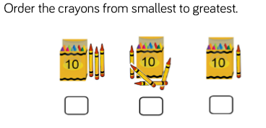
Fluency

Slide 48
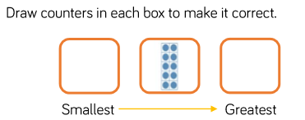
Fluency

Slide 49
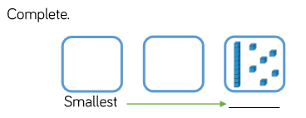
Fluency

Slide 50
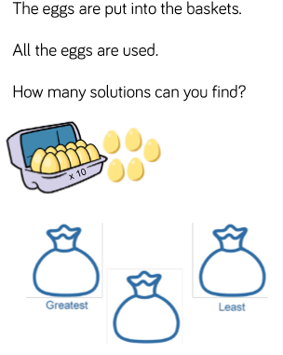
Reasoning and problem solving

Slide 51
Reasoning and problem solving

Slide 52
Year 1 Autumn Block 4 Number -place value numbers to 20
Order numbers
NCLO:Identify and represent numbers using objects and pictorial representations including the number line, and use the language of: equal to, more than, less than (fewer), most, least.

Slide 53
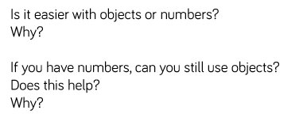
Key vocabulary and questions
Greatest, smallest, less than, more than, order

Slide 54
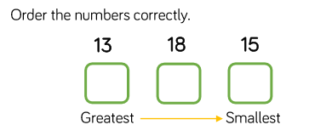
Fluency

Slide 55
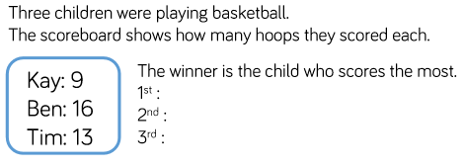
Fluency

Slide 56
Fluency

Slide 57
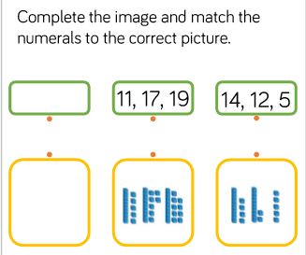
Reasoning and problem solving

Slide 58
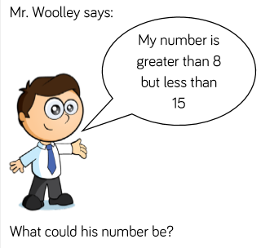
Reasoning and problem solving

