Slide 1
Year 3 Spring Block 4
Length and Perimeter
NCLO-to measure length

Slide 2
Key vocabulary and questions
What would be the best equipment to measure X with? (e.g. tape measure, ruler, metre stick)
Look at each side of different measuring equipment – what’s the same, what’s different?
What do we have to remember when using a ruler to measure? Which side are we going to use to measure?
What unit of measure would we use to measure X? What should you do if it the object does not start from 0?

Slide 3
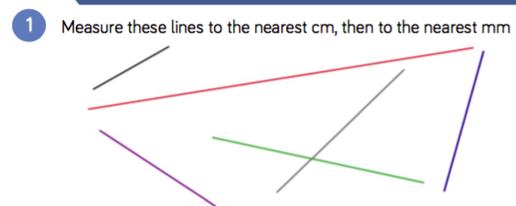
Fluency

Slide 4
Fluency

Slide 5
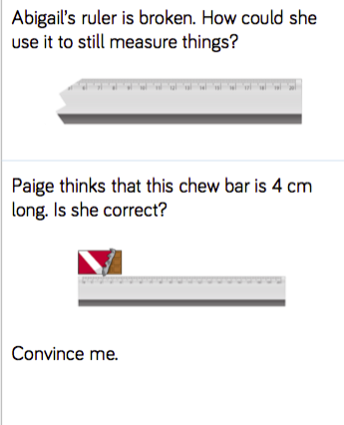
Reasoning and problem solving

Slide 6
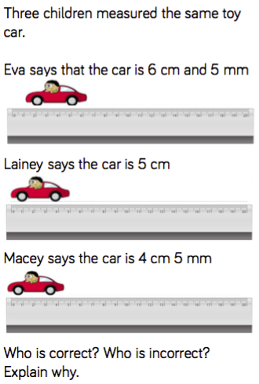
Reasoning and problem solving

Slide 7
Year 3 Spring Block 4
Length and perimeter
NCLO:to understand that 100cm is equivalent to 1m and to convert between cm and m

Slide 8
Key vocabulary and questions
If there are 100 cm in 1 metre, how many centimetres would there be in 2 metres? How many centimetres in 3 metres? How many other equivalents can you think of?
Can you explain how you are partitioning each measurement?
Could you partition it in any other way? Why is it most effective to partition the hundreds and then the tens and ones?

Slide 9
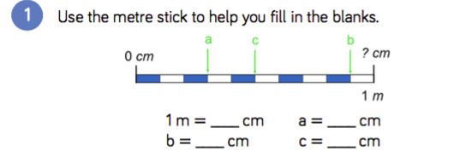
Fluency

Slide 10
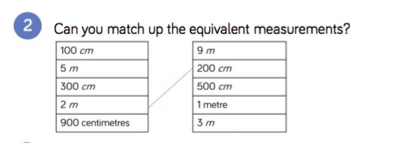
Fluency

Slide 11
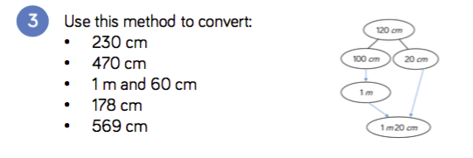
Fluency

Slide 12
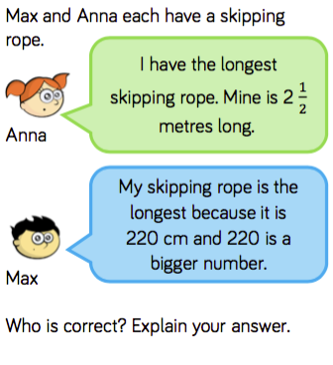
Reasoning and problem solving

Slide 13
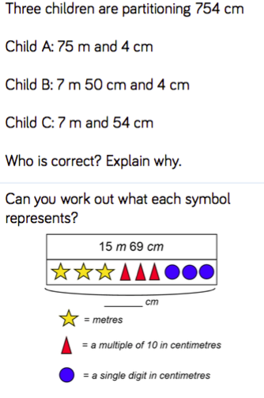
Reasoning and problem solving

Slide 14
Year 3 Spring Block 4
Length and Perimeter
NCLO:to understand that 10 mm is equivalent to 1 cm

Slide 15
Key vocabulary and questions
If there are 10 mm in 1 cm, how many mm would there be in 2 cm?
Can you explain how you are partitioning each number? Can you partition it any other way? Why is it most effective to partition the hundreds and then the tens and ones?

Slide 16
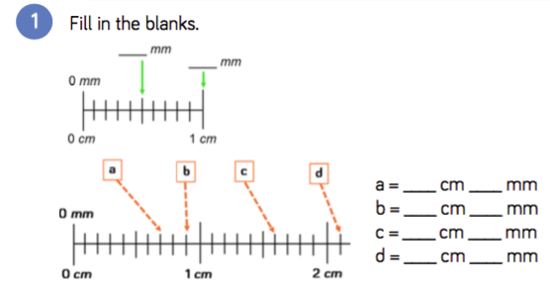
Fluency

Slide 17
Fluency

Slide 18
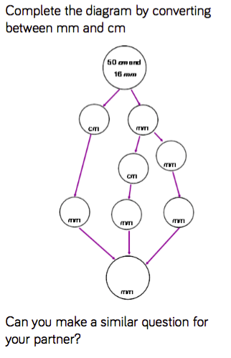
Reasoning and problem solving

Slide 19
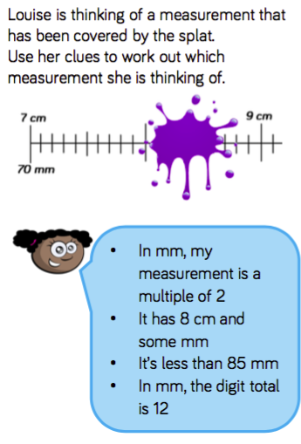
Reasoning and problem solving

Slide 20
Year 3 Spring Block 4
Length and Perimeter
NCLO: to compare and order lengths based on measurements in mm, cm and m.

Slide 21
Key vocabulary and questions
Can you order the children’s’ heights from shortest to tallest?
How could you make it easier to compare and order these measurements?
Estimate whose tower you think will be the tallest. Explain why.

Slide 22
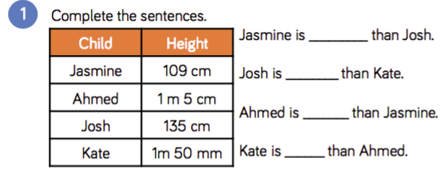
Fluency

Slide 23
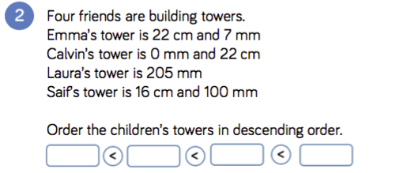
Fluency

Slide 24
Fluency

Slide 25
Reasoning and problem solving

Slide 26
Reasoning and problem solving

