Slide 1
Year 5 Spring Block 1
Multiplication and Division
NCLO: To multiply numbers up to 4 digits by a one or two digit number using a formal written method

Slide 2
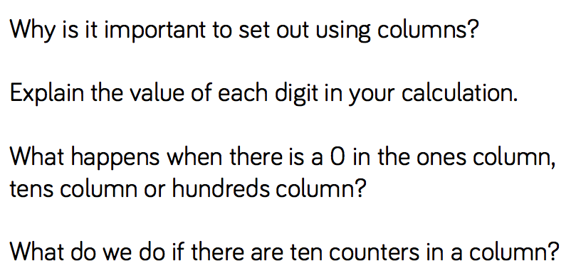
Key vocabulary and questions

Slide 3
Fluency

Slide 4
Fluency

Slide 5
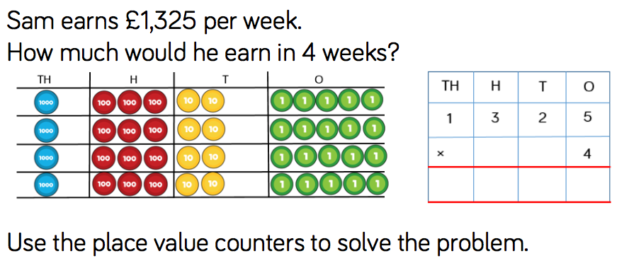
Reasoning and problem solving

Slide 6
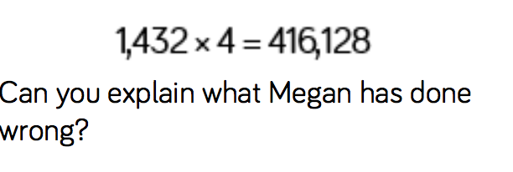
Reasoning and problem solving

Slide 7
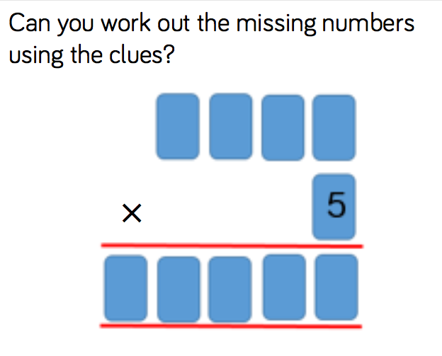
Reasoning and problem solving
The 4 digits being multiplied by 6 are consecutive numbers.
• The first 2 digits of the answer are the same.
• The 4th and 5th digits in the answer add to make the 3rd.

Slide 8
Year 5 Spring Block 1
Multiplication and Division
To use the area model to multiply

Slide 9
Key vocabulary and questions
How can we represent this calculation? What are we multiplying?
Where can we see 20 × 20? What does the 40 represent?
What’s the same and what is different between the three representations (base ten, place value, grid)?

Slide 10
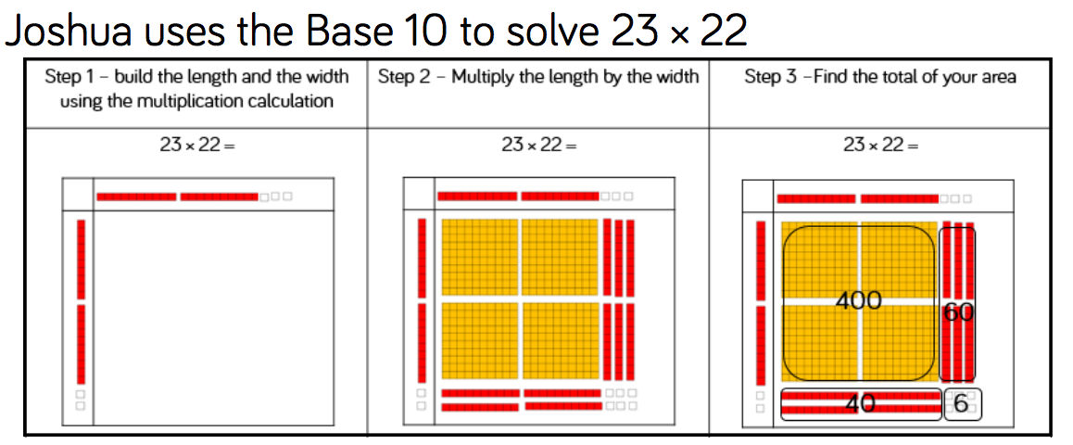
Fluency

Slide 11
Fluency

Slide 12
Fluency

Slide 13
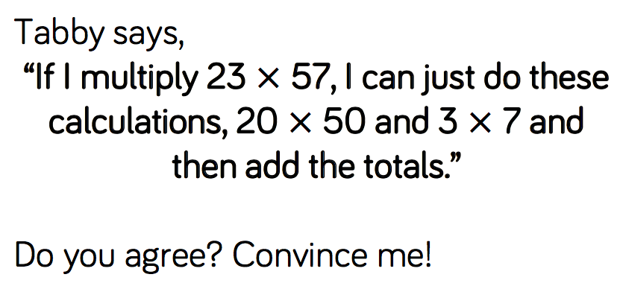
Reasoning and problem solving

Slide 14
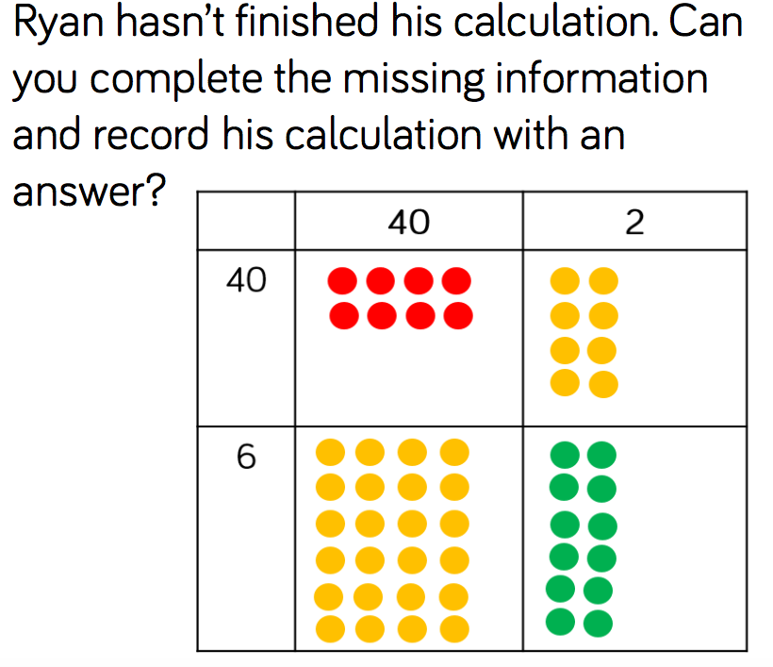
Reasoning and problem solving

Slide 15
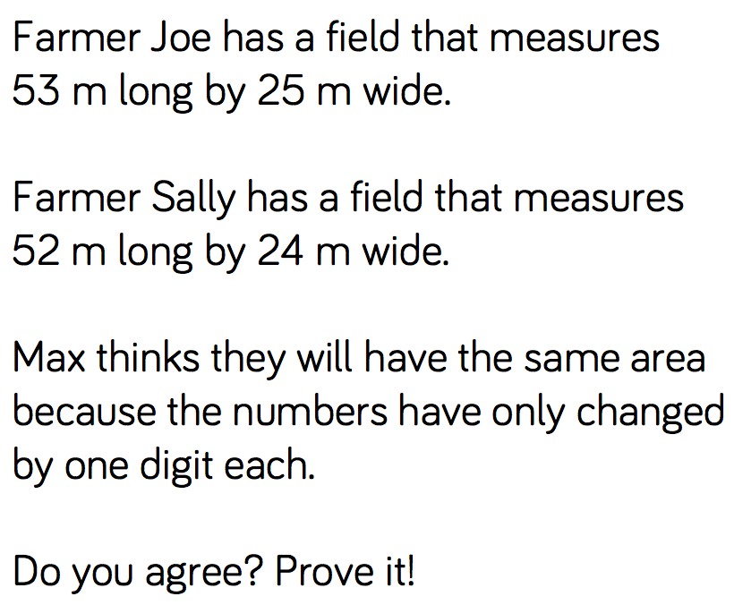
Reasoning and problem solving

Slide 16
Year 5 Spring Block 1
Multiplication and Division
NCLO: To multiply 2 digit number by 2 digit umbers using formal written methods

Slide 17
Key vocabulary and questions
^{Why is the zero important?}
What numbers are being multiplied in the first line and the second line?
What do we do with an exchange? What happens if the exchange is more than 1?
If we know what 38 × 12 is, how else could we work out 39×12?

Slide 18
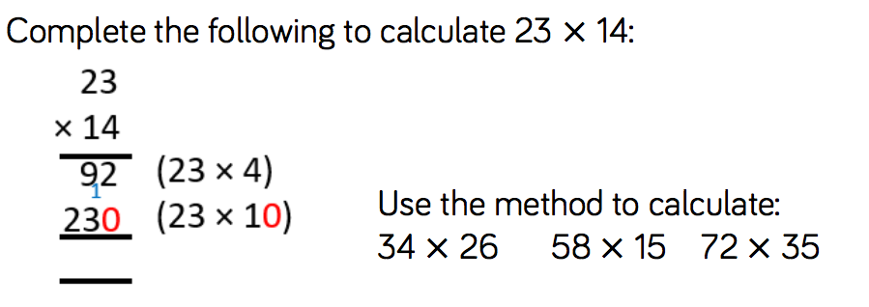
Fluency

Slide 19
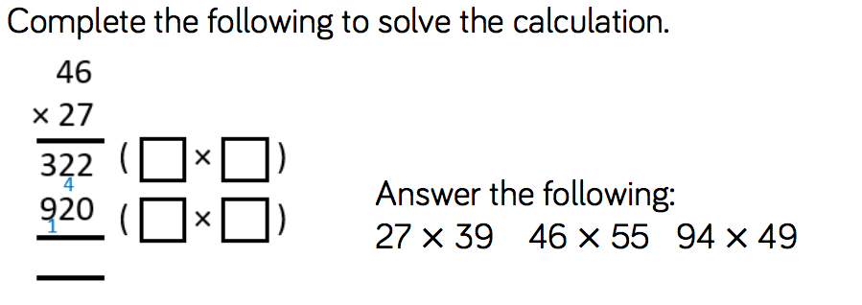
Fluency

Slide 20
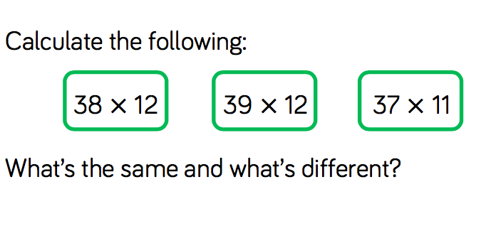
Fluency

Slide 21
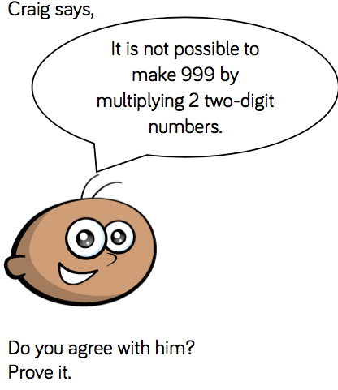
Reasoning and problem solving

Slide 22
Reasoning and problem solving

Slide 23
Year 5 Spring Block 1
Multiplication and Division
NCLO: To use formal written methods to solve multiplication problems

Slide 24
Key vocabulary and questions
^{Why is the zero important?}
What numbers are being multiplied in the first line and the second line?
What do we do with an exchange?
What happens if there is an exchange at the end of the number?

Slide 25
Fluency

Slide 26
Fluency

Slide 27
Fluency

Slide 28
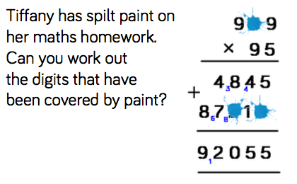
Reasoning and problem solving

Slide 29
Reasoning and problem solving

Slide 30
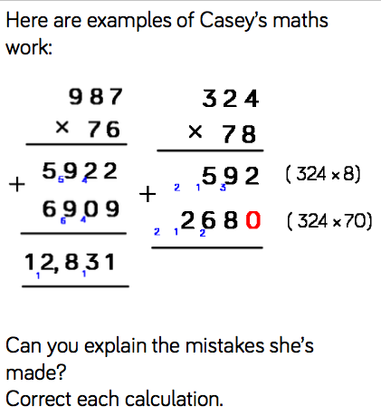
Reasoning and problem solving

Slide 31
Year 5 Spring Block 1
Multiplication and Division
NCLO: To multiply 4 digit numbers by 2 digits using formal written methods

Slide 32
Key vocabulary and questions
What steps do we need to go through when using this multiplication method?
Look at the numbers in each question, can they help you estimate which answer will be the largest?

Slide 33
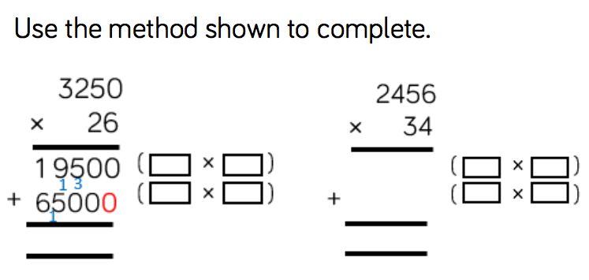
Fluency

Slide 34
Fluency

Slide 35
Fluency

Slide 36
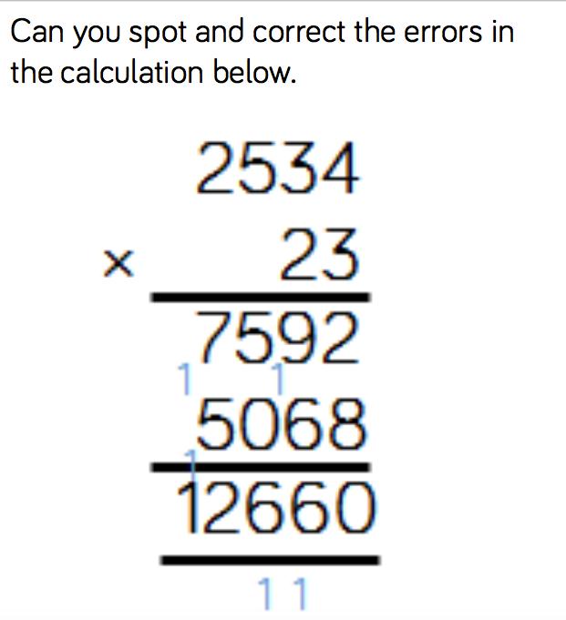
Reasoning and problem solving

Slide 37
Reasoning and problem solving

Slide 38
Year 5 Spring Block 1
Multiplication and Division
NCLO: To use formal written methods to divide by a 1 digit number

Slide 39
Key vocabulary and questions
How many groups of 4 thousands are there in 4 thousands?
How many groups of 4 hundreds are there in 8 hundreds? How many groups of 4 tens are there in 9 tens?
How many groups of 4 ones are there in 12 ones?
Do I need to solve both calculations to compare the divisions?

Slide 40
Fluency

Slide 41
Fluency

Slide 42
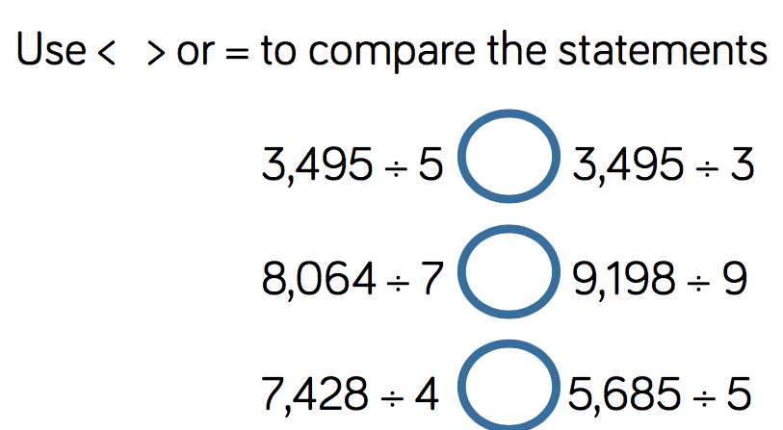
Fluency

Slide 43
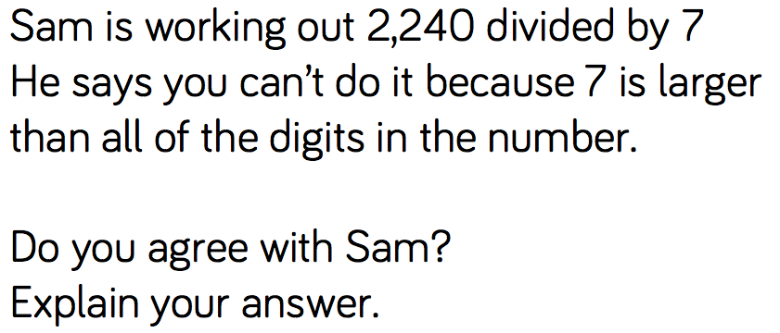
Reasoning and problem solving

Slide 44
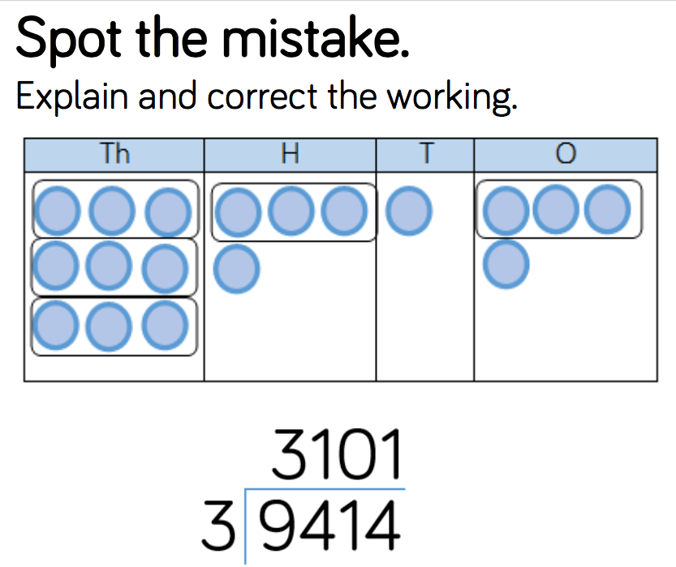
Reasoning and problem solving

Slide 45
Year 5 Spring Block 1
Multiplication and Division
NCLO: To solve division problems and interpret remainders in context

Slide 46
Key vocabulary and questions
What is a remainder?
How can you represent and interpret remainders?
If I can’t make a group in this column, what do I do? What happens if we can group the one equally?
In this number story, what does this remainder mean?
When would we round the remainder up or down? What context would we just focus on the remainder?

Slide 47
Fluency

Slide 48
Fluency

Slide 49
Fluency

Slide 50
Reasoning and problem solving

Slide 51
Reasoning and problem solving

Slide 52
Reasoning and problem solving

