Slide 1
Year 5 Autumn Block 2
Addition and subtraction
NCLO: To add whole numbers with more than 4 digits using formal written methods

Slide 2
Key vocabulary and questions
Add
Subtract
Sum
Greater than
Less than

Slide 3
Key vocabulary and questions
Will you have to exchange? How do you know which columns will be affected?
Does it matter that the two numbers don’t have the same amount of digits?
Which number goes on top in the calculation? Does it affect the answer?

Slide 4
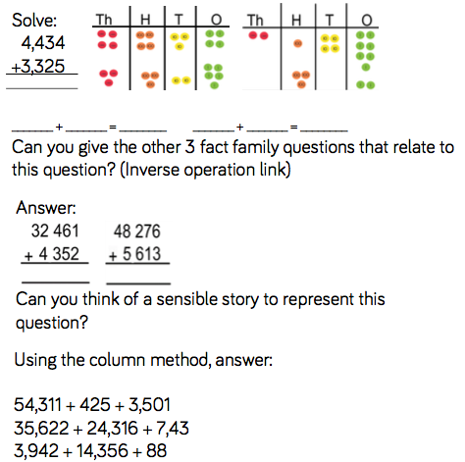
Fluency

Slide 5
Fluency

Slide 6
Fluency

Slide 7
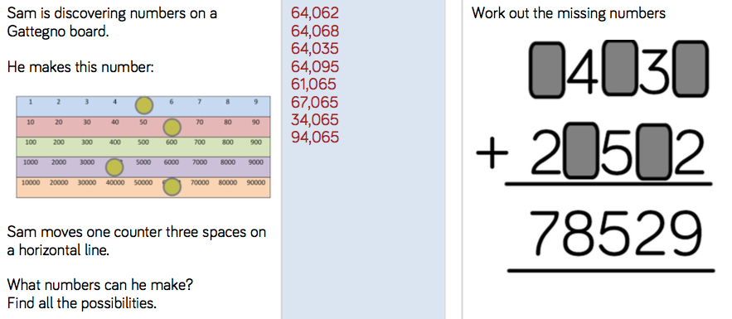
Reasoning and problem solving

Slide 8
Reasoning and problem solving

Slide 9
Year 5 Autumn Block 2
Addition and subtraction
NCLO: To subtract whole numbers with more than 4 digits using formal written methods

Slide 10
Key vocabulary and questions
Exchange
Place holder
Difference
Less than
Take away
Subtract

Slide 11
Key vocabulary and questions
Why is it important that we start subtracting the ones first? What could happen if we didn’t?
Does it matter which number goes on top? Why?
Will you have to exchange? How do you know which columns will be affected?
Does it matter that the two numbers don’t have the same amount of digits?

Slide 12
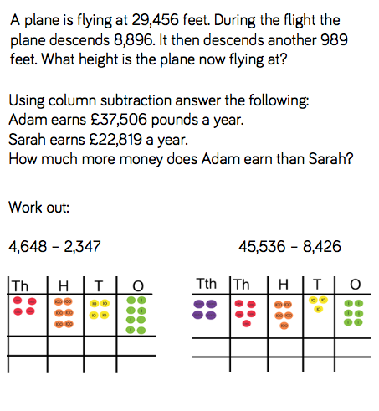
Fluency

Slide 13
Fluency

Slide 14
Fluency

Slide 15
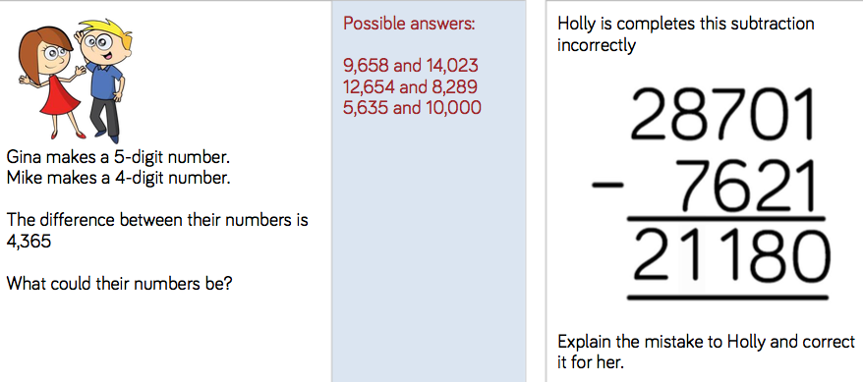
Reasoning and problem solving

Slide 16
Reasoning and problem solving

Slide 17
Year 5 Autumn Block 2
Addition and subtraction
NCLO: To use rounding to check answers to calculations and determine levels of accuracy

Slide 18
Key vocabulary and questions
^{Estimating}
^{Accuracy}
^{Degree of accuracy}
^{Rounding}
^{Multiples}

Slide 19
Key vocabulary and questions
Which numbers shall I round to?
Why should I round to this number?
Why should an estimate be quick?
When, in real life, would we use an estimate?

Slide 20
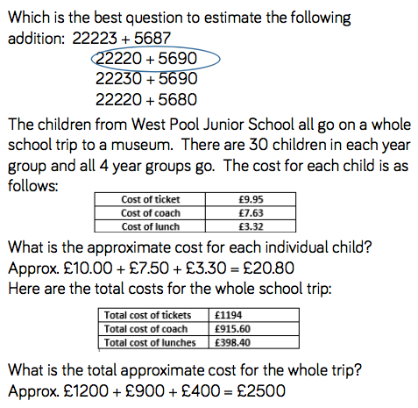
Fluency

Slide 21
Fluency

Slide 22
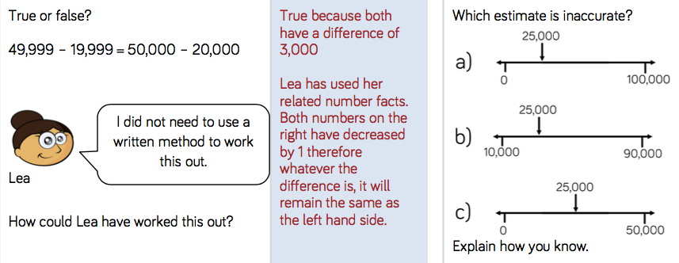
Reasoning and problem solving

Slide 23
Reasoning and problem solving

Slide 24
Year 5 Autumn Block 2
Addition and subtraction
NCLO: To use inverse operations to check and solve calculations

Slide 25
Key vocabulary and questions
^{Inverse}
How can you tell if your answer is sensible?
What is the inverse of addition?
What is the inverse of subtraction?

Slide 26
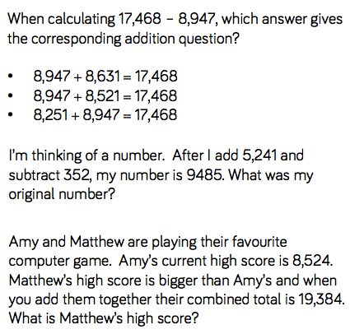
Fluency

Slide 27
Fluency

Slide 28
Fluency

Slide 29
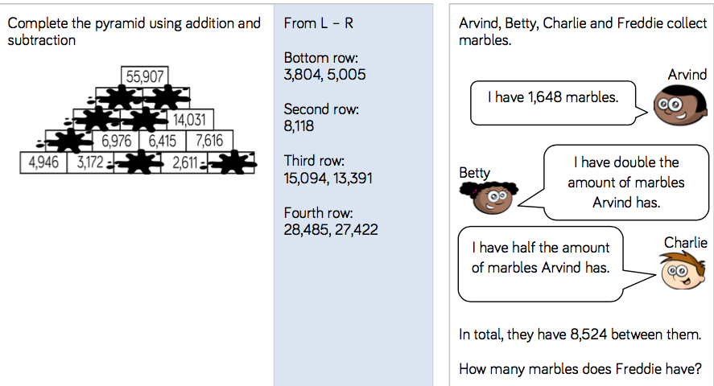
Reasoning and problem solving

Slide 30
Reasoning and problem solving

Slide 31
Year 5 Autumn Block 2
Addition and subtraction
NCLO: To solve addition and subtraction multi-step problems in contexts, deciding which operations and methods to use and why

Slide 32
Key vocabulary and questions
Total
Sum
Difference
Altogether
Less than
Increase
Greater than

Slide 33
Key vocabulary and questions
Look at the word problem on the board:
What is the key vocabulary in the question? What are the key bits of information?
Can we put this information in to a model? Which operations do we need to use?

Slide 34
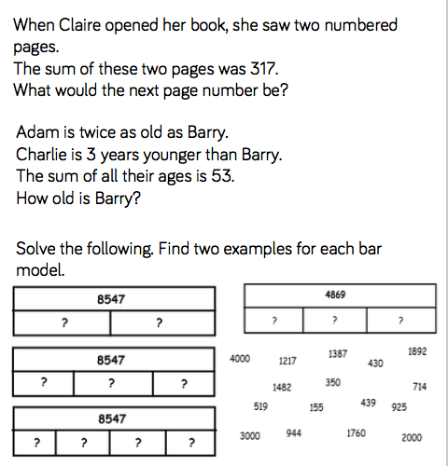
Fluency

Slide 35
Fluency

Slide 36
Fluency

Slide 37
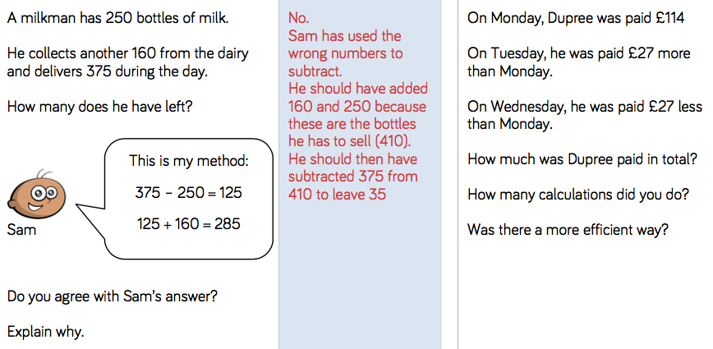
Reasoning and problem solving

Slide 38
Reasoning and problem solving

