Slide 1
Year 6 Spring Block 1
Decimals
NCLO: To identify the value of each digit in numbers given to 3 decimal places

Slide 2
Key vocabulary and questions
^{354.631}
How many tenths are in the number?
^{How many hundredths?}
Can you make the number on the place value chart?
How many hundredths are the same as 5 tenths?

Slide 3
Fluency

Slide 4
Fluency

Slide 5
Fluency

Slide 6
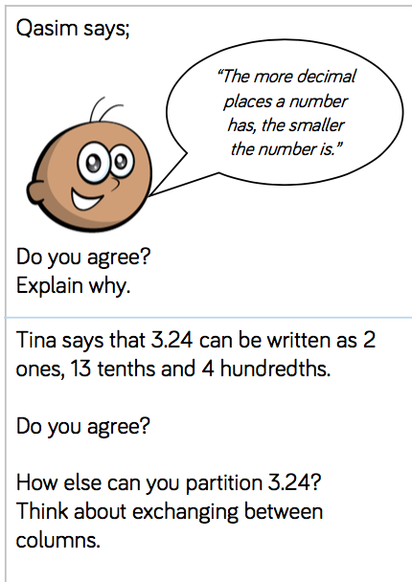
Reasoning and problem solving
Notes:
Possible answer:
I do not agree with this as the number 4.39 is smaller than the number 4.465, which has more decimal numbers.

Slide 7
Reasoning and problem solving
Notes:
Possible answer:
I disagree; Tina’s numbers would make 3.34 rather than 3.24.
I can make 3.24 by having 1 one, 22 tenths and 4 hundredths.

Slide 8
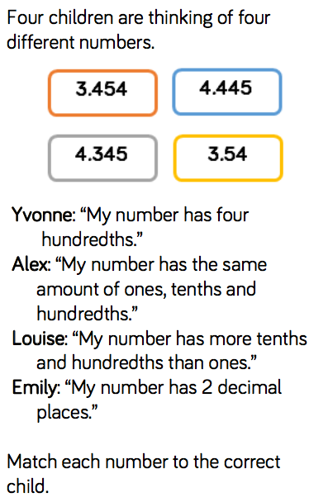
Reasoning and problem solving
Notes:
Yvonne: 4.345 Alex: 4.445 Louise: 3.454 Emily: 3.54

Slide 9
Year 6 Spring Block 1
Decimals
NCLO: to multiply numbers by 10, 100 and 1,000 giving answers up to 3 decimal places.

Slide 10
Key vocabulary and questions
What number is represented on the place value chart?
Why is 0 important when multiplying by 10, 100 and 1,000? What patterns do you notice?
What is the same and what is different when multiplying by 10, 100, 1,000 on the place value chart compared with the Gattegno chart?

Slide 11
Fluency

Slide 12
Fluency

Slide 13
Fluency

Slide 14
Reasoning and problem solving

Slide 15
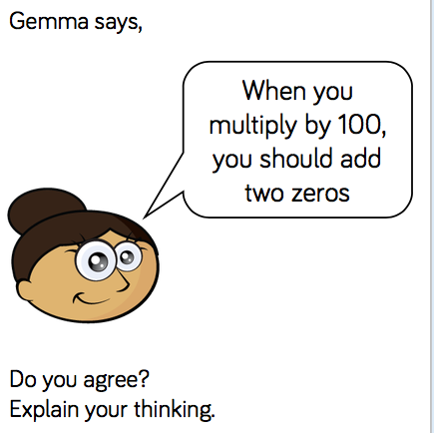
Reasoning and problem solving

Slide 16
Year 6 Spring Block 1
Decimals
NCLO: to multiply numbers by 10, 100 and 1,000 giving answers up to 3 decimal places.

Slide 17
Key vocabulary and questions
What happens to the counters/digits when you divide by 10, 100 or 1000?
^{Why is the zero important?}
What is happening to the value of the digit each time it moves one column to the right?
What is the relationship between tenths, hundredths and thousandths?

Slide 18
Fluency

Slide 19
Fluency

Slide 20
Fluency

Slide 21
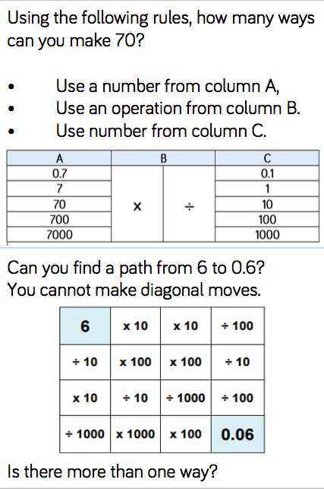
Reasoning and problem solving

Slide 22
Reasoning and problem solving

Slide 23
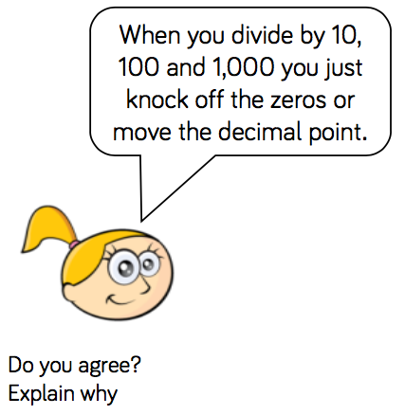
Reasoning and problem solving

Slide 24
Year 6 Spring Block 1
Decimals
NCLO: To multiply one-digit numbers with up to 2 decimal places by whole numbers

Slide 25
Key vocabulary and questions
Which is bigger, 0.1, 0.01 or 0.001. Why?
How many 0.1s do you need to exchange for a whole one? Can you draw a bar model to represent the problem?
Can you think of another way to multiply by 5? (multiply by 10 and divide by 2).

Slide 26
Fluency

Slide 27
Fluency

Slide 28
Fluency

Slide 29
Reasoning and problem solving

Slide 30
Reasoning and problem solving

Slide 31
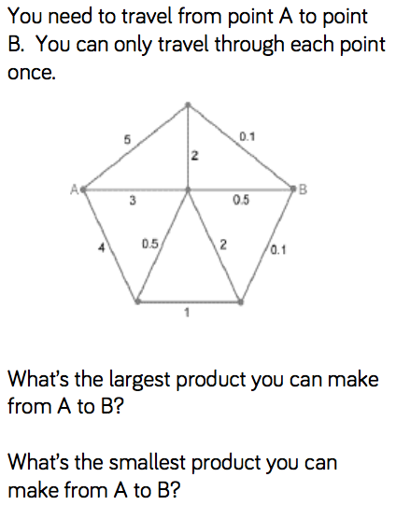
Reasoning and problem solving

Slide 32
Year 6 Spring Block 1
Decimals
NCLO: To multiply one-digit numbers with up to 2 decimal places by whole numbers

Slide 33
Key vocabulary and questions
Are we grouping or sharing? Explain why. How are these different? How are they the same?
How else could we partition the number 3.69? (For example, 2 ones, 16 tenths and 9 hundredths.)
How could we check that our answer is correct using the inverse? Which method, sharing or grouping, shows the inverse more clearly?

Slide 34
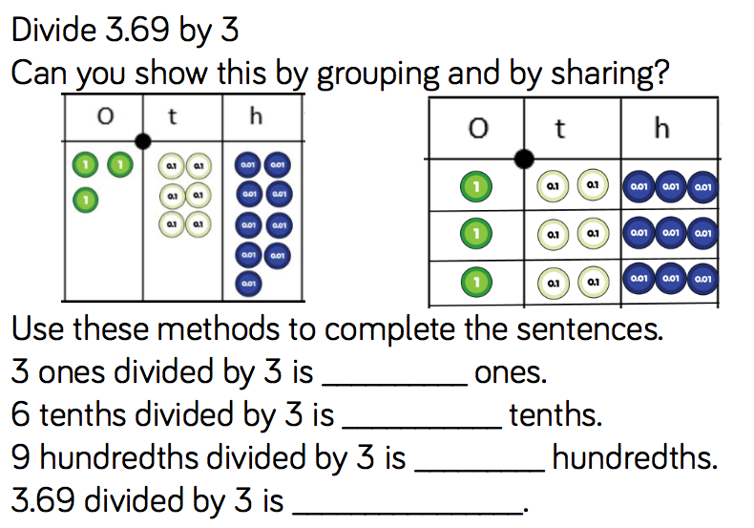
Fluency

Slide 35
Fluency

Slide 36
Fluency

Slide 37
Reasoning and problem solving

Slide 38
Reasoning and problem solving

Slide 39
Year 6 Spring Block 1
Decimals
NCLO: to use division to solve problems in cases where the answer has up to 2 decimal places

Slide 40
Key vocabulary and questions
How can we represent this problem using a bar model? How will we calculate what this item costs?
How will we use division to solve this?
How will we label our bar model to represent this?

Slide 41
Fluency

Slide 42
Fluency

Slide 43
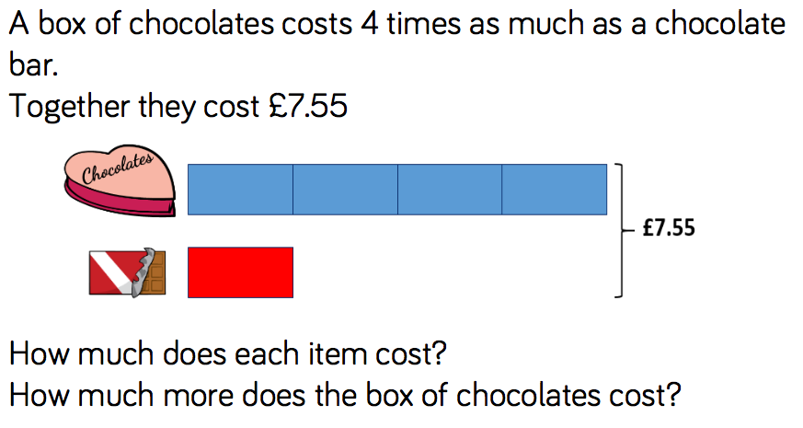
Fluency

Slide 44
Reasoning and problem solving

Slide 45
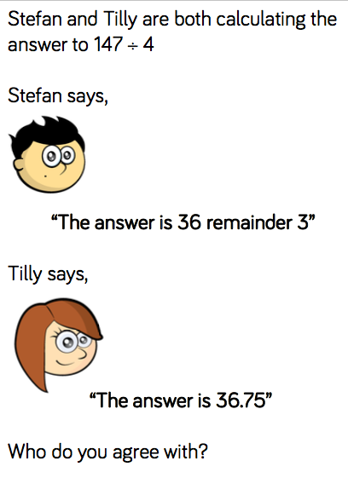
Reasoning and problem solving

Slide 46
Year 6 Spring Block 1
Decimals
NCLO: To use and understand fraction and decimal equivalences

Slide 47
Key vocabulary and questions
How would you record your answer as a decimal and a fraction? Can you simplify your answer?
How would you convert the tenths to hundredths?
What do you notice about the numbers that can be simplified in the table?
Can you have a unit fraction that is larger than 0.5? Why?

Slide 48
Fluency

Slide 49
Fluency

Slide 50
Fluency

Slide 51
Reasoning and problem solving

Slide 52
Reasoning and problem solving

Slide 53
Year 6 Spring Block 1
Decimals
NCLO: To use and understand fraction and decimal equivalences

Slide 54
Key vocabulary and questions
How many tenths are equivalent to one hundredth?
How would you convert a fraction to a decimal?
Which is the most efficient method? Why?

Slide 55
Fluency

Slide 56
Fluency

Slide 57
Fluency

Slide 58
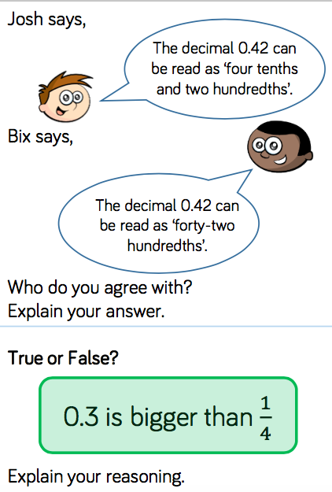
Reasoning and problem solving

Slide 59
Reasoning and problem solving

Slide 60
Reasoning and problem solving

Slide 61
Reasoning and problem solving

Slide 62
Year 6 Spring Block 1
Decimals
NCLO: To understand the relationship between fractions and division

Slide 63
Key vocabulary and questions
Do we divide the numerator by the denominator or divide the denominator by the numerator? Explain why.
^{When do we need to exchange?}
Are we grouping or are we sharing? Explain why.

Slide 64
Fluency

Slide 65
Fluency

Slide 66
Fluency

Slide 67
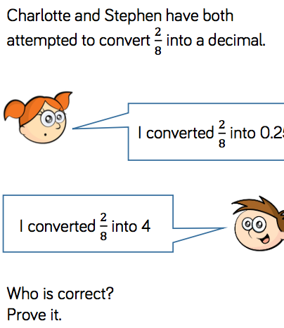
Reasoning and problem solving

Slide 68
Reasoning and problem solving

