Slide 1
Year 6 Spring Block 3
Algebra
NCLO: To generate and describe linear number sequences with one step.

Slide 2
Key vocabulary and questions

Slide 3
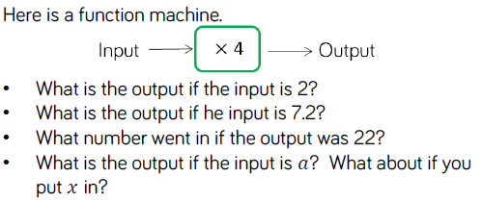
Fluency

Slide 4
Fluency

Slide 5
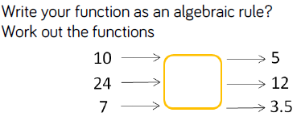
Fluency

Slide 6
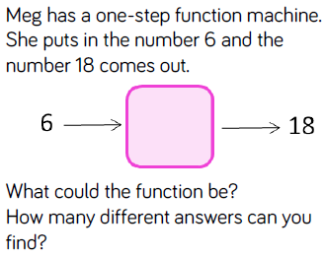
Reasoning and problem solving

Slide 7
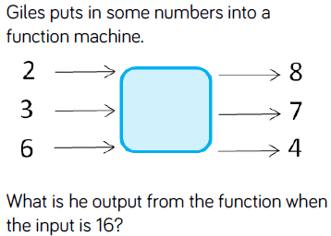
Reasoning and problem solving

Slide 8
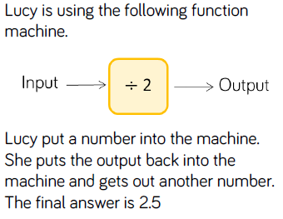
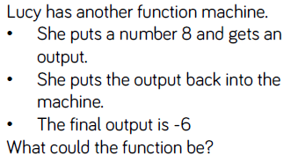
Reasoning and problem solving

Slide 9
Year 6 Spring Block 3
Algebra
NCLO: To generate and describe linear number sequences with two steps.

Slide 10
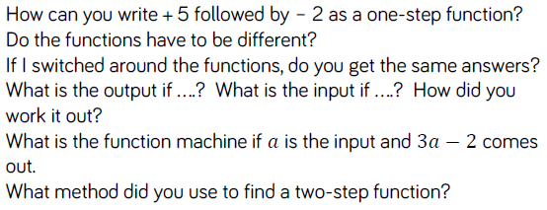
Key vocabulary and questions

Slide 11
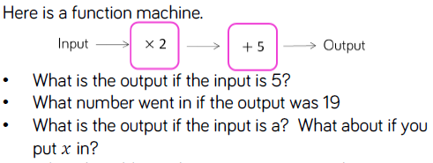
Fluency

Slide 12
Fluency

Slide 13
Fluency

Slide 14
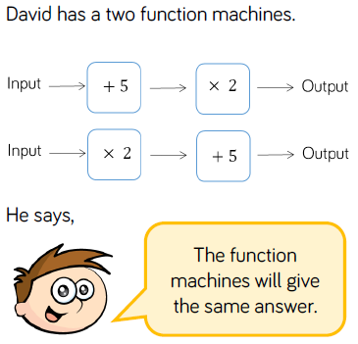
Reasoning and problem solving

Slide 15
Reasoning and problem solving

Slide 16
Year 6 Spring Block 3
Algebra
NCLO: To use simple formulae.

Slide 17
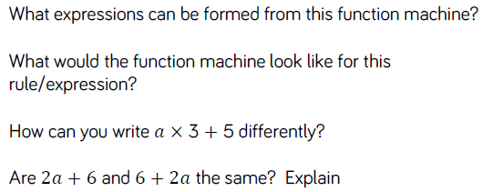
Key vocabulary and questions

Slide 18
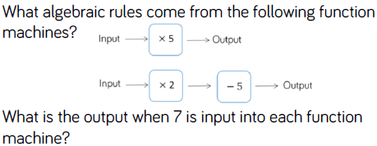
Fluency

Slide 19
Fluency

Slide 20
Fluency

Slide 21
Reasoning and problem solving

Slide 22
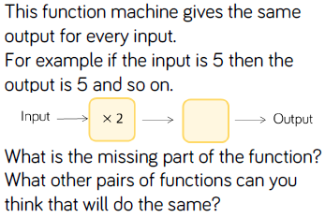
Reasoning and problem solving

Slide 23
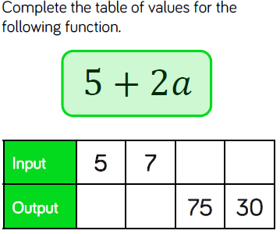
Reasoning and problem solving

Slide 24
Year 6 Spring Block 3
Algebra
NCLO: To use simple formulae and express missing number problems algebraically.

Slide 25
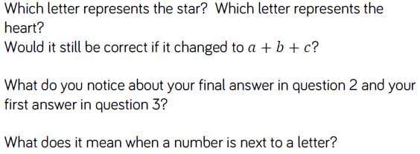
Key vocabulary and questions

Slide 26
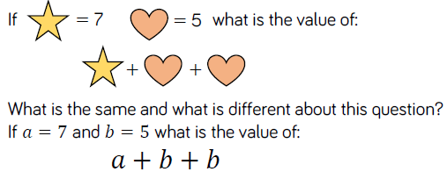
Fluency

Slide 27
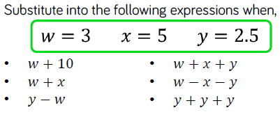
Fluency

Slide 28
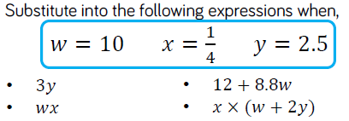
Fluency

Slide 29
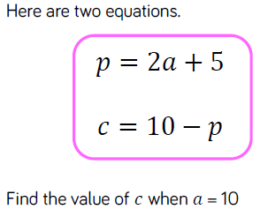
Reasoning and problem solving

Slide 30
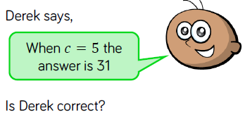
Reasoning and problem solving

Slide 31
Year 6 Spring Block 3
Algebra
NCLO: To express missing number problems algebraically.

Slide 32
Key vocabulary and questions

Slide 33
Fluency

Slide 34
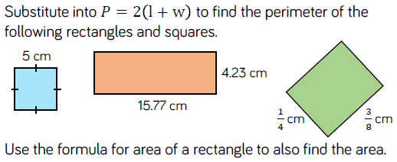
Fluency

Slide 35
Fluency

Slide 36
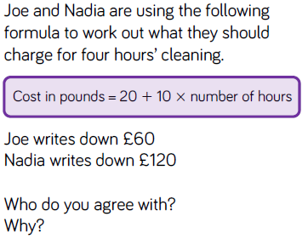
Reasoning and problem solving

Slide 37
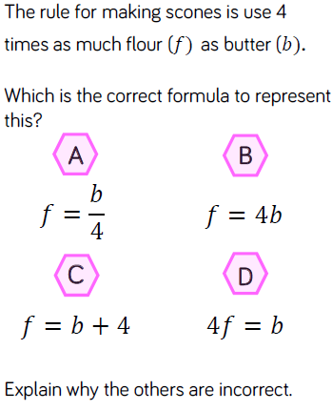
Reasoning and problem solving

