Slide 1
Year 6 Autumn Block 4
Geometry
NCLO: Describe positions in the first quadrant

Slide 2
Key vocabulary and questions
Quadrant
Co-ordinate
Axis
X axis
Y axis
Origin
Horizontal
Vertical

Slide 3
Key vocabulary and questions
Which axis do we look at first?
Does joining up the vertices already given help you to draw the shape?
Can you draw a shape in the first quadrant and describe the co-ordinates of the vertices to a friend?

Slide 4
Fluency

Slide 5
Fluency

Slide 6
Fluency

Slide 7
Reasoning and problem solving

Slide 8
Reasoning and problem solving

Slide 9
Year 6 Autumn Block 4
Geometry
NCLO: To describe positions on the full coordinate grid

Slide 10
Key vocabulary and questions
Quadrant
Co-ordinate
Axis
X axis
Y axis
Origin
Horizontal
Vertical

Slide 11
Key vocabulary and questions
Which axis do we look at first?
If (0, 0) is the centre of the axis (the origin), which way do you move on the x axis to find negative co-ordinates? Which way do you move on the y axis to find negative co-ordinates?

Slide 12
Fluency

Slide 13
Fluency

Slide 14
Fluency

Slide 15
Reasoning and problem solving

Slide 16
Reasoning and problem solving

Slide 17
Year 6 Autumn Block 4
Geometry
NCLO: To draw and translate simple shapes on the coordinate plane

Slide 18
Key vocabulary and questions
Translation
Vector
Vertex
Co-ordinate
Horizontal
Vertical

Slide 19
Key vocabulary and questions
What does translation mean?
Which point are you going to look at when describing the translation?
Does each vertex translate in the same way?

Slide 20
Fluency

Slide 21
Fluency

Slide 22
Reasoning and problem solving

Slide 23
Reasoning and problem solving

Slide 24
Year 6 Autumn Block 4
Geometry
NCLO: To reflect simple shapes in the axes

Slide 25
Key vocabulary and questions
Reflection
Transformations
Axes
Symmetry

Slide 26
Key vocabulary and questions
How is reflecting different to translating?
Can you reflect one vertex at a time? Does this make it easier to reflect the shape?

Slide 27
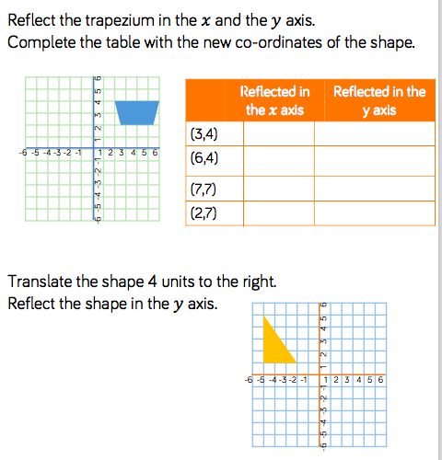
Fluency

Slide 28
Fluency

Slide 29
Reasoning and problem solving

Slide 30
Reasoning and problem solving

