Slide 1
Year 6 Spring Block 4 Converting Units
Metric Measures
NCLO: Solve problems involving the calculation and conversion of units of measure using decimal notation up to 3 decimal places.
To use read, write and convert between standard units, converting measurements of length, mass, volume and time from a smaller unit of measure to a larger unit and vice versa using decimal notation up to 3 decimal places.

Slide 2
Key vocabulary and questions

Slide 3
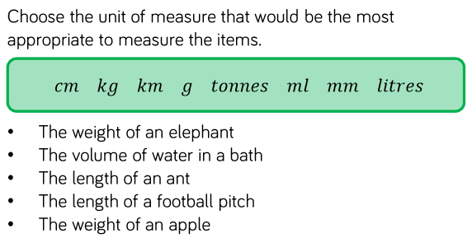
Fluency

Slide 4
Fluency

Slide 5
Fluency

Slide 6
Reasoning and problem solving

Slide 7
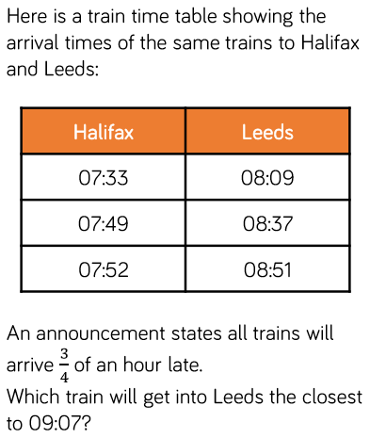
Reasoning and problem solving

Slide 8
Year 6 Spring Block 4 Converting Units
Convert Metric Measures
NCLO: Solve problems involving the calculation and conversion of units of measure using decimal notation up to 3 decimal places.
To use read, write and convert between standard units, converting measurements of length, mass, volume and time from a smaller unit of measure to a larger unit and vice versa using decimal notation up to 3 decimal places.

Slide 9
Key vocabulary and questions
Metric, convert

Slide 10
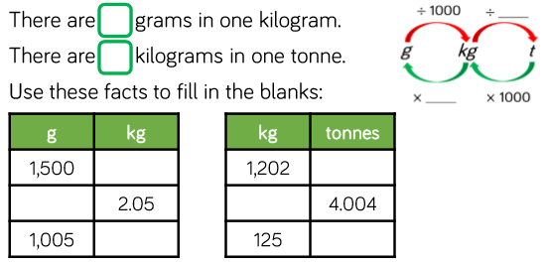
Fluency

Slide 11
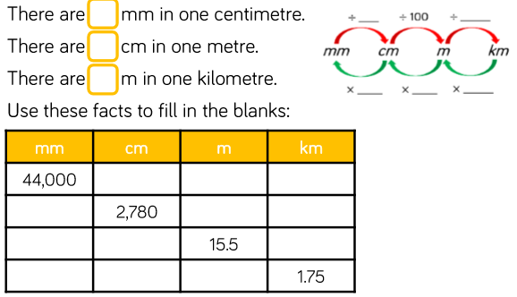
Fluency

Slide 12
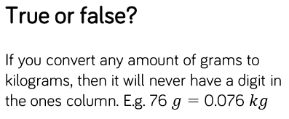
Reasoning and problem solving

Slide 13
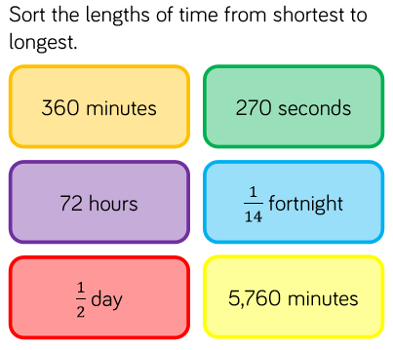
Reasoning and problem solving

Slide 14
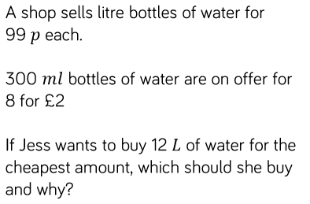
Reasoning and problem solving

Slide 15
Year 6 Spring Block 4 Converting Units
Calculate with metric measures
NCLO: Solve problems involving the calculation and conversion of units of measure using decimal notation up to 3 decimal places.
To use read, write and convert between standard units, converting measurements of length, mass, volume and time from a smaller unit of measure to a larger unit and vice versa using decimal notation up to 3 decimal places.

Slide 16
Key vocabulary and questions

Slide 17
Fluency

Slide 18
Fluency

Slide 19
Fluency

Slide 20
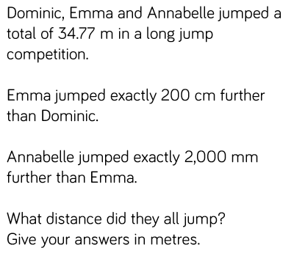
Reasoning and problem solving

Slide 21
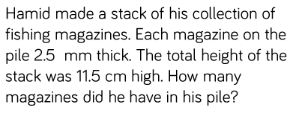
Reasoning and problem solving

Slide 22
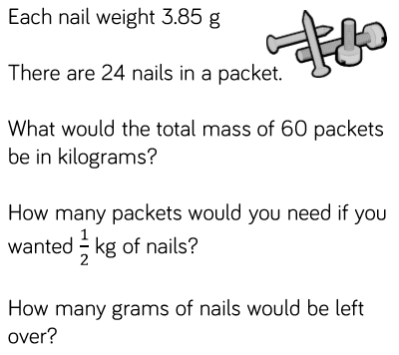
Reasoning and problem solving

Slide 23
Year 6 Spring Block 4 Converting Units
Miles and kilometres
NCLO: To convert between miles and kilometres.

Slide 24
Key vocabulary and questions
Miles, kilometres

Slide 25
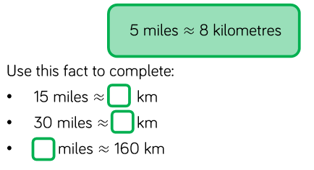
Fluency

Slide 26
Fluency

Slide 27
Fluency

Slide 28
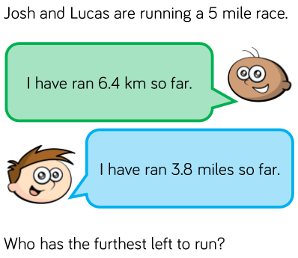
Reasoning and problem solving

Slide 29
Reasoning and problem solving

Slide 30
Year 6 Spring Block 4 Converting Units
Imperial Measures
NCLO: Solve problems involving the calculation and conversion of units of measure using decimal notation up to 3 decimal places.
To use read, write and convert between standard units, converting measurements of length, mass, volume and time from a smaller unit of measure to a larger unit and vice versa using decimal notation up to 3 decimal places.

Slide 31
Key vocabulary and questions
Imperial, metric, inch, foot, stone, pound, ounces, gallon, pint

Slide 32
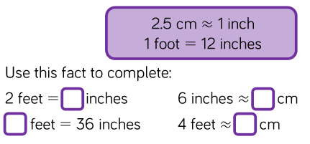
Fluency

Slide 33
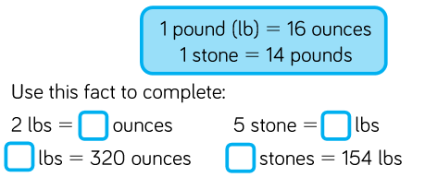
Fluency

Slide 34
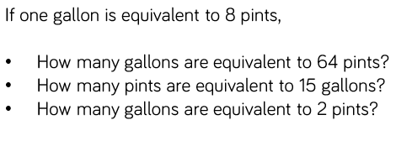
Fluency

Slide 35
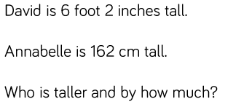
Reasoning and problem solving

Slide 36
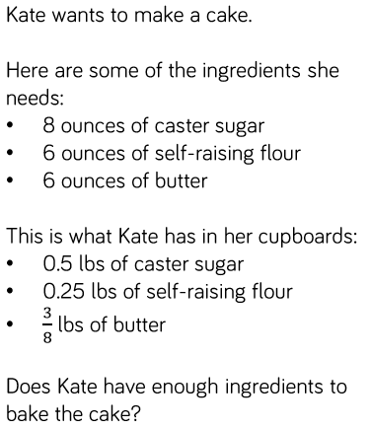
Reasoning and problem solving

