Slide 1
Year 6 Spring Block 5 Perimeter, area and volume
NCLO: I can calculate the area of a triangle

Slide 2
Key vocabulary and questions
What formula can you use to calculate the area of a triangle?
If there is more than one triangle making up a shape, how can we use the formula to find the area of the whole shape?
How do we know which length tells us the height of the triangle?

Slide 3
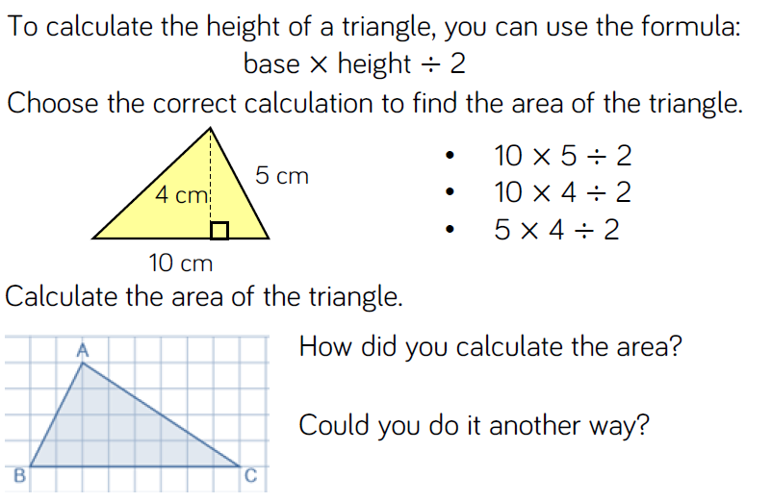
Fluency

Slide 4
Fluency

Slide 5
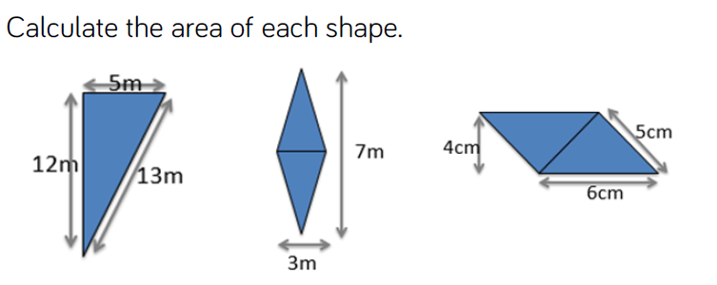
Fluency

Slide 6
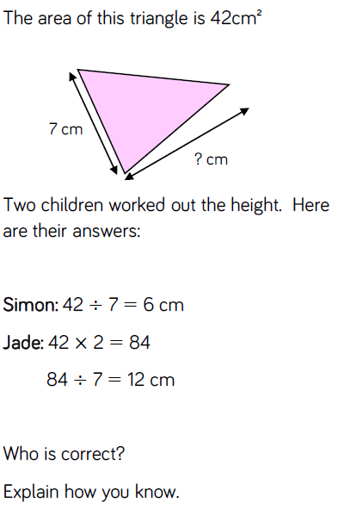
Reasoning and problem solving
Notes:
Children sorted into boys and girls.
Children sorted into wearing white, wearing red.
Children sorted into white shoes, non-white shoes.

Slide 7
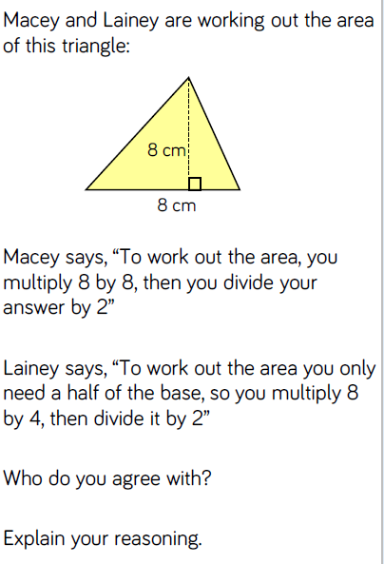
Reasoning and problem solving

Slide 8
Year 6 Spring Block 5 Perimeter, area and volume
NCLO: I can calculate the area of a parallelogram

Slide 9
Key vocabulary and questions
Can you make a rectangle and a parallelogram using a rectangle and two identical triangles?
Can you describe a parallelogram?
Can you make a parallelogram in to a rectangle?
What do you notice about the area of a rectangle and a parallelogram?

Slide 10
Fluency

Slide 11
Fluency

Slide 12
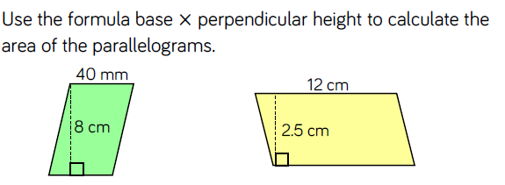
Fluency

Slide 13
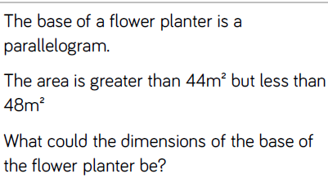
Reasoning and problem solving
Notes:
Children sorted into boys and girls.
Children sorted into wearing white, wearing red.
Children sorted into white shoes, non-white shoes.

Slide 14
Reasoning and problem solving

Slide 15
Year 6 Spring Block 5 Perimeter, area and volume
NCLO: I can find volume by counting cubes

Slide 16
Key vocabulary and questions
What’s the same and what’s different between area and volume?
Can you explain how you worked out the volume?
What did you visualise?

Slide 17
Fluency

Slide 18
Fluency

Slide 19
Fluency
If one multilink cube = one cubic unit, make as many models as you can with 12 cubic units.

Slide 20
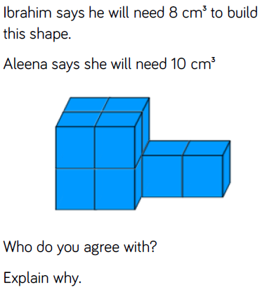
Reasoning and problem solving

Slide 21
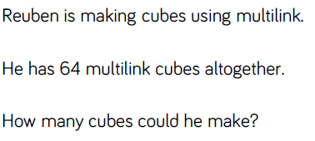
Reasoning and problem solving

Slide 22
Year 6 Spring Block 5 Perimeter, area and volume
NCLO: I can find the volume of a cuboid

Slide 23
Key vocabulary and questions
Can you identify the length, width and height of the cuboid?
If the length of a cuboid is 5 cm and the volume is 100 cm³, what could the width and height of the cuboid be? What knowledge can I use to help me calculate the missing lengths?

Slide 24
Fluency

Slide 25
Fluency

Slide 26
Fluency

Slide 27
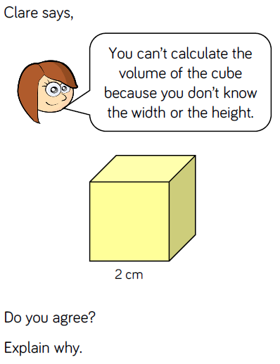
Reasoning and problem solving
Notes:
Children sorted into boys and girls.
Children sorted into wearing white, wearing red.
Children sorted into white shoes, non-white shoes.

Slide 28
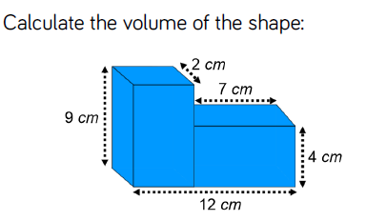
Reasoning and problem solving

Slide 29
Reasoning and problem solving

