Slide 1
Year 1 Spring Block 4 Weight and Volume
Introduce weight and mass
NCLO: To Compare, describe and solve
practical problems for mass/weight:
[for example, heavy/light, heavier
than, lighter than].

Slide 2
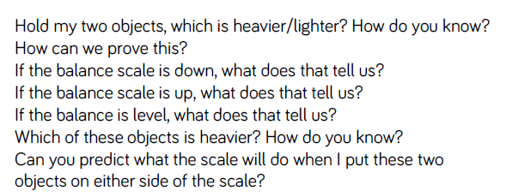
Key vocabulary and questions
Weight, mass, balance scales, comparing, heavier, lighter, the same, equal, stem sentence.

Slide 3
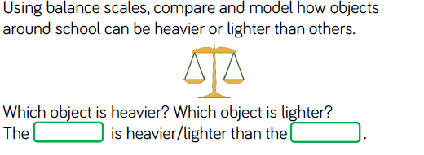
Fluency

Slide 4
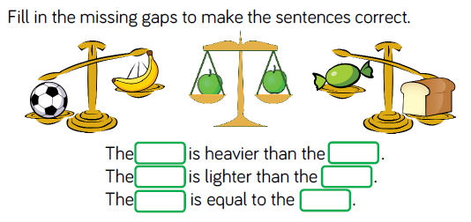
Fluency

Slide 5
Fluency

Slide 6
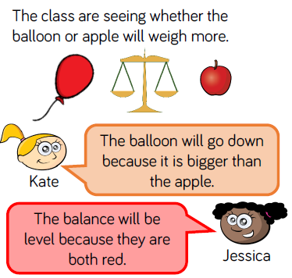
Reasoning and problem solving
Notes:
Children sorted into boys and girls.
Children sorted into wearing white, wearing red.
Children sorted into white shoes, non-white shoes.

Slide 7
Reasoning and problem solving

Slide 8
Year 1 Spring Block 4 Weight and Volume
Measure mass
NCLO: Measure and begin to record
mass/weight.

Slide 9
Key vocabulary and questions
non-standard units (e.g. cubes, bricks) ,weigh, compare, mass, weight, object, measure, balance scales, equals, same, heavier, lighter.
When the scales are balanced, what does this mean? Can anyone think of any symbols we use in maths that are similar?
If I add one more cube to this side, what will happen?
How do you know? What if I take a cube away?
What other objects could we use to weigh the mass of something?
Which object do you predict will be heavier?

Slide 10
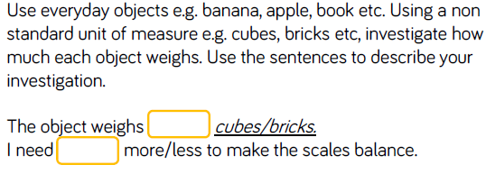
Fluency

Slide 11
Fluency

Slide 12
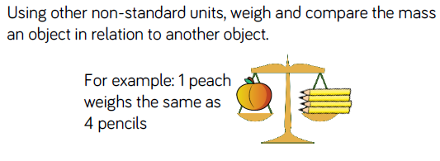
Fluency

Slide 13
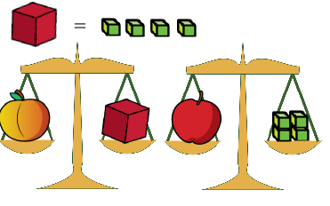
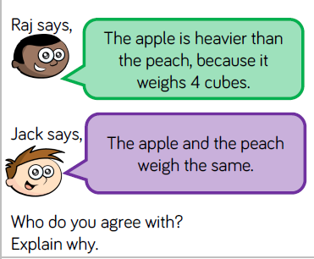
Reasoning and problem solving

Slide 14
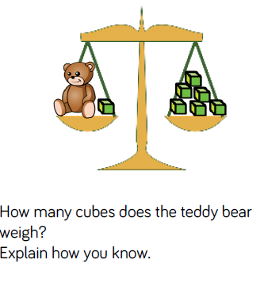
Reasoning and problem solving

Slide 15
Year 1 Spring Block 4 Weight and Volume
Compare mass
NCLO: To Compare mass/weight:
[for example, heavy/light, heavier
than, lighter than].

Slide 16
Key vocabulary and questions
non-standard units, weigh, objects and now focus compare, mass, balance scales, heavier, lighter, equal,< ,>.
How many cubes weigh the same as _______? Which object is heavier? Which object is lighter?
Which object do you predict will be heavier/lighter?
Can we order the objects from heaviest to largest?
Can I weigh this object with cubes and this object with bricks and order them? Explain why.

Slide 17
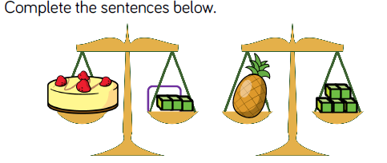
Fluency

Slide 18
Fluency

Slide 19
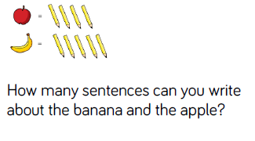
Reasoning and problem solving

Slide 20
Reasoning and problem solving

Slide 21
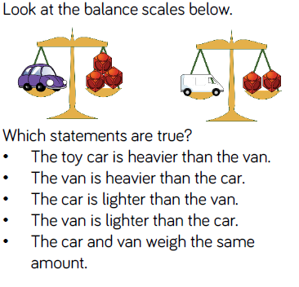
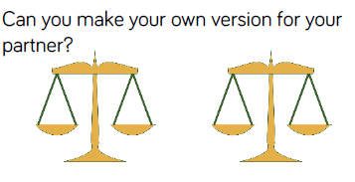
Reasoning and problem solving
Extension

Slide 22
Year 1 Spring Block 4 Weight and Volume
Introduce capacity
NCLO: To Compare, describe and solve
practical problems for capacity and
volume [for example, full/empty,
more than, less than, half, half full,
quarter]

Slide 23
Key vocabulary and questions
Capacity, containers, compare, full, empty, greater than ,less than, equal ,volume, stem sentence
Look at my bottle, is it full? Is it empty?
Compare my two bottles, which has more liquid in? Which has less?
How can we show the container is nearly full or nearly empty?
What’s the same? What’s different? If the container is different can we compare the volume easily? Why?

Slide 24
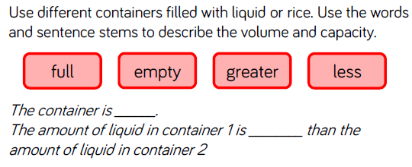
Fluency

Slide 25
Fluency

Slide 26
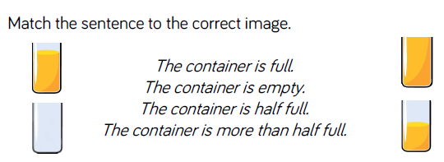
Fluency

Slide 27
Reasoning and problem solving

Slide 28
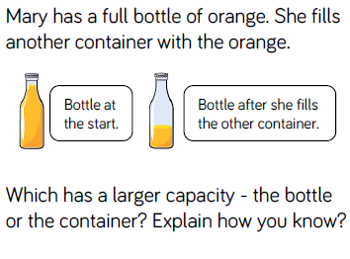
Reasoning and problem solving

Slide 29
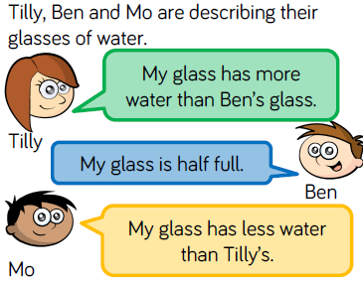
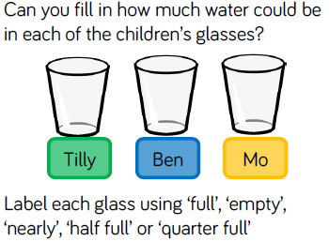
Reasoning and problem solving

Slide 30
Year 1 Spring Block 4 Weight and Volume
Measure capacity
NCLO: To measure and begin to record capacity and volume.

Slide 31
Key vocabulary and questions
Capacity, different, containers, non standard units, measure, same ,difference, volume, liquid
How can we measure how much liquid will fill my container?
What could I use?
Can I start measuring the capacity with a spoon and then switch to a jug? Why not?
How many bowls of liquid fill the bottle?
How many cups of liquid are in the bottle?
How is this different? How is this the same?

Slide 32
Fluency

Slide 33
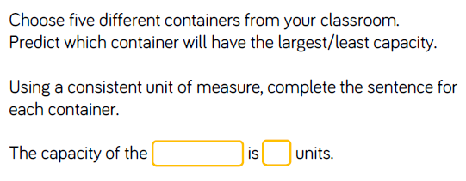
Fluency

Slide 34
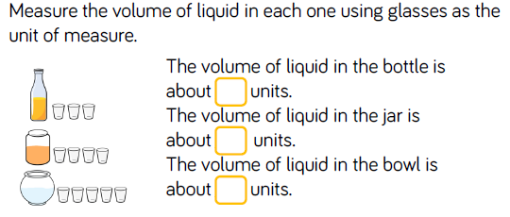
Fluency

Slide 35
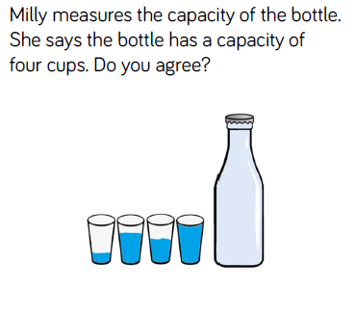
Reasoning and problem solving

Slide 36
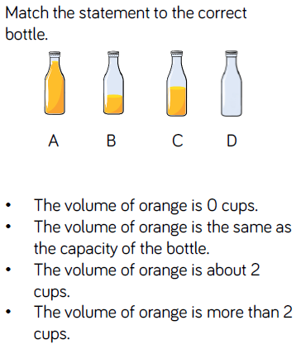
Reasoning and problem solving

Slide 37
Year 1 Spring Block 4 Weight and Volume
Compare Capacity
NCLO: To compare, describe and solve
practical problems for capacity and
volume [for example, full/empty,
more than, less than, half, half full,
quarter].

Slide 38
Key vocabulary and questions
Compare, capacity , different containers, non standard units of measure,more, less, equal, volume ,symbols <, > ,=.
Which container has the largest/smallest capacity?
Can we order them from largest to smallest?
Which container has the most or least volume?
Look at these two containers, can we compare them?
Can we show A has more than B but less than C?

Slide 39
Fluency

Slide 40
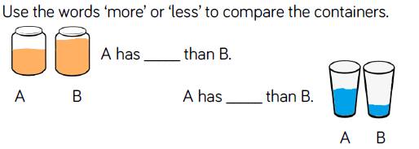
Fluency

Slide 41
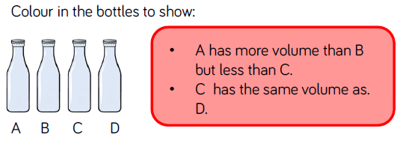
Fluency

Slide 42
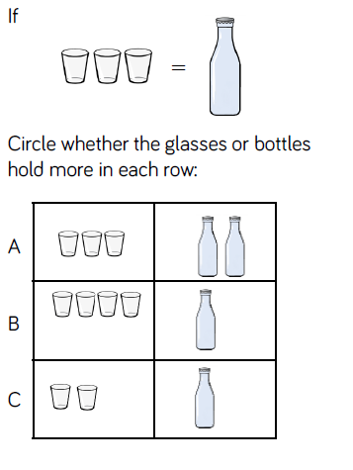
Reasoning and problem solving

Slide 43
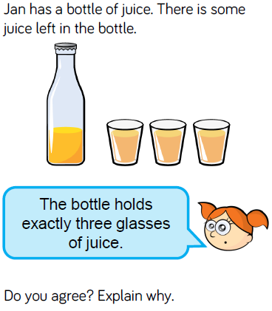
Reasoning and problem solving

