Slide 1
Year 1 SPAG
Spaces between words
NCLO: Leaving spaces between words

Slide 2
Spaces between words
Sentences are made up of words and finger spaces.

Slide 3
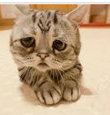
Can they say where the words should be separated?
Look at this sentence. Read it out loud to the children. Does it make sense?
Thecatissad

Slide 4
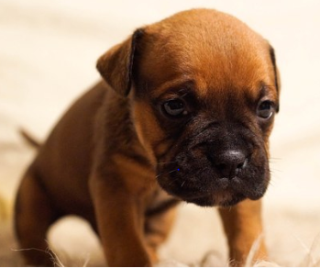
Can they say where the words should be separated?
Look at this sentence. Read it out loud to the children. Does it make sense?
Thedogissad

Slide 5
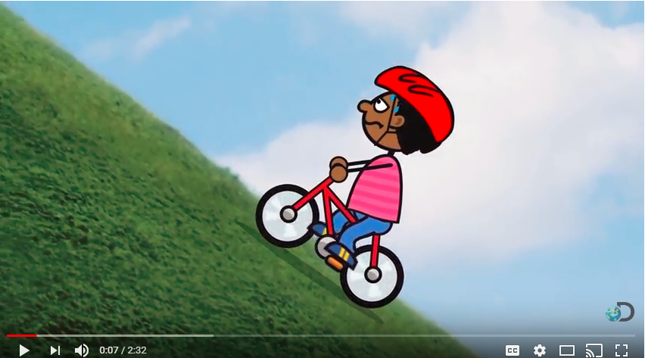
Finger spaces clip

Slide 6
Your Turn
Look at the sentence below. Can you re-write it using finger spaces?
Ihadarat

Slide 7
Look at the three sentences again. Can you put finger spaces, capital letters and full-stops in all 3 sentences?
Finger Space Doctor

Slide 8
Check

