Slide 1
Year 1 SPAG
Using capital letters
NCLO: Use capital letters for names of people, places , the days of the week and the personal pronoun “I”.

Slide 2
Using capital letters
We can use capital letters for names of people, places and days of the week.
We always use a capital letter for I

Slide 3
What do capital letters look like?
BIG AND SMALL LETTERS SONG

Slide 4
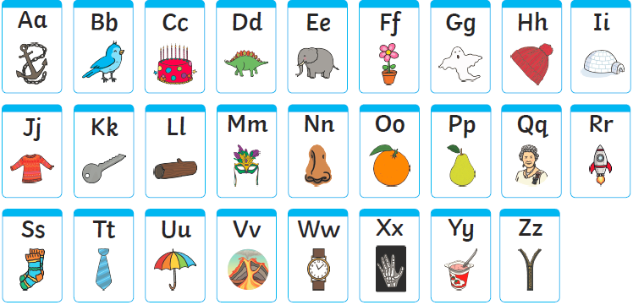
Can you write some?
What do capital letters look like?

Slide 5
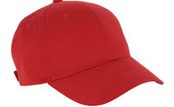
Capital letters.
Look at these sentences. Can you put the capital letters in the right place?
Can you mime putting a cap
On each time you need a capital letter?
i am five years old.
on friday, we play football.
my favourite city is london, the capital of england.

Slide 6
Your turn - dead common or nice and proper?
Look at these words. Do they need capital letters?
Can you sort the nouns into groups?
bear
i
archie
thames
dog
sophie
chair
school
hat
mrs
monday

Slide 7
Your turn Capital letters.
Look at these sentences. Can you write some of your own using the alphabet?
A is for Archie an amiable ant.
B is for Bertie a beautiful bear.
C is for Catherine a clever cat.

