Slide 1
Year 1 SPAG
Plurals adding s or -es
NCLO: Use s or –es at the end of nouns to make them plural

Slide 2
Using s and -es
We can add s or –es to naming words when we mean more than one.

Slide 3
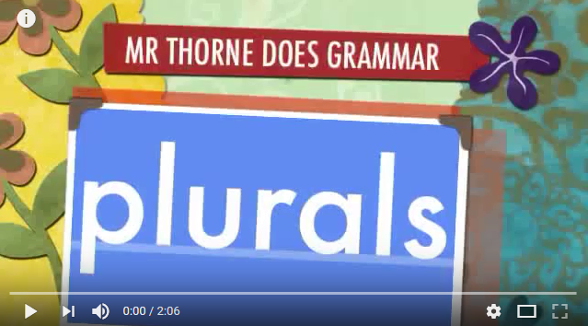
Video clip

Slide 4
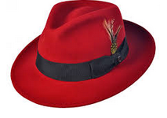
Adding s or -es
One is singular. More than one is plural.
We ad s to naming words when we mean more than one.
one hat
two hats

Slide 5
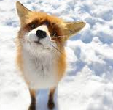
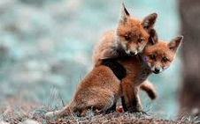
Adding s or -es
One is singular. More than one is plural.
If a naming word ends in
ch sh s or x we add es.
One match
Three matches
One fox
Two foxes

Slide 6
Your turn - Look at the words. Make the plural words.
Remember if it ends in ch sh s or x we add es.
glass + es =
bus + es =
watch + es =
fox + es =
dress + es =
torch + es =

Slide 7
Your turn add s or -es
snail =
spider =
box =
bench =
kiss =
bush =

