Slide 1
Year 1 SPAG
Using and
NCLO: Use and to join words and sentences.

Slide 2
Using and
We can use the word and to join two phrases or two separate sentences together.

Slide 3
Can you clap the number of words ?
What is a sentence?
Show the children the sentence and count the words notice the finger spaces, capital letter and full-stop.
I went to the zoo.

Slide 4
Read the two sentences. Can you add and?
I went to the zoo.
I saw a lion and a penguin.

Slide 5
Two sentences become one.
I went to the zoo and I saw a lion and a penguin.

Slide 6
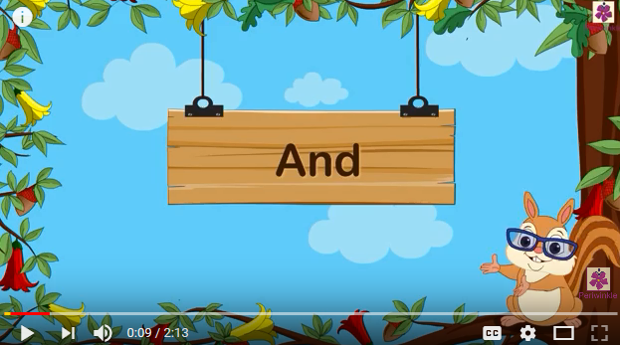
Using and video clip

Slide 7
Your Turn
Look at the sentences below. Can you join them together using and?
I went to the zoo. I saw a kangaroo and a parrot.
I went to the zoo. I saw a tiger and a panda.
I went to the zoo. I saw a zebra and a hippo.

Slide 8
Check
Look at the sentences below. Did you add and correctly?
I went to the zoo and I saw a kangaroo and a parrot.
I went to the zoo and I saw a tiger and a panda.
I went to the zoo and I saw a zebra and a hippo.

Slide 9
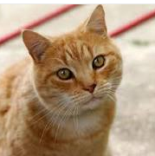
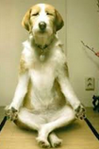
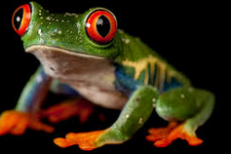
Silly Sentences
Look at the sentences below. Can you join make some silly sentences using and?
The cat ate my sock. The dog sneezed.
My frog eats flies. My cat rides a bike.
A monkey flies to the moon. A dog does yoga.

Slide 10
Silly Sentences - check
Did you make some silly sentences?
The cat ate my sock and the dog sneezed.
My frog eats flies and my cat rides a bike.
A monkey flies to the moon and a dog does yoga.

