Slide 1
Year 4 Autumn Block 1 Place Value
Roman Numerals
NCLO:

Slide 2
Key vocabulary and questions
Why is there no zero in the Roman numerals?
What might it look like?
Do you notice any patterns?
If 20 is XX what might 200 be?
How can you check you have represented the Roman numeral correctly?

Slide 3
Fluency

Slide 4
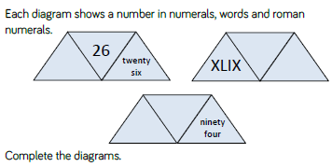
Fluency

Slide 5
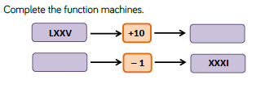
Fluency

Slide 6
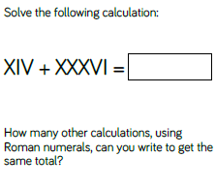
Reasoning and problem solving

Slide 7
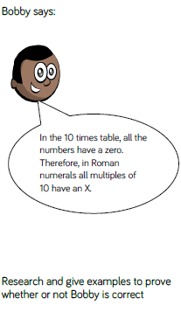
Reasoning and problem solving

Slide 8
Year 4 Autumn Block 1 Place Value
Round to the nearest 10
NCLO: To round any number to the nearest 10, 100, or 1000

Slide 9
Key vocabulary and questions
Place value, digit
Which column do we look at when rounding to the nearest 10?
What is a multiple of 10?
Which multiples of 10 does this number sit between?
Which number is being represented?
Will it round up or down? Why?

Slide 10
Fluency

Slide 11
Fluency

Slide 12
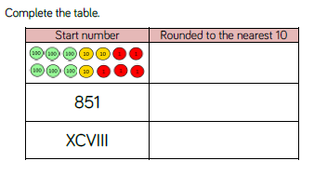
Fluency

Slide 13
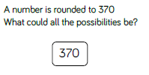
Reasoning and problem solving

Slide 14
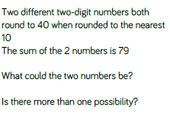
Reasoning and problem solving

Slide 15
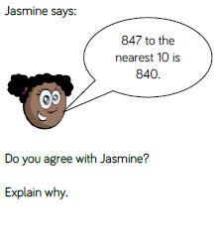
Reasoning and problem solving

Slide 16
Year 4 Autumn Block 1 Place Value
Round to the nearest 100
NCLO: To round any number to the nearest 100.

Slide 17
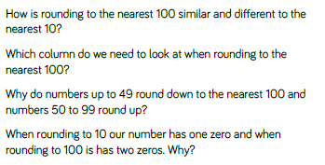
Key vocabulary and questions
Place value, digit

Slide 18
Fluency

Slide 19
Fluency

Slide 20
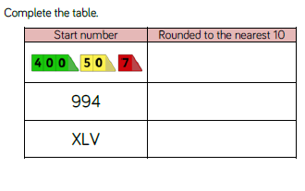
Fluency

Slide 21
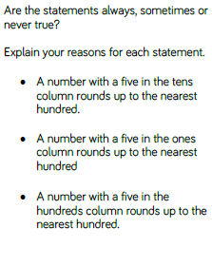
Reasoning and problem solving

Slide 22
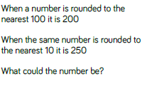
Reasoning and problem solving

Slide 23
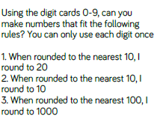
Reasoning and problem solving

Slide 24
Year 4 Autumn Block 1 Place Value
Count in 1,000s
NCLO: To find 1,000 more or less than a given number.

Slide 25
Key vocabulary and questions

Slide 26
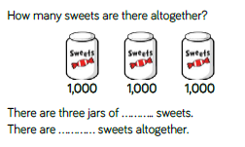
Fluency

Slide 27
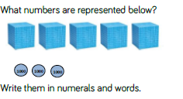
Fluency

Slide 28
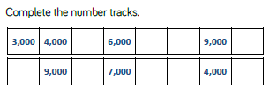
Fluency

Slide 29
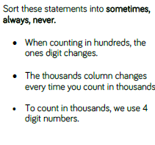
Reasoning and problem solving

Slide 30
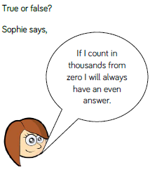
Reasoning and problem solving

Slide 31
Year 4 Autumn Block 1 Place Value
1,000s, 100s, 10s, 1s
NCLO: To recognise the place value of each digit in a four digit number (thousands, hundreds, tens and ones).

Slide 32
Key vocabulary and questions

Slide 33
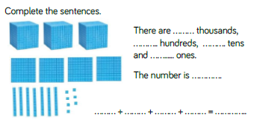
Fluency

Slide 34
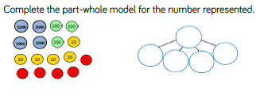
Fluency

Slide 35
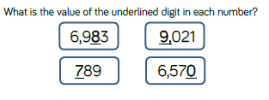
Fluency

Slide 36
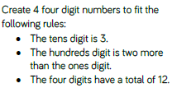
Reasoning and problem solving

Slide 37
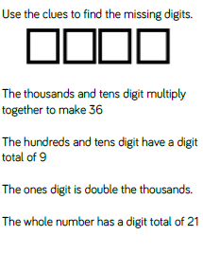
Reasoning and problem solving

Slide 38
Year 4 Autumn Block 1 Place Value
Partitioning
NCLO: To recognise the place value of each digit in a four digit number (thousands, hundreds, tens and ones).

Slide 39
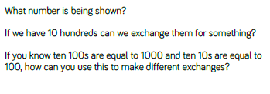
Key vocabulary and questions

Slide 40
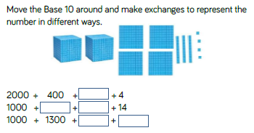
Fluency

Slide 41
Fluency

Slide 42
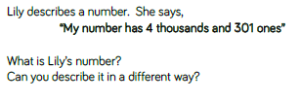
Fluency

Slide 43
Reasoning and problem solving

Slide 44
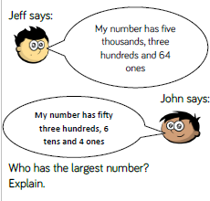
Reasoning and problem solving

Slide 45
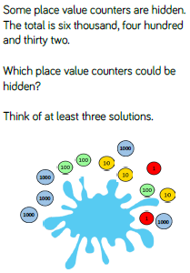
Reasoning and problem solving

Slide 46
Year 4 Autumn Block 1 Place Value
Number Line to 10,000
NCLO: To order and compare numbers beyond 1,000.

Slide 47
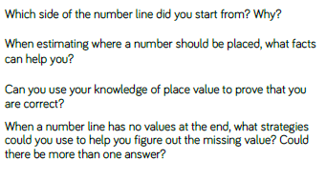
Key vocabulary and questions

Slide 48
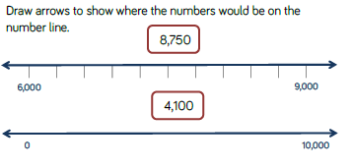
Fluency

Slide 49
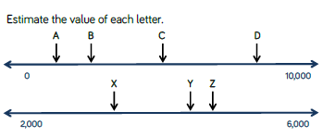
Fluency

Slide 50
Fluency

Slide 51
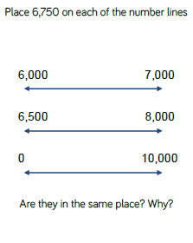
Reasoning and problem solving

Slide 52
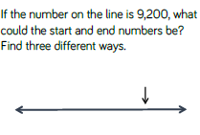
Reasoning and problem solving

Slide 53
Year 4 Autumn Block 1 Place Value
1,000 more or less
NCLO: To find 1,000 more or less than a given number.

Slide 54
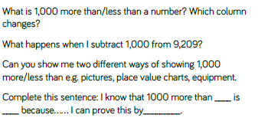
Key vocabulary and questions

Slide 55
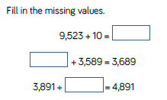
Fluency

Slide 56
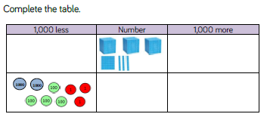
Fluency

Slide 57
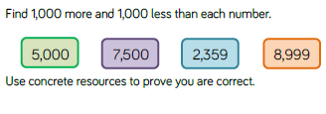
Fluency

Slide 58
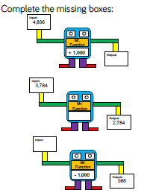
Reasoning and problem solving

Slide 59
Reasoning and problem solving

Slide 60
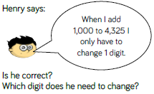
Reasoning and problem solving

Slide 61
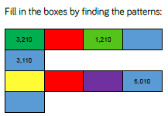
Reasoning and problem solving

Slide 62
Year 4 Autumn Block 1 Place Value
Compare 4-digit Numbers
NCLO: To order and compare numbers beyond 1,000

Slide 63
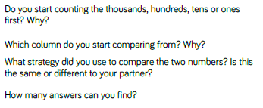
Key vocabulary and questions

Slide 64
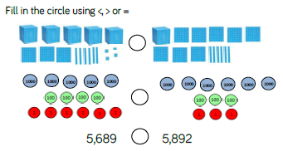
Fluency

Slide 65
Fluency

Slide 66
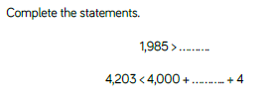
Fluency

Slide 67
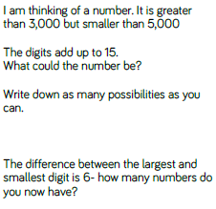
Reasoning and problem solving

Slide 68
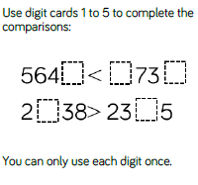
Reasoning and problem solving

Slide 69
Year 4 Autumn Block 1 Place Value
Ordering Numbers
NCLO: To order and compare numbers beyond 1,000.

Slide 70
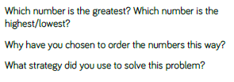
Key vocabulary and questions

Slide 71
Fluency

Slide 72
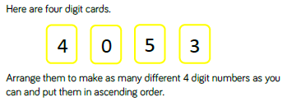
Fluency

Slide 73
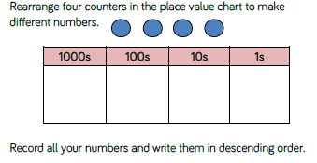
Fluency

Slide 74
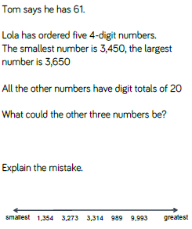
Reasoning and problem solving

Slide 75
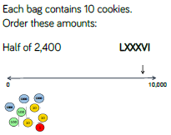
Reasoning and problem solving

Slide 76
Reasoning and problem solving

Slide 77
Year 4 Autumn Block 1 Place Value
Round to the nearest 1,000
NCLO: To round to the nearest 1000.

Slide 78
Key vocabulary and questions

Slide 79
Fluency

Slide 80
Fluency

Slide 81
Fluency

Slide 82
Reasoning and problem solving

Slide 83
Reasoning and problem solving

Slide 84
Year 4 Autumn Block 1 Place Value
Count in 25s
NCLO: To count in multiples of 25.

Slide 85
Key vocabulary and questions

Slide 86
Fluency

Slide 87
Fluency

Slide 88
Fluency

Slide 89
Reasoning and problem solving

Slide 90
Reasoning and problem solving

Slide 91
Reasoning and problem solving

Slide 92
Year 4 Autumn Block 1 Place Value
Negative Numbers
NCLO: To count backwards through zero to include negative numbers.

Slide 93
Key vocabulary and questions

Slide 94
Fluency

Slide 95
Fluency

Slide 96
Fluency

Slide 97
Reasoning and problem solving

Slide 98
Reasoning and problem solving

Slide 99
Reasoning and problem solving
Anna I counting down from 11 in fives.
Does she say -11?
Prove it.

