Slide 1
Year 2 SPAG
NCLO: Be able to use the present and past tenses correctly and consistently, including the progressive form.

Slide 2
The present tense tells us something that is true at this point in time.
The past tense tells us about something that finished in the past.
The verbs in the sentence tell us the tense it is written in.

Slide 3
Present tense ( regular verbs have no suffix or have –s or –es added)
I like milk.
Grandma enjoys watching television.
Mary brushes her hair.
We see the tigers in the cage.

Slide 4
Past tense (regular verbs end in the suffix –ed and many irregular verbs do not.)
The little girl smiled.
The children played on the slide.
We cooked the chicken in the oven.
He ate fish and chips for tea.
Tom cried when he fell over.

Slide 5
The present progressive and the past progressive tense are used for actions that continue for a period of time in the present or the past. They end in the –ing form of the verb.

Slide 6
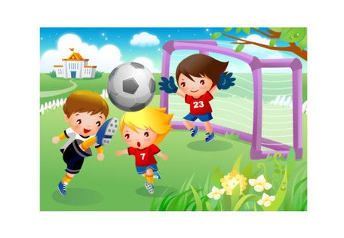
The present progressive The children are reading their books.
The past progressive. We were playing football.

Slide 7
What are they doing now? Write the present progressive form of the verbs.
1: Mum is ________ a cup of tea. (drink)
2:The cows are _______ over the fence. (jump)
3The baby is ________. (cry)

Slide 8
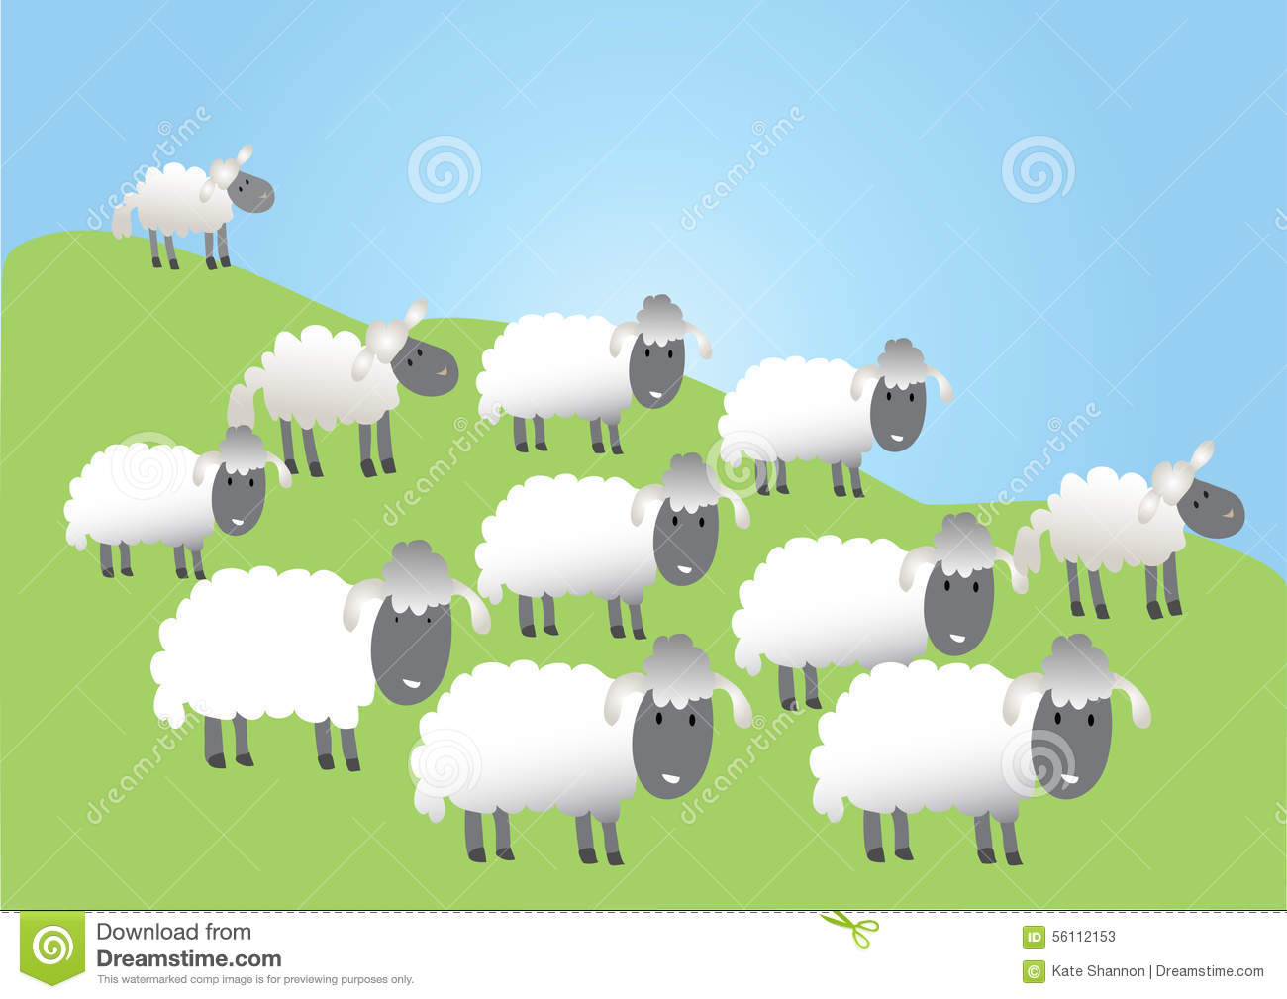
What were they doing before ? Write the past progressive form of the verbs.
1:We were ___________ football. (play)
2:She was ________ in the bed. (sleep)
3:The sheep were ____ in the field. (graze)

