Slide 1
Year 2 SPAG
NCLO: Be able to use suffixes in adjectives
Adding –y to –er and -est

Slide 2
Adding –y to –er and -est
For words ending in –y, change the y to I and add –er or –est
funny→funnier→funniest

Slide 3
Copy the table. Add –er or –est to change the root word.
Root word | Add -er | Add -est
cloudy
happy
bossy
merry
pretty

Slide 4
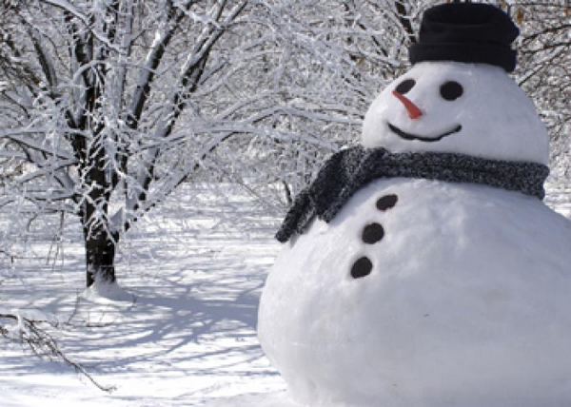
Copy and complete the sentences
1: The pantomime was the _____I had ever seen. (funny)
2: It is _______ today than it was yesterday. (chilly)
3: Fred’s bicycle is the ________in the street. (shiny)
4: Mum says I have the _______socks in the world. (smelly)

