Slide 1
Year 2 SPAG
NCLO: Be able to use suffixes to form adjectives
Adding –y

Slide 2
Adding -y
Most words just add -y
sleep→sleepy
For words ending in –e, take off the final –e and add –y.
laze→lazy
After a short vowel sound, double the final letter and add –y
fur→furry

Slide 3
Add –y to each word, and write the new words
chill grump noise bend fun shine icy nut mess run grease snap

Slide 4
Copy and complete the sentences using the new words.
1: The car skidded on the ________road.
2: The _________man shouted at the children.
3: The boys were asked to tidy their ________room.
4:The film was very _____________.

Slide 5
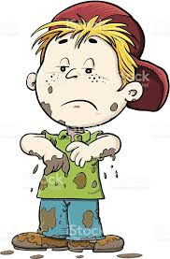
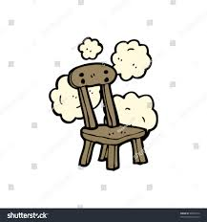
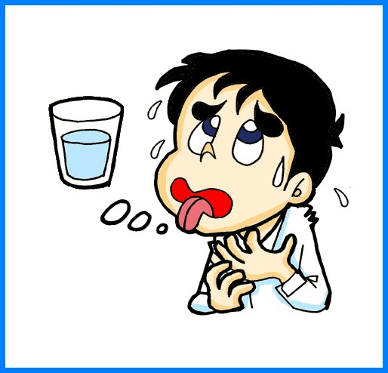
Now try this
Read the clues and write the words.
1:covered in wet, sticky earth m____________y
2:covered with dust d_____________y
3:a ball is this b_____________y
4:reddish-pink in colour r_____________y
5:needing a drink th____________y

