Slide 1
Year 2 SPAG
Co-ordination - using or, and or but.
NCLO: Using or, and or but to join two ideas together in a sentence.

Slide 2
Co-ordination using or, and or but
Co-ordination gives equal attention to two items. Both parts of the sentence could stand alone but we join them choosing the correct word.

Slide 3
Co-ordination using or, and, but
Here are some examples of using co-ordination. Can you circle the co-ordinate in each sentence?
We were going to the park today but it was raining.
I broke my glasses and now I have to buy a new pair.
Would you like fish and chips or a jacket potato for lunch?

Slide 4
Conjunction Junction video clip
https://www.youtube.com/watch?v=4AyjKgz9tKg

Slide 5
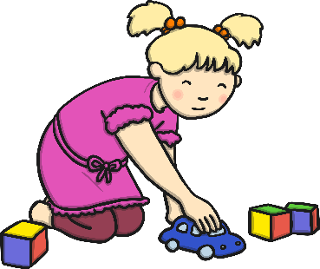
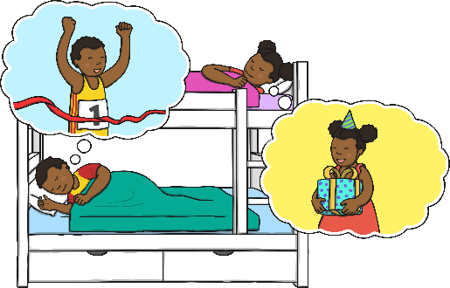
Co-ordination using or, and, but
Can you look at these pictures and write a sentence using and in it? The first one has been done for you.
The girl is playing with the car and the blocks.

Slide 6
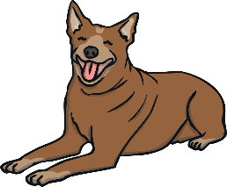
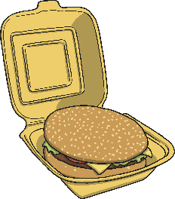
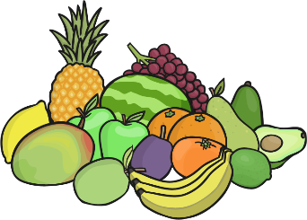
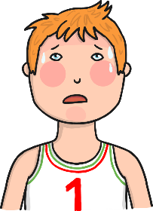
Co-ordination using or, and, but
Can you look at these pictures and write a question using or in it? The first one has been done for you.
Would you rather be a cat or a dog?

Slide 7
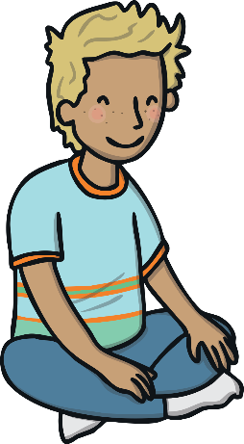
Co-ordination using or, and, but
Can you think of a silly sentence saying why you haven't done something. Look at the example below to help you.
e.g. I was going to do my homework, but then my dog ate my activity sheet!

Slide 8
Your turn - or and or but?
Choose the correct co-ordination to join the sentence together.
I was going to come to your party ____ I was ill.
Do you want to go to the beach __ the park?
I would like to be a dentist ____ a doctor when I grow up.
He rode his scooter ____ carried his school bag.
I

