Slide 1
Year 3 SPAG
Direct Speech
NCLO: Using and punctuating direct speech

Slide 2
Inverted Commas
Inverted commas, or speech marks, (“ ” and ‘ ’) show when people are actually speaking. When people’s exact words are written down in this way, this is called direct speech.

Slide 3
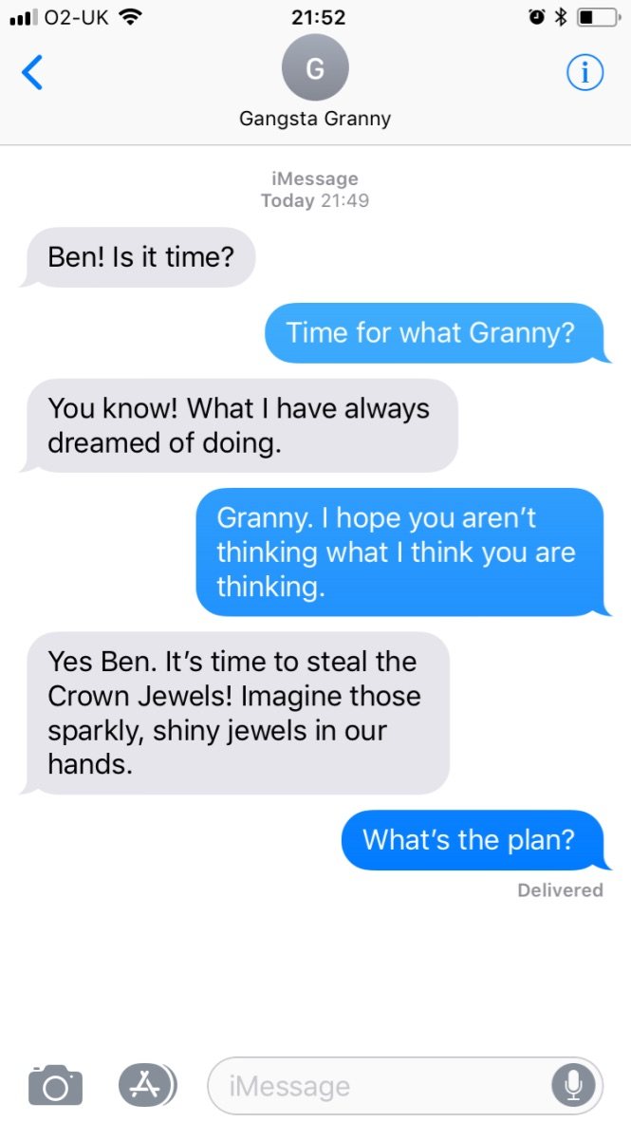
How would we write this as direct speech in a piece of narrative writing?
Look at this conversation between Gangsta Granny and her Grandson Ben.

Slide 5
As a class can we finish writing the conversation as direct speech below?
Trying hard to contain her excitement, Granny asked Ben, “Ben! Is it time?’
“Time for what Granny?” replied Ben.

Slide 6
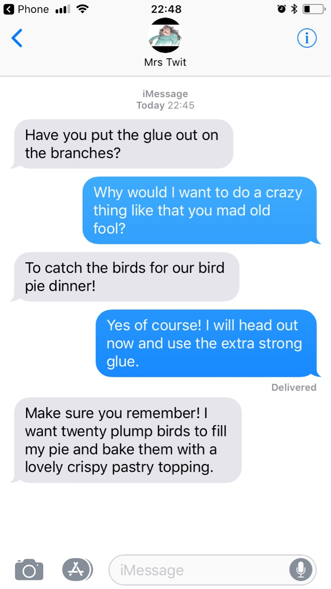
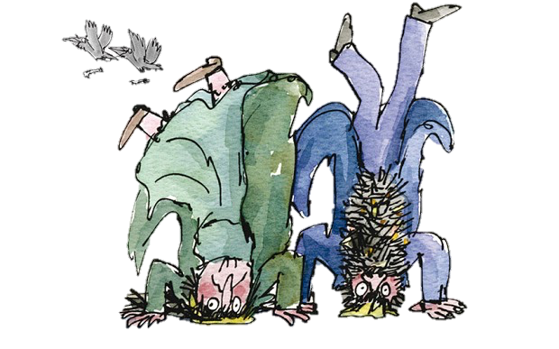
Your Turn
Look at the conversation between Mr and Mrs Twit. Can you write this as direct speech using correct punctuation?

Slide 7
Look at the piece of writing below. It contains some direct speech but hasn’t been punctuated. Can you put the punctuation in the correct places?
Direct Speech Doctor
Once upon a time there was a little girl and a little boy went to stay with their Grandma. Last thing at night, Grandma said goodnight, children, gave them a kiss, turned out the light, and closed the door. But the children said it’s too noisy! So Grandma said what you need is a cat. So she said goodnight, children, gave them a kiss and a cat, turned out the light and closed the door. But the cat said meoooow. So the children it’s too noisy.

