Slide 1
Year 3 SPAG
NCLO: Formation of nouns using a range of prefixes

Slide 2
An informative presentation about forming nouns using a range of prefixes

Slide 3
What is a prefix?
A prefix is a group of letters that is added to the beginning of a word to change its meaning.
It is similar to a suffix, which is added to the end of a word.
Prefixes are added to a root word; a word that makes sense on its own but can also have prefixes and suffixes added to it.

Slide 4
What is a noun?
Nouns are words used to refer to people, places, things and ideas.
Can you think of any nouns?
Prefixes can be used to form nouns.

Slide 5
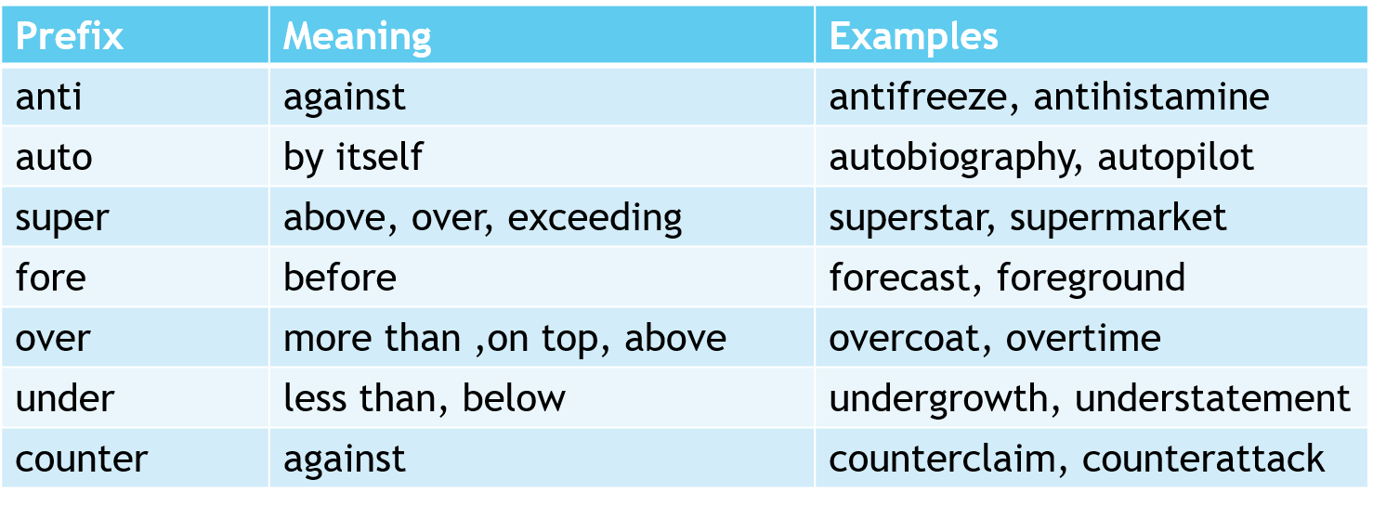
Nouns formed with prefixes
This table shows some prefixes which may be used to form nouns with meanings and examples.

Slide 11
Have a go!
Form nouns by choosing the correct prefix
_________freeze
________coat
________biography
________statement
_________attack
________star
_______cast
Now explain what each of these words means
Prefixes
anti
auto
super
fore
over
under
counter

Slide 12
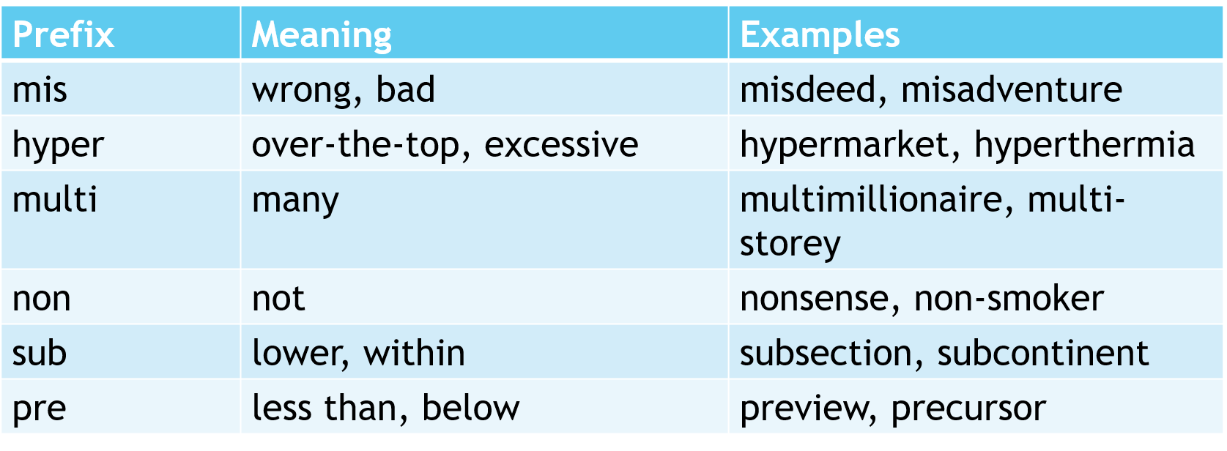
Nouns formed with prefixes
This table shows some more prefixes which may be used to form nouns with meanings and examples.

Slide 13
Can you spot the nouns which contain a prefix in this text?
Jack Brown was once a multimillionaire singer who was a global superstar. He lost his fortune after a series of misdeeds and misadventures. To state that his misfortunes make interesting reading would be an understatement! Find out more about Jack Brown by reading his autobiography. A preview of his book is available online. The book will be on sale in bookshops, supermarkets and in subsections of department stores from the 1st of September.

Slide 14
Reflection
Can you explain:
What is a noun?
What is a prefix? How are prefixes used?
How many noun prefixes can you think of? List them.

