Slide 1
Year 3 SPAG
NCLO: Use a or an correctly

Slide 2

Articles
a or an?

Slide 3
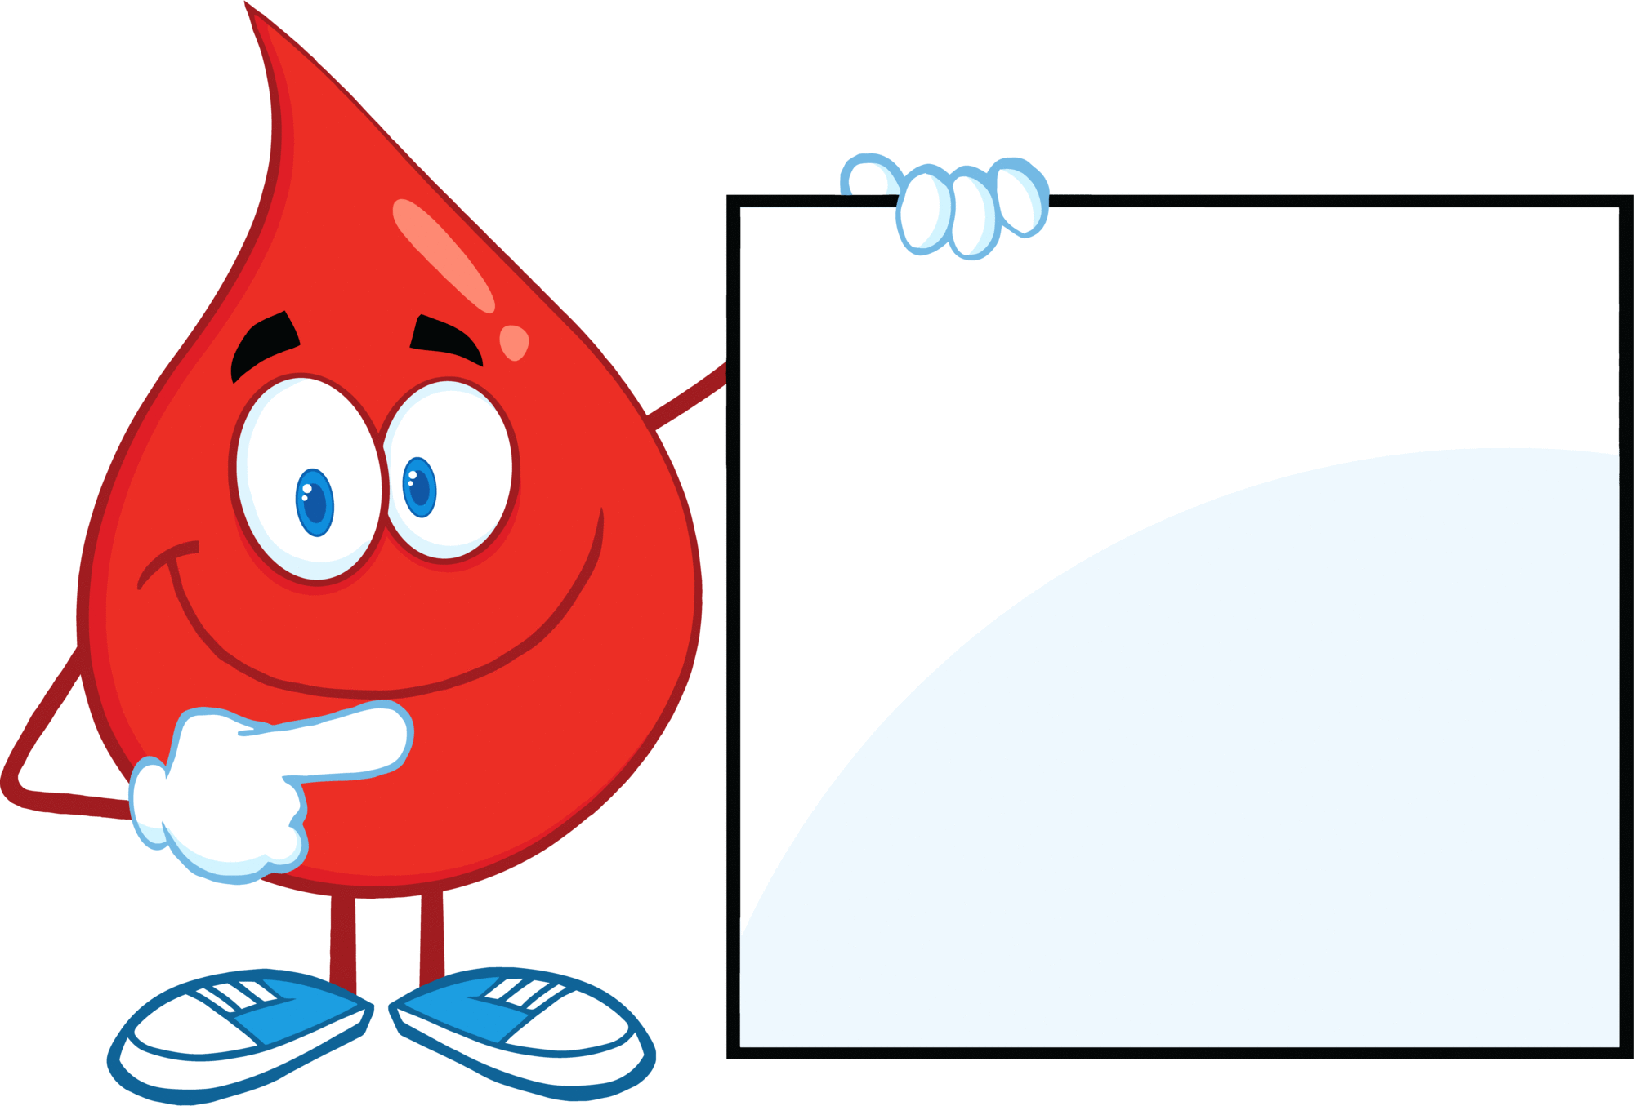

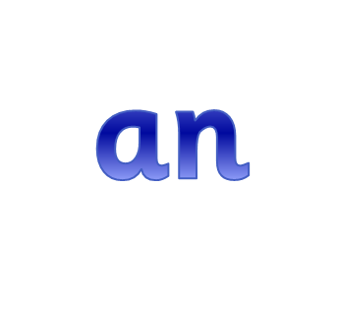
These two words are known as ‘articles’.
We use them when we are talking about something in general, such as ‘a dog’ or ‘an animal’.
Do you know when to use ‘a’ and when to use ‘an’?

Slide 4
Use ‘a’ when the next word begins with a consonant sound:
a house
a school
a friend
a teacher

Slide 5
Use ‘an’ when the next word begins with a vowel sound:
an umbrella
an elephant
an apple
an itch
an orange

Slide 6
Which should you use?
a
an

Slide 7

Which should you use?
a
an

Slide 8
Which should you use?
a
an

Slide 9
Which should you use?
a
an

Slide 10

Which should you use?
a
an

Slide 11
Which should you use?
a
an

Slide 12
Which should you use?
a
an

Slide 13
Which should you use?
a
an

Slide 14
Which should you use?
a
an

Slide 15
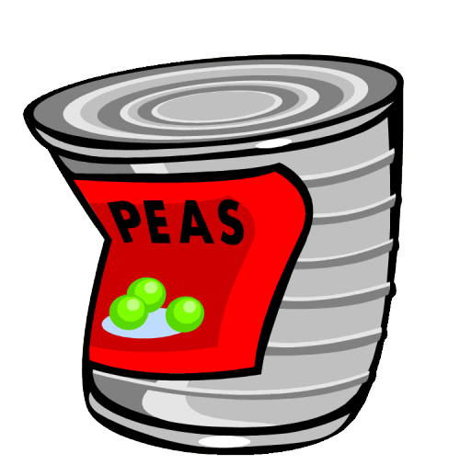
Which should you use?
a
an

Slide 16
Which should you use?
a
an

Slide 17

Which should you use?
a
an

Slide 18
Which should you use?
a
an

