Slide 1
Year 3 SPAG
NCLO: Using conjunctions, adverbs and prepositions to express time and cause
Lesson 1: Adverbs

Slide 2
Verbs and Adverbs
Verbs and Adverbs Game.
How to play:
Your teacher will read out three sentences.
In the first sentence, as soon as you hear a VERB, stand up as quickly as you can.
The first person on each table to stand up wins 1 point.

Slide 3
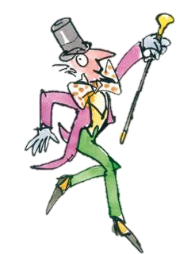
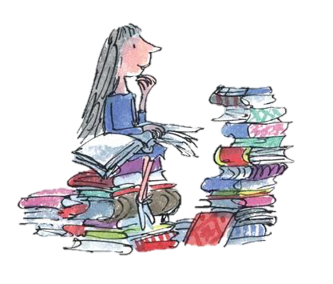
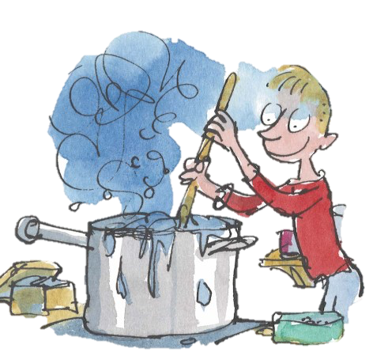
Verbs and Adverbs
Verbs Answers
Mr Wonka walked to the factory.
Matilda read her book.
George stirs the medicine.
Which tables won 1 point?
Now you have reminded yourselves about verbs.
Today we are going to learn about adverbs.

Slide 4
Verbs and Adverbs
An adverb is used to describe how, what, when, where and why a verb happens.
Mr Wonka walked quickly to the factory
verb
adverb
This explains how Mr Wonka walked.
Who can mime (silently act) what Mr Wonka was doing?

Slide 5
Verbs and Adverbs
An adverb is used to describe how, what, when, where and why a verb happens.
Matilda read her book quietly.
verb
adverb
This explains how Matilda read.
Who can mime (silently act) what Matilda did?

Slide 6
Verbs and Adverbs
An adverb is used to describe how, what, when, where and why a verb happens.
George always stirs the medicine.
adverb
verb
This explains when George stirs.
Who can mime (silently act) what George is doing?

Slide 7
Verbs and Adverbs
What are adverbs?
They are added to the verb to answer questions like…
How?
When?
Where?
Why?
They describe the way something happens.
They often end in –ly but not always!
Click the play button to watch a video!

