Slide 1
Using conjunctions, adverbs and prepositions to express time and cause

Slide 2
Time conjunctions tell us when
something is happening.
Before she plays netball, Kate
always does a warm-up.
Conjunctions such as ‘because’ and ‘so’ link something happening with the cause or reason.
.
Remember
the comma!
Because she doesn’t want to get injured,
Kate always does a warm-up.

Slide 3
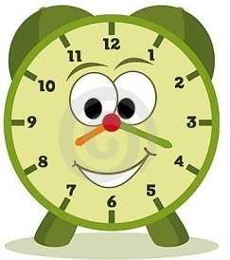
Time and cause conjunctions
Time
Cause
When.....
So that.....
Before.....
Because.....
While.....
After.....

Slide 4
Can you match the beginnings and ends of these sentences?
.

Slide 5
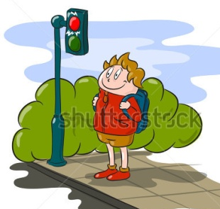
Expressing TIME using conjunctions
Before you cross the road,
some animals hibernate.
When Bob heard the alarm,
Alex wouldn’t answer his phone.
While the rugby was on television,
he ran outside the building, screaming loudly.
During the winter,
always look both ways.

Slide 6
Expressing CAUSE using conjunctions
Because she felt scared,
Madge took her umbrella with her.
So that nobody slipped over,
Betty took her teddy to bed.
So that he could get a house point,
Harold picked up the banana skin.
Because the forecast was bad,
Albert tidied up the pencils.

Slide 7
Challenge!
With your partner, write one sentence beginning with a TIME conjunction:
Before......,
After........,
When.......,
While..........,
Then write one sentence beginning with a CAUSE conjunction:
So that.............,
Because..............,

Slide 8
NEXT
Cut your sentences in half AFTER the comma!
While she was cycling, Meg rang her bell loudly.
Write your name on the back of each piece of paper
Hold them in the air for me to collect!

Slide 9
THEN
I will give you halves of other people’s sentences!
Can you match them up again? You will need to work together as a class to help each other.
While she was cycling,
Meg rang her bell loudly.
Let’s share our favourite sentences.

