Slide 1
Year 4 SPAG
NCLO:
Indicating possession by using the possessive apostrophe with plural nouns

Slide 2
What is meant by possession?
Possession means that something belongs to someone or something. We show this by using possessive apostrophes. Usually we add a possessive apostrophe and s to a word to show ownership:
Tom’s bike
Andrew’s desk
The girl’s jumper
The cat’s paws

Slide 3
Have a go!
Where should the apostrophe be placed in these sentences?
1. Ellas coat was in the playground.
2. Jims desk was a mess.
3. The girls umbrella blew away.
4. The monsters teeth were pointed and sharp.
5. Adeels bike had a puncture.

Slide 4
What does plural mean? Singular means there is just one. Plural means there is more than one.
Singular
Plural
Apples
Children
Houses
Apple
Child
House

Slide 5
Have a go!
What are the plurals of these words?
chair girl boy man
woman car
child sheep bed teacher
mouse
Discuss: Hani says to make a noun plural you just add s – is she correct?

Slide 6
Were you right?
The plurals of these words are:
chair-chairs girl-girls boy-boys
man-men woman-women
car-cars child-children sheep-sheep
bed-beds teacher-teachers
mouse-mice
Hani is wrong. You do make most nouns plural by adding s but it doesn’t always work like this. Some nouns are exceptions to this rule.

Slide 7
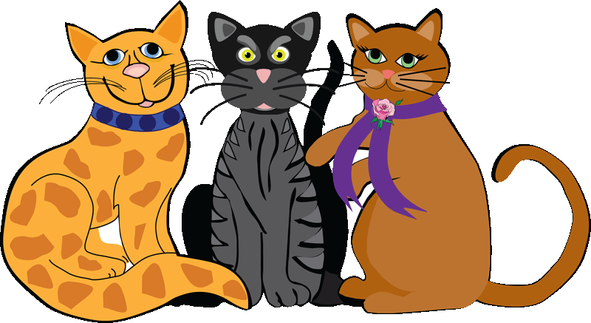
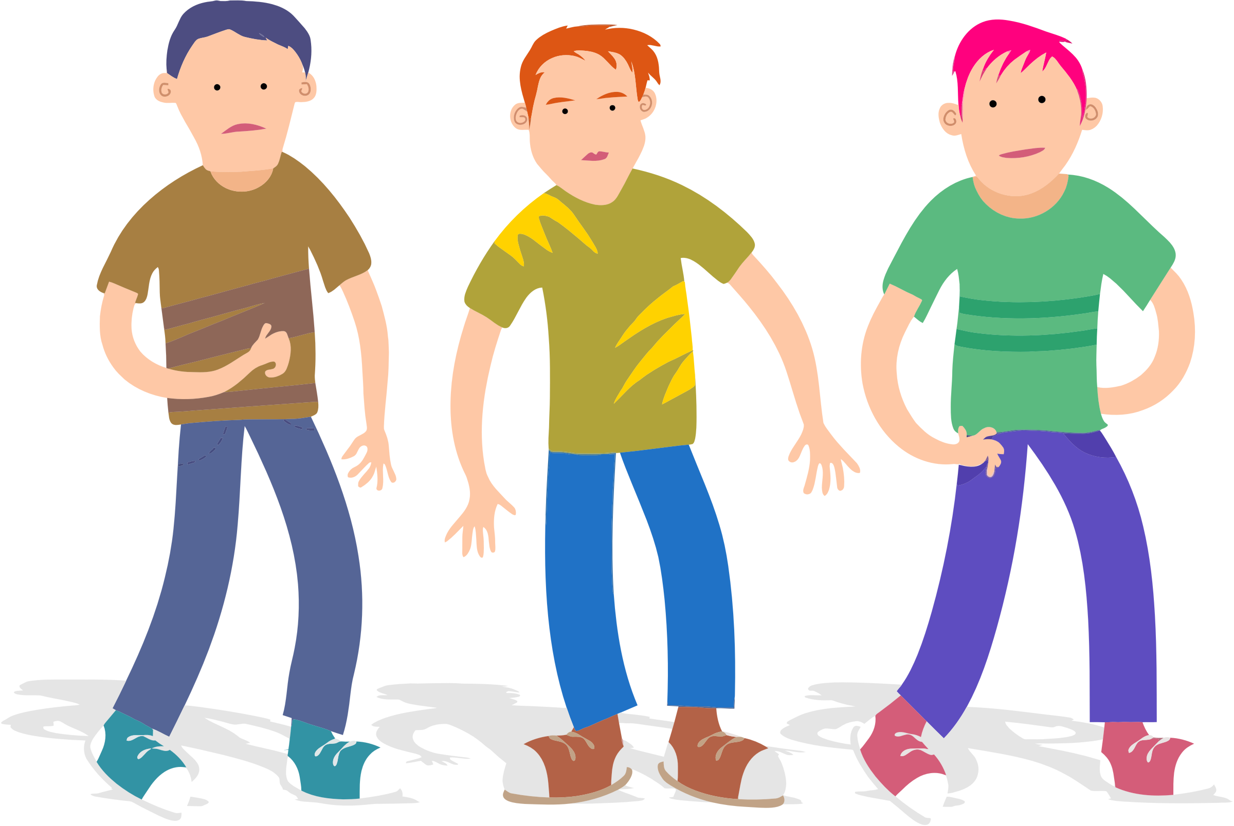
Apostrophes to mark plural possession
Usually we add an apostrophe and s to show possession. However, if a noun already ends in s we just add an apostrophe.
This is the case with most plurals. Most plural words end in s so we just add an apostrophe to show ownership. We don’t need to add another s.
The girls’ cloakroom
The cats’ dinner
The boys’ bedroom

Slide 8
Apostrophes to mark plural possession
Not all plurals end in s. If the plural does not end in s then we need to add an apostrophe and s.
The children’s playground
The women’s dresses

Slide 9
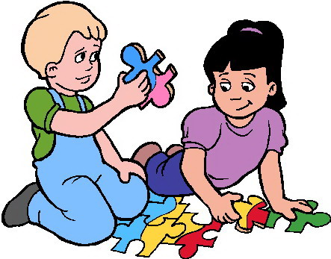
Apostrophes to mark plural possession
If two named people own something, the apostrophe is placed after the second person’s name.
Zara and Tim’s jigsaw

Slide 10
Have a go
Add apostrophes to show plural possession.
The childrens classroom was upstairs.
Ana was in the girls football team.
Adam couldn’t find the boys lockers.
James and Ellas party is on Saturday.
My brothers bedroom is bigger than mine.
All of the trees branches were bare.

Slide 11
Can you spot the apostrophes which are used to show plural possession in this text?
Amy’s coat was old and tattered. All of the coat’s buttons had fallen off. The coat’s hood was ripped as well. Amy and her mother went to the department store to get a new one. They took the lift to the children’s floor where the girls’ coats were. Amy choose her new coat.
Amy’s mother decided that she wanted to get herself a new jumper, so they went to the women’s floor. Amy’s mother choose her new jumper. Amy was ready to go, home, but her mother wanted to keep on shopping.
‘Your dad’s shoes are looking a bit old,’ said Amy’s mother. ‘Let’s go to the men’s floor to see if we can find him a new pair.’

Slide 12
Were you right?
Amy’s coat was old and tattered. All of the coat’s buttons had fallen off. The coat’s hood was ripped as well. Amy and her mother went to the department store to get a new one. They took to the lift to the children’s floor where the girls’ coats were. Amy choose her new coat.
Amy’s mother decided that she wanted to get herself a new jumper so they went to the women’s floor. Amy’s mother choose her new jumper. Amy was ready to go, home but her mother wanted to keep on shopping.
‘Your dad’s shoes are looking a bit old,’ said Amy’s mother. ‘Let’s go to the men’s floor to see if we can find him a new pair.’
Discuss: In which places are apostrophes used to show singular possession?

Slide 13
Reflect and Discuss
Explain what these terms mean:
Possession
Plural
Possessive apostrophe
Singular possession
Plural possession
Can you explain the rules for adding apostrophes to show plural possession?

