Slide 1
Year 4 SPAG
NCLO: Grammatical difference between plural and possessive

Slide 2
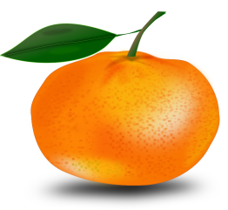
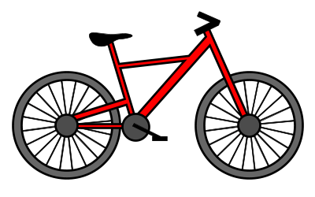
What is meant by plural? Singular means there is just one. Plural means there is more than one. To make many nouns plural, you simply add an s.
Singular
Plural
Orange
Bike
Rose
Oranges
Bikes
Roses

Slide 3
Have a go!
What are the plurals of these words?
bed table cat dog
hat pencil computer
heater pan
Discuss: What does plural mean?

Slide 4
Examples of Exceptions Look at these exceptions. Can you work out the plural of the last word in each list?
If a noun ends in a y and the letter preceding the y is a consonant we change the y to an i and add es.
city – cities puppy – puppies baby-babies lady- ?
If the noun ends in a y and the letter preceding the y is a vowel we just add a s to make the word plural
donkey – donkeys day- days toy-toys key- ?
If the noun ends in f this is often changed to ve before adding s
wife – wives wolf –wolves leaf-?
If nouns end with ch, sh, ss or x we add es.
church- churches dish-dishes fox – foxes brush - ?

Slide 5
Plurals which do not end in s
All of the examples of plurals we have looked at so far end in s. There are only a few plurals which do not end in s. These plurals are known as irregular plurals. Look at the examples below:
child – children
man-men
woman-women
mouse-mice
tooth –teeth
sheep – sheep

Slide 6
Have a go!
What are the plurals of these words?
child church monkey
day baby box wolf
sheep puppy person
Discuss: Tasha says to make a noun plural you just add s. Is she correct?

Slide 7
Were you right?
child – children
church –churches
monkey –monkeys
day –days
baby -babies
box –boxes
wolf- wolves
sheep –sheep
puppy – puppies
person-people
Tasha is wrong. You usually just add s but not always as the examples above show.

Slide 8
What is meant by possessive s?
Possession means that something belongs to someone or something. Usually we show this by adding a possessive apostrophe and s.
Emma’s bag
Andrew’s house
The girl’s book
The cat’s tail

Slide 9
Have a go!
Where should the apostrophe be placed in these sentences?
1. Janes coat was left in the playground.
2. Asifs bedroom needed tidying.
3. The mans trousers were ripped.
4. The vampires teeth were sharp.
5. Antoines handwriting is very neat.

Slide 10
Were you right?
1. Jane’s coat was left in the playground.
2. Asif’s bedroom needed tidying.
3. The man’s trousers were ripped.
4. The vampire’s teeth were sharp.
5. Antoine’s handwriting is very neat.

Slide 11
The difference between plural and possessive s
Remember an apostrophe is never used to represent a plural noun. Look at the following sentences.
1.The car’s zoomed along the street.
2.The cars zoomed along the street.
Cars is plural so an apostrophe is not needed.

Slide 12
Have a go!
Which of these sentences contain inappropriate apostrophes?
Jane’s car has broken down.
I like school dinner’s.
I am going to the seaside in the holiday’s.
Asif’s bike is brand new.
The picture’s in the art gallery are wonderful.
I had lots of present’s for my birthday.

Slide 13
Were you right?
Sentences 2,3, 5 and 6 contain apostrophes incorrectly used for plurals. Sentences 1 and 4 contain correctly used apostrophes.
Jane’s car has broken down.
I like school dinner’s.
I am going to the seaside in the holiday’s.
Asif’s bike is brand new.
The picture’s in the art gallery are wonderful.
I had lots of present’s for my birthday.

Slide 14
Can you spot the plurals in this text?
It was the day of Emma’s party. She had sent out the invitations last week and ten of her friends had said they were coming. The party was going to be taking place at Emma’s house. It was ten ‘o’clock and the party was due to start at three ‘o’ clock. It was time to make preparations.
Emma’s dad took her shopping. He bought party hats, paper plates and plastic knives, forks and spoons. He also bought lots of snacks, cakes, bread and fillings for sandwiches.
When Emma and her dad got home, they set out the food and put up some decorations. It was now half past two. Emma was just about to go to her room to put her party dress on when the doorbell rang. One of Emma’s friends had arrived 30 minutes early!

Slide 15
Were you right?
It was the day of Emma’s party. She had sent out the invitations last week and ten of her friends had said they were coming. The party was going to be taking place at Emma’s house. It was ten ‘o’clock and the party was due to start at three. It was time to make preparations.
Emma’s dad took her shopping. He bought party hats, paper plates and plastic knives, forks and spoons. He also bought lots of snacks, cakes, bread and fillings for sandwiches.
When Emma and her dad got home, they set out the food and put up some decorations. It was now half past two. Emma was just about to go to her room to put her party dress on when the doorbell rang. One of Emma’s friends had arrived 30 minutes early!
Discuss – which words in this text show the use of apostrophes for possession?

Slide 16
Reflect and Discuss
Explain what these terms mean:
Plural
Possessive apostrophe
Can you explain the difference between plural and possessive s?

