Slide 1
YEAR 6
Using a colon to introduce a list

Slide 2
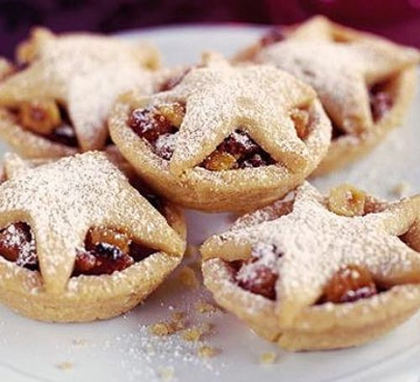
Colons ( : ) are used: to introduce a list. In front of him were the following: mince pies, holly and other delicious delights. In this example the items in the list are separated by commas.

Slide 3
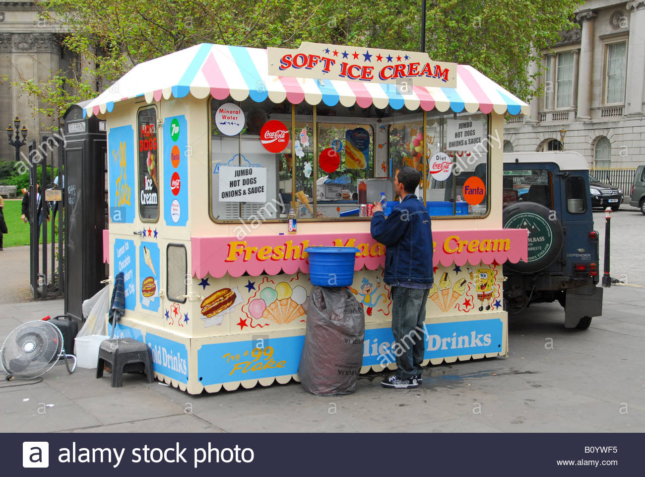
If the items in the list are longer than one or two words separate them with a semi-colon. The attractions of the park included: a new roundabout; a short pony ride; a long slide and an ice-cream stall.

Slide 6
Notes:
Children sorted into boys and girls.
Children sorted into wearing white, wearing red.
Children sorted into white shoes, non-white shoes.

