Slide 1
Year 6 SPAG formal and informal language and subjunctive form
NCLO: Recognising vocabulary and structures that are appropriate for formal speech and writing including subjunctive form

Slide 2
Formal and informal language
In different text types or genres you may be able to spot the difference between formal and informal language being used by the author.
Formal writing uses more complicated words (as well as the Subjunctive Form)
Informal writing sometimes uses question tags as well as contractions such as ‘didn’t and won’t’

Slide 3
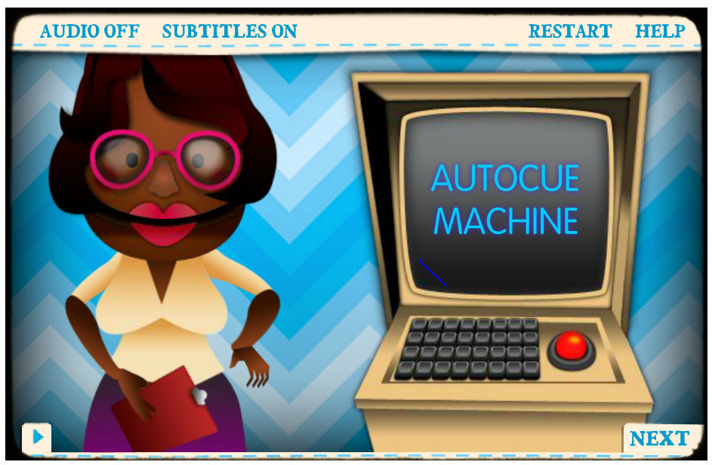
Can you spot the difference between formal and informal language?
http://www.bbc.co.uk/bitesize/ks3/english/writing/formal_informal/activity/

Slide 4
Tips to make your writing more formal
Make your writing clear and to the point.
Try linking ideas with: in addition, nevertheless, on the other hand, by contrast, although, alternatively.
Include some complex sentences in your writing. Try using semi-colons if you feel confident about using them correctly.
It's good to use figurative language if you think it fits in with the purpose and audience of the task. Metaphors and similes work well in speeches.

Slide 5
If you want to write in a formal tone try to avoid the following:
Don't use 'Well' or 'You know' or 'Anyway' or 'Like I just said' or any phrase that sounds like you are having a friendly chat.
Avoid using: 'And', 'But', 'Because' or 'So' at the beginning of a sentence.
Keep exclamation marks to a minimum!!!
Words like 'nice' and 'a lot' have no power. Try to think of more descriptive words eg 'delicious' or 'endless'.
Clichés are colourful phrases that people use all the time in speech. So often, in fact, that they seem worn out and boring in writing. Avoid phrases such as 'pretty as a picture', 'big as a house', 'skinny as a rake'.

Slide 6
Subjunctive form
Subjunctive form might be used in a formal text. When a sentence is talking about something important or urgent, it would use the subjunctive form.
She must make sure she buys a cat. →
It is essential that she buy a cat.

Slide 7
The subjunctive form might also be used if you are talking about a situation that isn’t real:
If I was a good waiter, I’d never drop anything. →
If I were a good waiter, I would never drop anything.
Replace was with were to write in the subjunctive…..

Slide 8
Subjunctive form and tense
The subjunctive form is always the same - it doesn’t matter if the sentence is present or past tense.
He asks that the people stay quiet
He asked that the people stay quiet
It is important that everyone be polite
It was important that everyone be polite.

Slide 9
The difference between informal and subjunctive
She must make sure she buys a cat. Informal
It is essential that she buy a cat.
Subjunctive
It is important that we are quiet.
Informal
It is essential that we be quiet.
Subjuntive

