Slide 1
Year 6 SPAG Passive verbs
NCLO: using passive verbs to affect the presentation of information in a sentence.

Slide 2
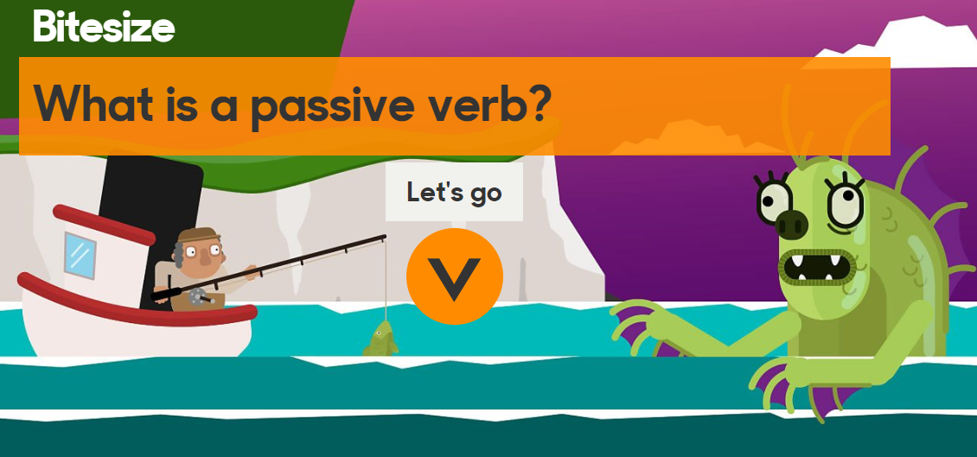
Passive verbs - BBC video
What is a passive verb?

Slide 3
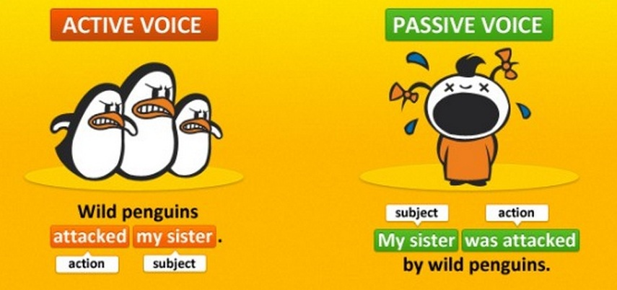
Passive sentences usually have more words than active ones, which is one reason the reader has to work harder to get at the meaning. This is sometimes done on purpose, perhaps to avoid assigning blame or in cases where it's not clear who did something.

Slide 4
Can you rewrite these active voice sentences in the passive voice?
I really love this dog.
Monkeys live in the jungle.
She threw the ball to John.
The dog ran back to the car.
I made a mistake. Read more at http://grammar.yourdictionary.com/style-and-usage/active-voice-adds-impact-to-your-writing.html#RicvZhSiUydDYWzt.99
I really love this dog.
Monkeys live in the jungle.
She threw the ball to John.
The dog ran back to the car.
I made a mistake.

Slide 5
Can you rewrite these active voice sentences in the passive voice?
I really love this dog.
Monkeys live in the jungle.
She threw the ball to John.
The dog ran back to the car.
I made a mistake. Read more at http://grammar.yourdictionary.com/style-and-usage/active-voice-adds-impact-to-your-writing.html#RicvZhSiUydDYWzt.99
I really love this dog. This dog is really loved by me.
Monkeys live in the jungle. The jungle is where monkeys live.
She threw the ball to John. The ball was thrown to John.
The dog ran back to the car. The car is where the car ran back to.
I made a mistake. A mistake was made.

Slide 6
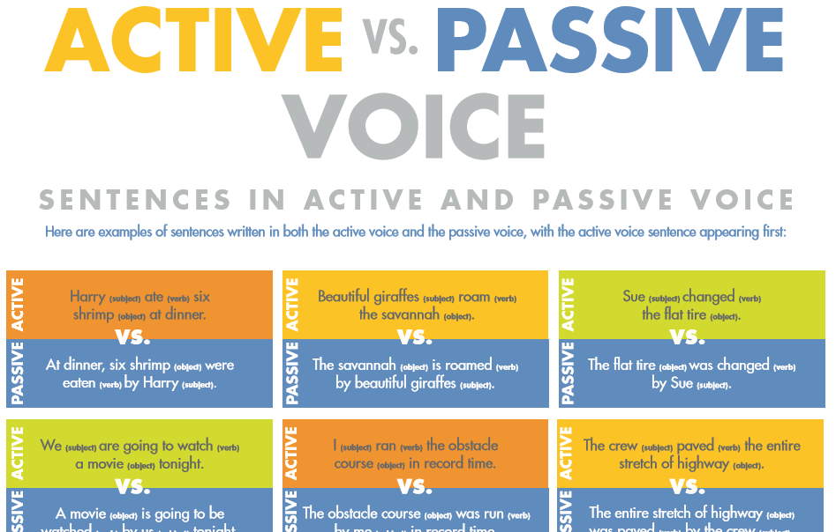
Poster about active and passive voice
http://www.yourdictionary.com/pdf/articles/51.activevspassivevoice.pdf

