Slide 1
Year 6 SPAG Perfect form of verbs
NCLO: using perfect form of verbs to mark relationships of time and cause

Slide 2
Present perfect verbs
We use present perfect for a past action whose time is not mentioned and has a relation to the present. We are not interested in its time but the action itself.

Slide 4
Present perfect
has/have + past participle
You have seen that movie many times.
I have visited my grandfather.
They have eaten delicious food.
People have travelled to the Moon.

Slide 5
Past perfect tense
The past perfect tense is formed with the past tense of the verb to have (had) and the past participle of the verb (e.g. eaten, stolen, taken). The past perfect tense describes an event that happened in the past before another event was completed in the past

Slide 6
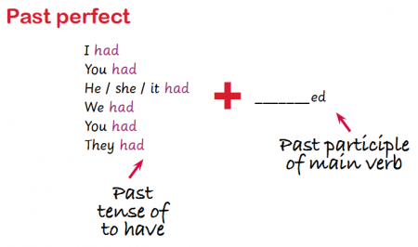
The past perfect is used to talk about an event that was completed in the past before something else happened:
I had just finished cooking the meal when my guests arrived. I didn't want to watch the film, as I had already seen it.

Slide 7
Past perfect verbs
had + past participle
I had walked for miles before I found my way.
They had read almost all the books on the shelf.
We had found ourselves in the middle of nowhere.

