Slide 1
Year 6 Knowing how words are related as synonyms and antonyms

Slide 2
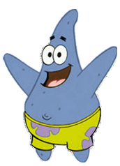
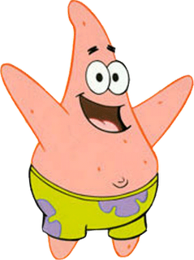
Synonyms Words that mean exactly the same or nearly the same as another word
Hey, you look like me…
Hey, I look like you…

Slide 3
Think of synonyms for these words
friend
journey
house
woman
ugly
brave
robust
bad
small

Slide 4
Think of THREE synonyms for each word below: Work with your partner excellent slow dull expensive

Slide 5
Can you replace the word bad with a better synonym?
Late one night I heard a bad noise - what could it be? Was is some bad creature doing a bad deed? As I went to investigate I could smell something bad, and I wondered what bad thing could have happened. All the bad things I could think of filled my mind, and as a I crept round the corner I saw a bad sight…
It was a ______________ !
dreadful horrible terrible awful evil gruesome nasty vile hideous

Slide 6
An antonym of a word is a word which has the opposite meaning
Try these:
bad
destroy
short
loose
bright
remember
enormous
break

Slide 7
Discuss with your partner why we need to consider synonyms and antonyms and how an understanding of each will improve our writing.
Notes:
Children sorted into boys and girls.
Children sorted into wearing white, wearing red.
Children sorted into white shoes, non-white shoes.

