Slide 1
Year 5 SPAG
VERB PREFIXES
NCLO: Using verb prefixes

Slide 2

What Are Prefixes?
A prefix is a group of letters we add to the front of a word.
Prefixes change the meaning or purpose of the word, e.g.
un + kind = unkind
How has the word meaning been altered?
The word has become its opposite meaning (antonym)

Slide 3
What prefixes can you think of?
De-
Over-
Re-
Mis-
Dis-

Slide 4
The prefix ‘dis’
Sally disagreed with Tom over who threw the snowball.
How has the word meaning been altered with this prefix?
agree-----disagree
Again the word has become an antonym (opposite) of the root word.

Slide 5
The prefix ‘dis’
Can you disable the alarm?

Slide 6
Add the suffix ‘dis’ to these root words!
dis
coloured
dis
trust
dis
like
dis
dis
order
dis
please
dis
approve

Slide 7
The prefix ‘re’
Danny had to refill the bucket.

Slide 8
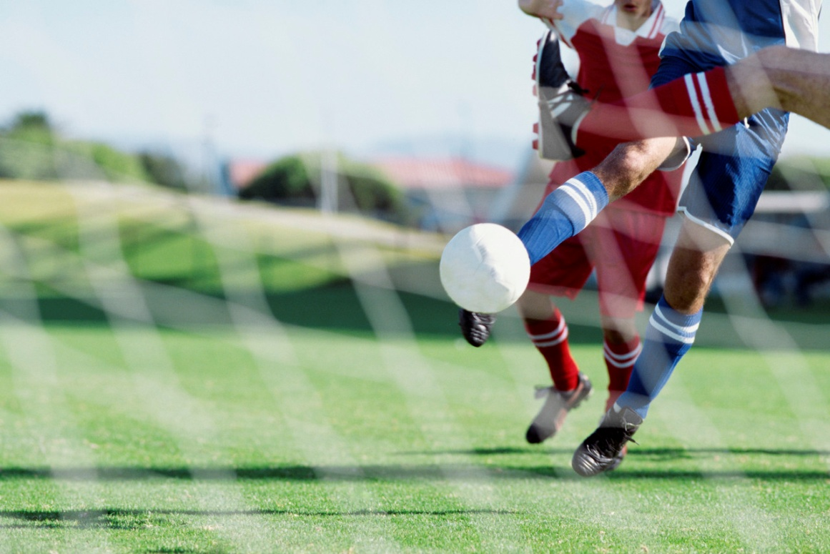
The prefix ‘re’
The T.V. showed an action replay.

Slide 9
The prefix ‘de’
Dad had to defrost the chicken before he put it in the oven.

Slide 10
The prefix ‘de’
The time to depart from the station had arrived.

Slide 11
The prefix ‘mis’
Here are some examples of words with this prefix.
What do you think ‘mis’ means when it is used before a root word?
Misbehave
Mistrial
Misfit
Misstep
Mislead
Can you think of any other words which use the prefix mis-?
The prefix mis- means ‘wrongly’
or ‘badly.’

Slide 12
The prefix ‘over’
Here are some examples of words with this prefix.
What do you think ‘over’ means when it is used before a root word?
Overreact
Overdress
Overcook
Overfull
Overheat
Can you think of any other words which use the prefix over-?
The prefix over- means ‘too much’ of something, ‘above’ or ‘beyond.’

