Slide 1
Year 6 SPAG
Marking Boundaries
NCLO: Using semi-colons, colons and dashes to mark boundaries

Slide 2
Punctuation Marks
These are the punctuation marks we are learning about:
;
The semi-colon, which can be used to link two closely related sentences and separate items in a list.
:
The colon, which can be used to introduce a list (amongst other things).
-
A dash, which can be used to connect or separate phrases and sentences.

Slide 3
Colons and Semi Colons
What Do I Need To Know?
Colons | Semi-Colons
Can introduce a list To make a cake, you will need: 2 eggs, etc. Only use a colon if it follows a main clause. Go before bullet points Today’s meeting agenda: Volunteers for the fair Stall holders etc. Introduce explanations: Main Idea + More Detail I’d like to buy an ice-cream: probably strawberry flavour. | Break up lists (of longer phrases or clauses) When I go camping we will be building a campfire; putting up our tents in the dark; cooking yummy marshmallows, and fishing by the lake. Break up clauses Sally was ready for bed; Aaron wanted to keep playing. (Both sides are equally important)
The mouse was playing: the cat was asleep.
Here it seems as though the mouse was playing because the cat was asleep.
The mouse was playing; the cat was asleep.
Here we just have two statements of equal importance.

Slide 4
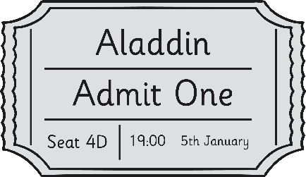
Punctuation Marks - Colons
Colons can be used to expand a sentence by linking independent clauses. They can introduce an idea that explains, expands or balances the information before the colon.
:
The pantomime was a huge success: over two thousand people had booked tickets to see it.
The fact that over two thousand people had booked tickets for the pantomime explains why it was a success.
Have a go at using a colon in this way on your whiteboard.

Slide 5
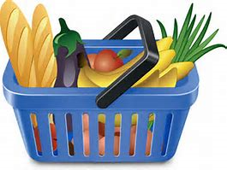
Punctuation Marks - Semi-Colons
;
The semi-colon keeps order in the sentence, separating the information about each item in the list.
Penny surveyed her shopping: potatoes, for the chips; beef, for the burgers; tomatoes, for the tomato ketchup and bananas, for the banoffee pie.
The semi-colon here keeps order in the sentence, separating the information about each item in the list.
Have a go at using a semi-colon in this way on your whiteboard.

Slide 6
Punctuation Marks - Dashes
Dashes can also be used to separate or connect two independent clauses, but they are often used in less formal writing.
-
Lilies are very pretty flowers – they smell disgusting though.
The dash here creates a disjunction in the flow of writing and introduces an unexpected surprise. Dashes can be used in this way to create shock or humour too.
Have a go at using a semi-colon in this way on your whiteboard.

Slide 7
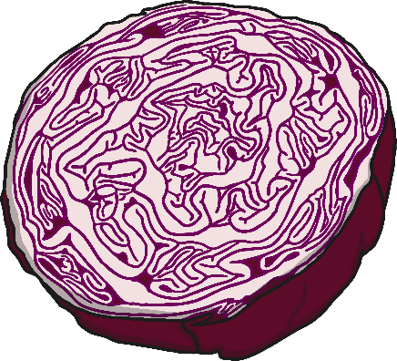
Punctuation Marks - Colons
:
Colons can also be used to introduce a list:
Rachael realised that she disliked cabbage for a number of reasons: it looked like brains, tasted disgusting and it never filled her up.
The colon here introduces Rachael’s list of reasons for disliking cabbage.
Have a go at using a colon in this way on your whiteboard.

Slide 8
Punctuation Marks - Dashes
Dashes can also be used to separate or connect two independent clauses, but they are often used in less formal writing.
-
Lilies are very pretty flowers – they smell disgusting though.
The dash here creates a disjunction in the flow of writing and introduces an unexpected surprise. Dashes can be used in this way to create shock or humour too.
Have a go at using dashes in this way on your whiteboard.

Slide 9
Punctuation Marks - Dashes
Two dashes can mark out extra information in sentences, similar to brackets.
-
Tilly – though I can’t quite believe how - jumped straight over the car and ran off into the woods.
The dashes here add extra information to the sentence like brackets would, but they draw more attention to what is written, making it feel more integrated into the main sentence.
Have a go at using dashes in this way on your whiteboard.

Slide 10
Colons and Semi Colons
What Do I Already Know?
Try these SPaG Test questions out independently…
Developed by www.keystage2literacy.co.uk

Slide 11
Colons and Semi Colons
What Do I Already Know?
Try these SPaG Test questions out independently…
Developed by www.keystage2literacy.co.uk

Slide 12
Colons and Semi Colons
What Do I Already Know?
Try these SPaG Test questions out independently…
Developed by www.keystage2literacy.co.uk

