Slide 1
Year 2 SPAG
Suffixes
NCLO: Formation of nouns using suffixes

Slide 2
What is a suffix?
Suffixes are endings that are added to root words.
Suffixes change the meaning or purpose of the word.
We are looking at suffixes that turn words into nouns
Climb + er = Climber
Verb
Noun

Slide 3
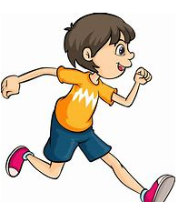
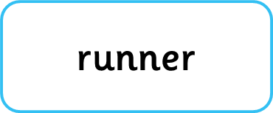
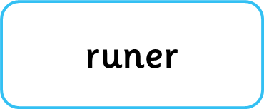

Slide 4
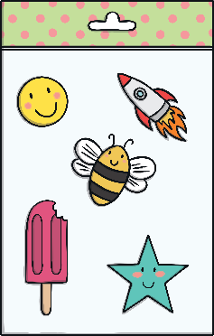
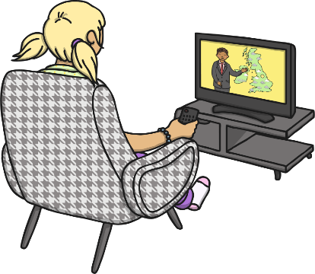
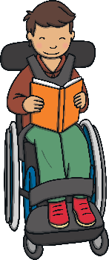
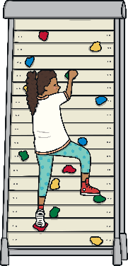
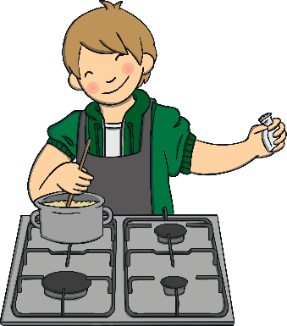
Can you add the suffix –er to these words to create a new noun to describe someone or something that does these things?
learn
er
stick
er
watch
er
read
er
climb
er
cook
er
Can you use each noun in a sentence?

Slide 5
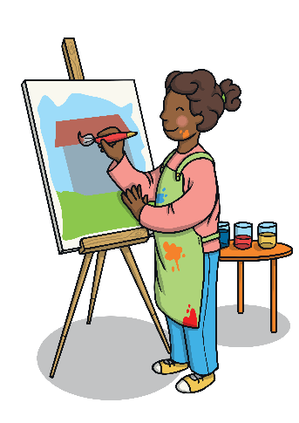
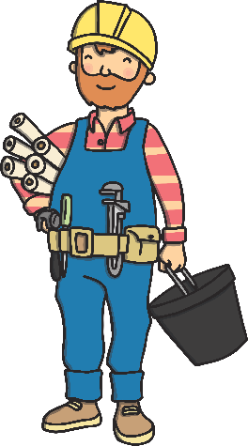
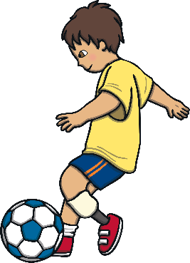
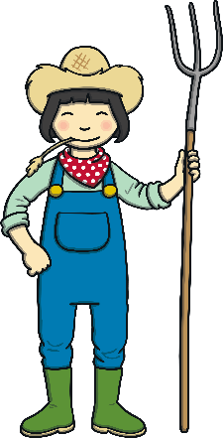
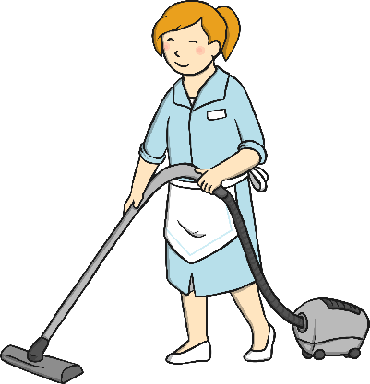
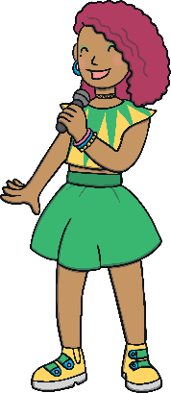
Can you guess what these people’s jobs are by reading what they do? Add the suffix –er to the doing verb to make the name of their job.
I paint. I am a _______.
I paint. I am a painter.
I build. I am a
_______.
I play football. I am a _______.
I build. I am a
builder.
I play football. I am a footballer.
I clean. I am a _______.
I sing. I am a ______.
I sing. I am a singer.
I farm. I am a _______.
I clean. I am a cleaner.
I farm. I am a farmer.
Can you think of any more jobs that end in –er? Can you write a speech bubble for that job, describing what they do and what they are called?

Slide 6
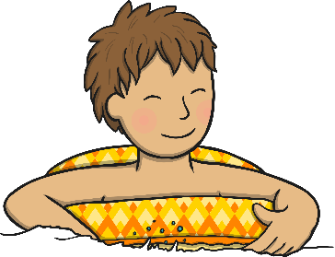
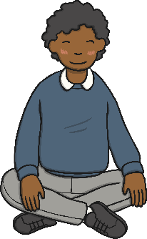
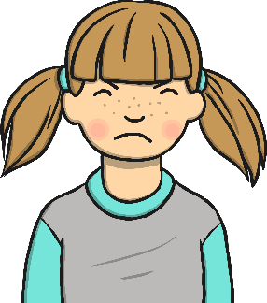
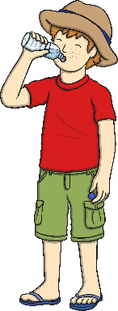
Can you describe what each of these people is feeling by looking at their expressions and adding the suffix –ment to the underlined word in their speech bubble? Click on it to see if you were right.
I know I will achieve my goals!
This picture amazes me!
I agree!
amazement
achievement
a________
agreement
a__________
a________
I feel content.
Why does my dad always embarrass me?
This cold water will refresh me!
contentment
embarrassment
c__________
e____________
refreshment
r____________
Can you write a sentence using each of the new nouns you have created?

Slide 7
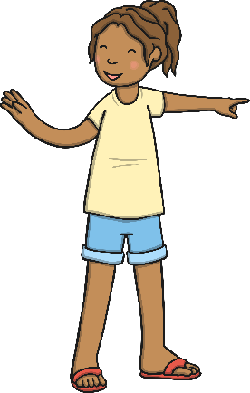
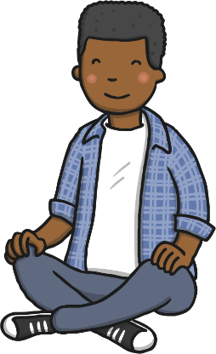
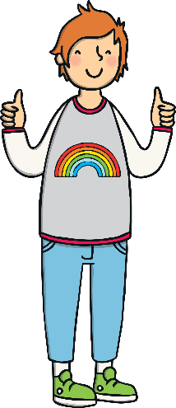
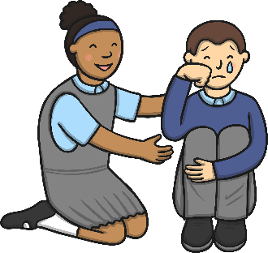
These children have been given special certificates for showing different qualities throughout the year. Can you work out what each quality is by adding the suffix –ness to the underlined word on their certificate?
For always being very helpful, Lara is given the certificate for
h__________.
For being brave and bold, Krystian is given the certificate for b_______.
For always being very helpful, Lara is given the certificate for
helpfulness.
For being brave and bold, Krystian is given the certificate for boldness.
For always being smiley and cheerful, Derek is given the certificate for
c________.
For always being smiley and cheerful, Derek is given the certificate for
cheerfulness.
For being lovely and calm, Aiden is given the certificate for
c_______.
For being lovely and calm, Aiden is given the certificate for
calmness.
For being a kind friend, Chantelle is given the certificate for
k_______.
For being a kind friend, Chantelle is given the certificate for
kindness.
Can you write a certificate for someone in your class, using a noun that ends in –ness?

Slide 8
Which suffix needs to be added to change the word to a noun?
As she walked away his heart was filled with sad .
Click the circles next to the words to reveal which suffix is correct.
ness
ly
fulness
ment
ful
lessly

Slide 9
Which suffix needs to be added to change the word to a noun?
To my amaze I won the race.
Click the circles next to the words to reveal which suffix is correct.
ment
fulness
ly
ness
lessly
ful

Slide 10
Which suffix needs to be added to change the word to a noun?
We had an agree that you would do the dishes.
Click the circles next to the words to reveal which suffix is correct.
ly
ful
fulness
ment
ness
lessly

