Slide 1
Year 5 SPAG
Linking ideas
NCLO: Link ideas across paragraphs using adverbials of time

Slide 2
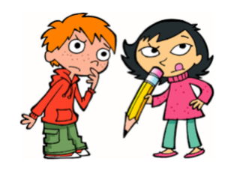
Link ideas across paragraphs using adverbials of time
Can you provide a definition for the word ‘paragraph’ in 15 words?

Slide 3
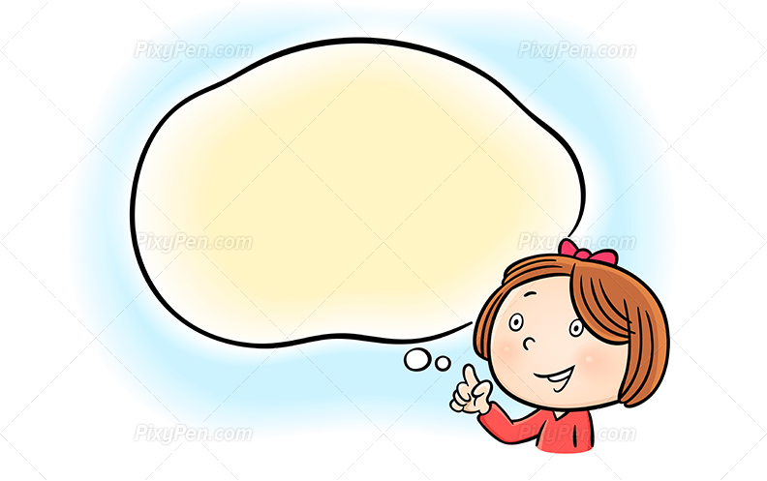
A paragraph is a group of sentences that is separate – when you remember, do one.
A paragraph is a group of 3 or more sentences which share a common theme.
Which of these do you think is best? Or do you prefer your own?
A paragraph is a self-contained unit of writing concerned with examining a particular point or idea.

Slide 4
Once you have mastered forming paragraphs effectively, you can begin to think about how to link your ideas across them in order to help your writing flow.
If you spend some time thinking about how to begin your new paragraph, you can deliberately choose words which will link the sentences in your new paragraph to the ideas you set out in the previous paragraph.
Doing this makes it clear to the reader that you are in control of the subject you are writing about!

Slide 5



Let’s see how the author of ‘Making Honey’ could have used adverbials to link paragraphs.
In the piece of writing entitled ‘Making Honey’ the author could have linked the paragraphs with adverbs of time.
Adverbs of time answer the question: ‘When?’
Bees eat honey and they start making it by visiting flowers. They collect nectar, which is a sugary liquid, from the blossom by sucking it out. They store it in their honey stomachs which are separate to their other stomachs.
When their stomachs are full, they fly back to the hive. When they get there, they pass the nectar to worker bees who chew it and then pass it to the next bee. As it passes from bee to bee, it gradually turns into honey.
Until they need to eat it, the bees store the honey in honeycomb cells – basically tiny jars made of wax. Because the honey is wet, they fan it with their wings to make it stickier. To keep it clean, they seal the cell with a wax lid.
How do these adverbials link the ideas across the paragraphs?

Slide 6
In the piece of writing entitled ‘Making Honey’ the author could also have linked the paragraphs with adverbs of frequency.
Adverbs of frequency answer the question: ‘How often?’
Normally, bees eat honey and they start making it by visiting flowers. They collect nectar, which is a sugary liquid, from the blossom by sucking it out. They store it in their honey stomachs which are separate to their other stomachs.
Every time their stomachs are full, they fly back to the hive. When they get there, they pass the nectar to worker bees who chew it and then pass it to the next bee. As it passes from bee to bee, it gradually turns into honey.
Usually the bees store the honey in honeycomb cells – basically tiny jars made of wax. Because the honey is wet, they fan it with their wings to make it stickier. To keep it clean, they seal the cell with a wax lid.
How do these adverbials link the ideas across the paragraphs?

Slide 7
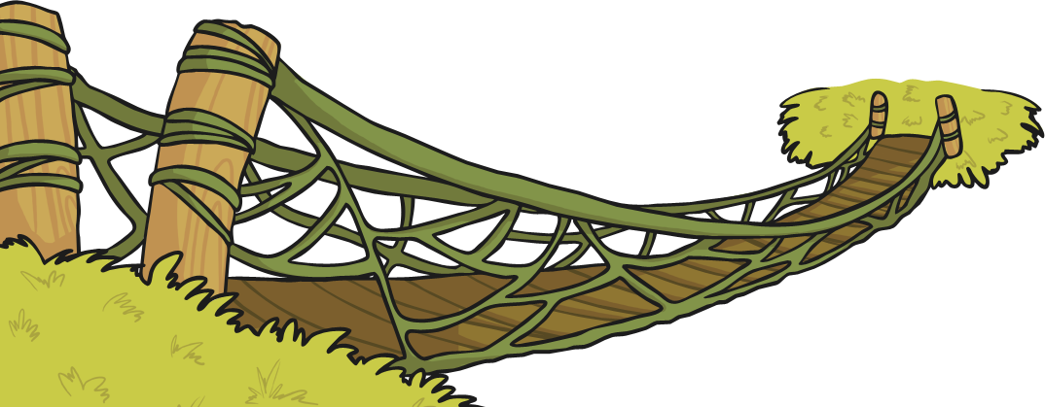
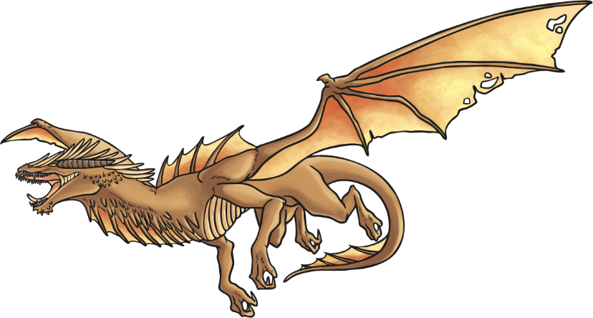
How do adverbials of place differ from prepositions?
Prepositions require an object…
Under the rock was a message.
Over the bridge was the safest route.
Adverbials of place do not…
Inside there were long shadows.
Nearby was the dragon’s cave.

Slide 8
In the piece of writing entitled ‘Making Honey’ the author could have linked the paragraphs with adverbs of number.
Adverbs of number answer the question: ‘In what order?’
Firstly, Bees visit flowers in order to make the honey that they eat. They collect nectar, which is a sugary liquid, from the blossom by sucking it out. They store it in their honey stomachs which are separate to their other stomachs.
Secondly, stomachs fill up and they fly back to the hive. They get there, pass the nectar to worker bees who chew it and then pass it to the next bee. As it passes from bee to bee, it gradually turns into honey.
Finally, the bees store the honey in honeycomb cells – basically tiny jars made of wax. Because the honey is wet, they fan it with their wings to make it stickier. To keep it clean, they seal the cell with a wax lid.
How do these adverbials link the ideas across the paragraphs?

Slide 9
Making choices about tenses can also link your paragraphs by ensuring that references bridge the gap between paragraphs. An example is given here…
She had brown hair and blue eyes, which was unusual. She performed for 12 hours straight. People wondered how she didn’t stop.
He had seen her before. She had been younger then and so had he.
Keeping tenses consistent in a specific frame of reference can also link ideas…
He wanted to be the record holder. That’s why he had practised for so long. He knew he could do it.
He might well have done it if it wasn’t for the dog…
Referring back to an aspect of the previous paragraph and making the right tense choice will effectively link ideas. Have a practice – what could the first sentence of the next paragraph to follow this one be?
The best thing about the day had been the rides. It was pure joy to relax and be thrown this way and that. There were so many to choose from.

Slide 10
In What Order? When? How Often? Where?
Which of the following words answer the questions ‘ In what order?’, ‘When?’, ‘How often?’ and ‘Where?’. Some of the words may answer more than one question – in these cases try to choose the ‘best fit.’
Which of the following words answer the questions ‘ In what order?’, ‘When?’, ‘How often?’ and ‘Where?’. Some of the words may answer more than one question – in these cases try to choose the ‘best fit.’
Draw a table in your book.
In what order?
When?
When?
How often?
Where?
sometimes
instantly
usually
normally
over
later
recently
nowhere
outside
after
once
firstly
on
secondly
regularly
anywhere
under
already
twice
below
whenever
often
never
finally
tomorrow
occasionally
frequently
nearby
before
rarely
always
hardly ever
thirdly
behind
simultaneously
next
under

Slide 11
Here are some suggested possible answers.
In what order?
How often?
firstly
secondly
thirdly
next
once
twice
simultaneously
finally
after
regularly
usually
often
sometimes
rarely
frequently
hardly ever
normally
occasionally
always
Where?
over
under
behind
below
anywhere
nearby
outside
on
nowhere
When?
already
recently
tomorrow
before
never
whenever
later
instantly

Slide 12

Find yourself a reading book in the classroom or use your own. Hunt down the words that begin each of the paragraphs. This is easy to do because the paragraphs are likely to be indented (The way the first line of a paragraph is set in from the margin.)
Write down any adverbs used to link paragraphs which answer the question
When? Where? or How Often? and make a note of each individual example you find.
You can decide if a word belongs to one of the groups by asking the question and trying to answer it with the word you have found. E.g. When? Yesterday.

Slide 13

In what order?
When?
How often?
Where?
firstly
once
finally
inside
about
below
while
yesterday
meanwhile
soon
immediately
never
occasionally

Slide 14

Decide which adverb of time to use to link each pair of paragraphs together.
Decide which adverb of time to use to link each pair of paragraphs together.
The tiny cheetah cub was captured and brought to the zoo. He was fed with milk and watched day and night. The cub was called Simba and was not put on display at first.
__________________ visitors were able to see him. Simba began to eat solid food and wash himself. He was introduced to the other cheetahs at the zoo.
before soon when now

Slide 15
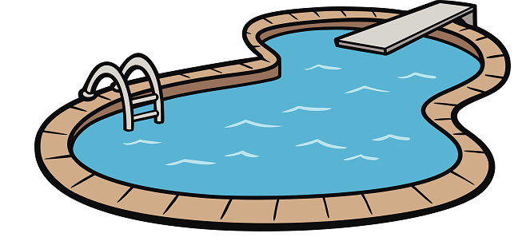
Decide which adverb of time to use to link each pair of paragraphs together.
Decide which adverb of time to use to link each pair of paragraphs together.
The swimming pool was muddy and murky and covered with floating leaves. There was thick gunge on the side walls. A cleaning company was called in to help.
_________________ long the pool looked as good as new. The water was sparkling, shimmering and clear. Time to party!
before soon when now

Slide 16
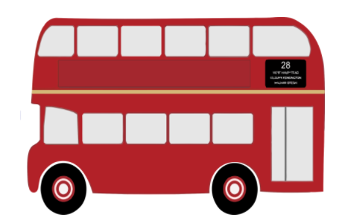
Decide which adverb of time to use to link each pair of paragraphs together.
Decide which adverb of time to use to link each pair of paragraphs together.
Mary was worried the bus would be late. She kept checking her watch every five minutes. If she missed it, the day would be ruined.
___________ she looked up and saw the bus, Mary was filled with relief. She climbed on the bus and sat herself by a window to enjoy the journey.
before soon when now

Slide 17

Decide which adverb of time to use to link each pair of paragraphs together.
Decide which adverb of time to use to link each pair of paragraphs together.
The weather has been icy and cold. The schools have been closed. Even the children have stayed inside.
_____________ this is set to change. Tomorrow the sun will shine and the snow will disappear. It will feel as though winter is over.
before soon when now

Slide 18
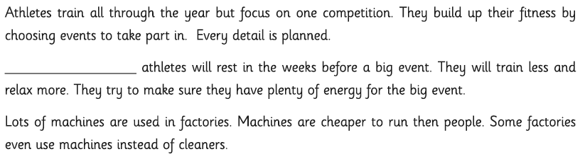


2. Decide which adverb of frequency to use to link each set of two paragraphs together.
Making a TV programme is fairly simple. Everybody works through the scenes – building the set and preparing the costumes. The filming begins and the actors and presenters need to get their lines right!
_______ there is a delay between the filming and the show being on TV. The pictures need to be edited and any sound effects and credits added. Sometimes some scences will need reshooting.
often usually occasionally sometimes

Slide 19
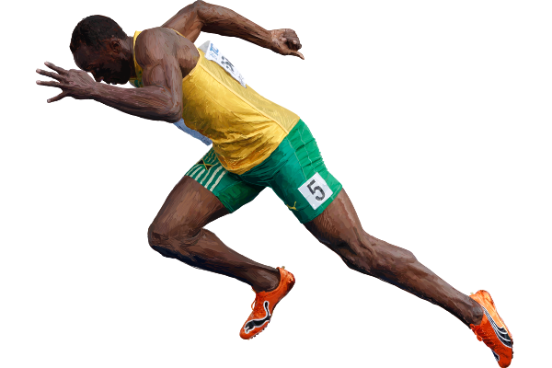
2. Decide which adverb of frequency to use to link each set of two paragraphs together.
Athletes train all through the year but focus on one competition. They build up their fitness by choosing events to take part in. Every detail is planned.
______________ athletes will rest in the weeks before a big event. They will train less and relax more. They try to make sure they have plenty of energy for the big event.
often usually occasionally sometimes

Slide 20
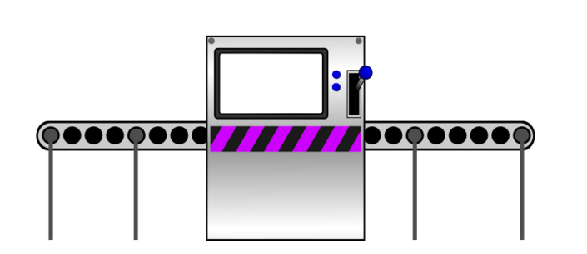
2. Decide which adverb of frequency to use to link each set of two paragraphs together.
Lots of machines are used in factories. Machines are cheaper to run then people. Some factories even use machines instead of cleaners.
_______________ a machine will break down. When this happens a human is required to fix the problem. Broken machines can cause money to be wasted if the problem is not fixed quickly.
often usually occasionally sometimes

Slide 21

2. Decide which adverb of frequency to use to link each set of two paragraphs together.
Metal detecting is a popular hobby. Some people spend hours of their spare time hunting for metal. They hope to get rich or to find important objects from history.
______________ metal detectors find something really special. In these cases there are rules about what people are allowed to keep. We do not know if some metal detectors have found treasure which people have kept secret.
often usually occasionally sometimes

Slide 22
2. Decide which adverb of place to use to link each set of two paragraphs together.
Metal detecting is a popular hobby. Some people spend hours of their spare time hunting for metal. They hope to get rich or to find important objects from history.
______________ metal detectors find something really special. In these cases there are rules about what people are allowed to keep. We do not know if some metal detectors have found treasure which people have kept secret.
anywhere below outside nearby

