Slide 1
Year 5 SPAG
Relative Clauses
NCLO: Using relative clauses beginning with who, which, where, when, whose, that or with an implied (i.e. omitted) relative pronoun

Slide 2
Relative clauses
Relative clauses are clauses starting with the relative pronouns who, that, which, whose, where, when. They are most often used to define or identify the noun that precedes them.

Slide 3
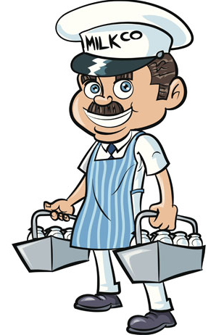
A relative clause is a subordinate clause that is often introduced by a relative pronoun. Here are some relative pronouns: that, which, whose and who Joe is the man who delivers the milk.
relative pronoun
relative clause

Slide 4
What you need to know
A relative clause adds extra information about a noun or a noun phrase. The sentence makes sense without it.
A relative clause contains a verb (because it is a clause).
It often begins with a relative pronoun: who, which, where or that. They relative pronoun may be omitted in some cases: Paul, (who is) a great cook, made my birthday cake.
A relative clause is a type of subordinate clause.

Slide 5
1. Circle the relative pronouns in red.
Underline the relative clauses in green.
a. I prefer the blue shoes which match my dress.
b. This is the house that Megan is going to move into.
c. I don't like people who are cruel to animals.
d. We found a lost dog whose owner was nowhere to be seen.
e. Yvonne likes to go for walks that have amazing views.
f. This is the computer game that I bought last week.

Slide 6
2. Add a suitable relative pronoun to complete the relative clauses below.
a. This is the book ..... Paula was reading.
b. The Tasty Tavern is a restaurant ..... specialises in vegetarian meals.
c. I need to find a shop ......sells fancy dress costumes.
d. Ulrika met a man .....dog was almost as big as he was.
e. Juliet is the person ....always gets her own way.
f. Let's go on holiday to a country .... has hot, sunny weather.
g. We saw a jellyfish ....tentacles were two metres long.

Slide 7
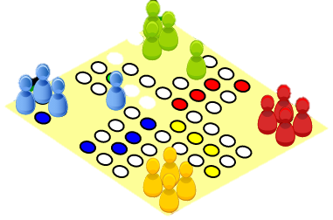
Match the main clause to the correct relative clause to make a sentence. Rewrite the sentence.
Main clause
a. I found an injured rabbit
b. Scott moved to a quiet village
c. Dad is looking for a builder
d. Kevin remembers the day
e. Colin wants to buy the game
Relative clause
who can renovate our house.
when he got lost at the funfair.
that he saw advertised on TV.
whose leg was broken.
where there were no other children.

Slide 8
4. Add a relative clause using 'who' or 'which' to each sentence.
a. Susanna waited for Edward....
b. There was a lot of noise....
c. Ronald went to the circus....
d. The people welcomed the man.....

Slide 9
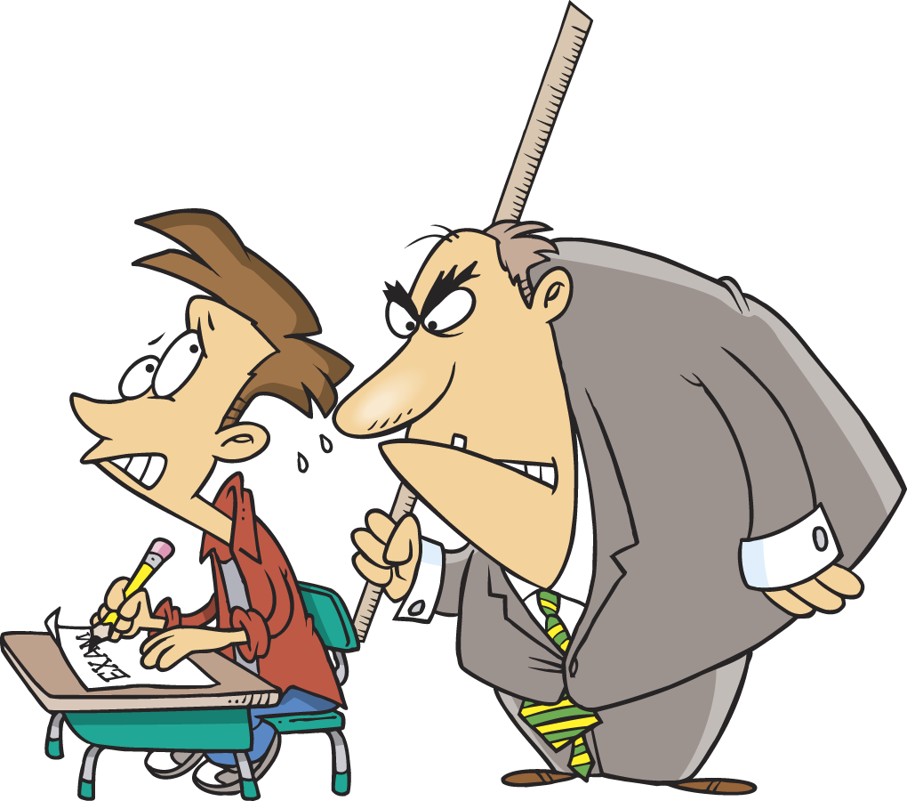
5. Write two sentences which contain a relative clause using the words below.
teacher strict
scientist experiment

Slide 10
Trickier Relative clauses
A relative clause sometimes comes in the middle of a sentence.
The girl, who knocked on the door, ran away.
relative pronoun
relative clause

Slide 11
1. Underline the relative clause in each of the sentences below.
a. After the party, which finished at midnight, we went to bed.
b. The room where the books are stored is being renovated.
c. Neil, whose son plays the drums in a band, loves rock music.
d. That day when I fell over was the most embarrassing day of my life.
e. The house that flooded during the storm can now be lived in again.
f. Liam, who wants to be a pilot, is taking flying lessons.

Slide 12
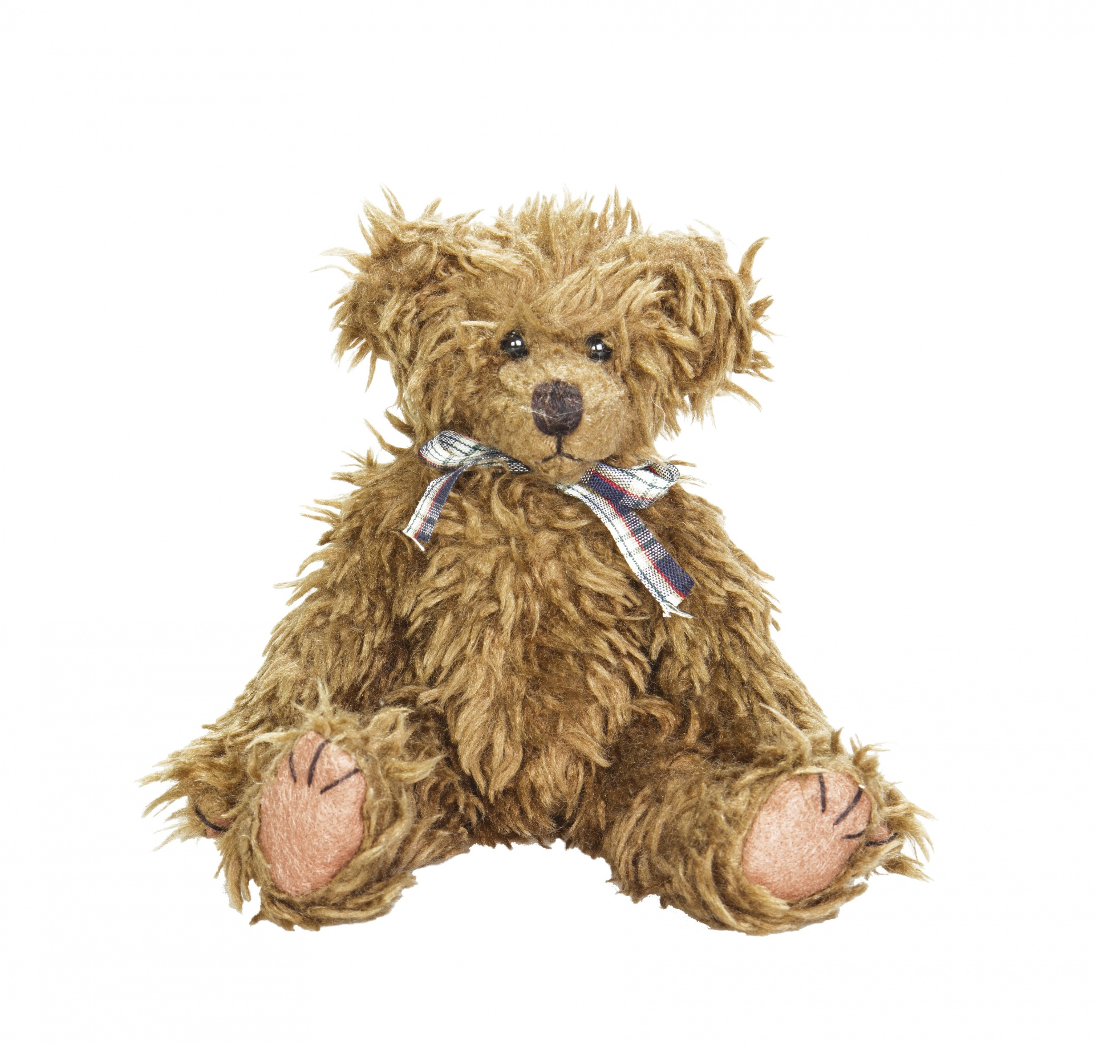
2. Add a suitable relative clause to complete the sentences below.
The boy ...................looked very angry.
b. a. Michael's phone ..................broke.
c. The town ........... is not very big.
d. Roger's nephew .......... is twelve.
e. That windy day .......... was awful.
f. My old teddy bear ........... is in the wash.

Slide 13
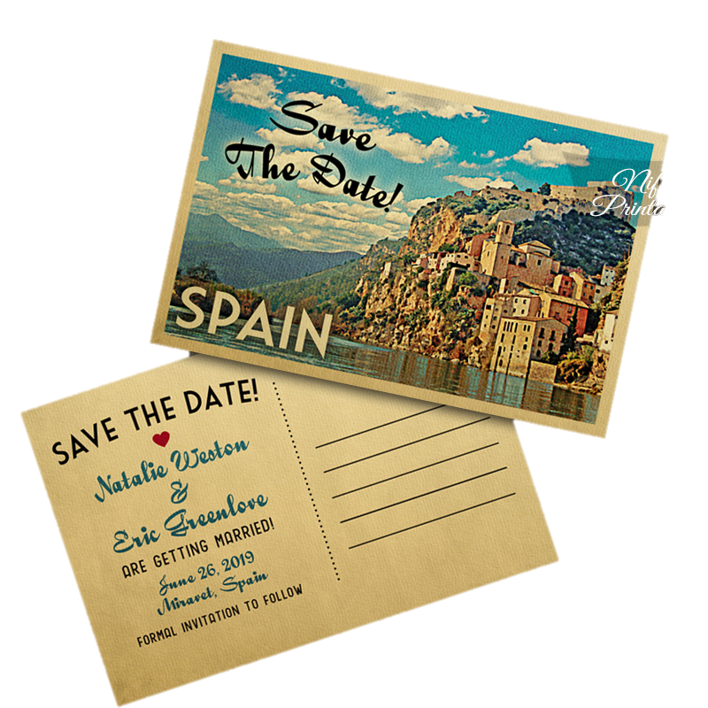
They got the postcard, which we sent from Spain.
relative clause with a pronoun
They got the postcard we sent from Spain.
relative clause without a relative pronoun

Slide 14
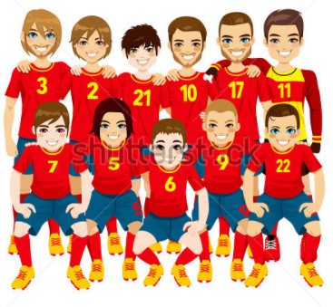
3. Copy these sentences into your book. Highlight the sentences that can also be written without a relative pronoun. The relative clauses are underlined.
a. I know a girl who says she's Lisa's friend.
b. The museum which we visited was very interesting.
c. Nobody knows the boy whose parents are abroad.
d. That's the football team that Josh is joining.
e. My tenth birthday was the day that Everton won the FA Cup.

Slide 15
4. Rewrite the sentences below without a relative pronoun.
a. The walk which we went on was far too long.
b. I've forgotten the name of the film which Jim recommended.
c. He can't remember the day that we went to the zoo.
Extension challenge:
Write sentences of your own that can be written with or without a relative pronoun.

