Slide 1
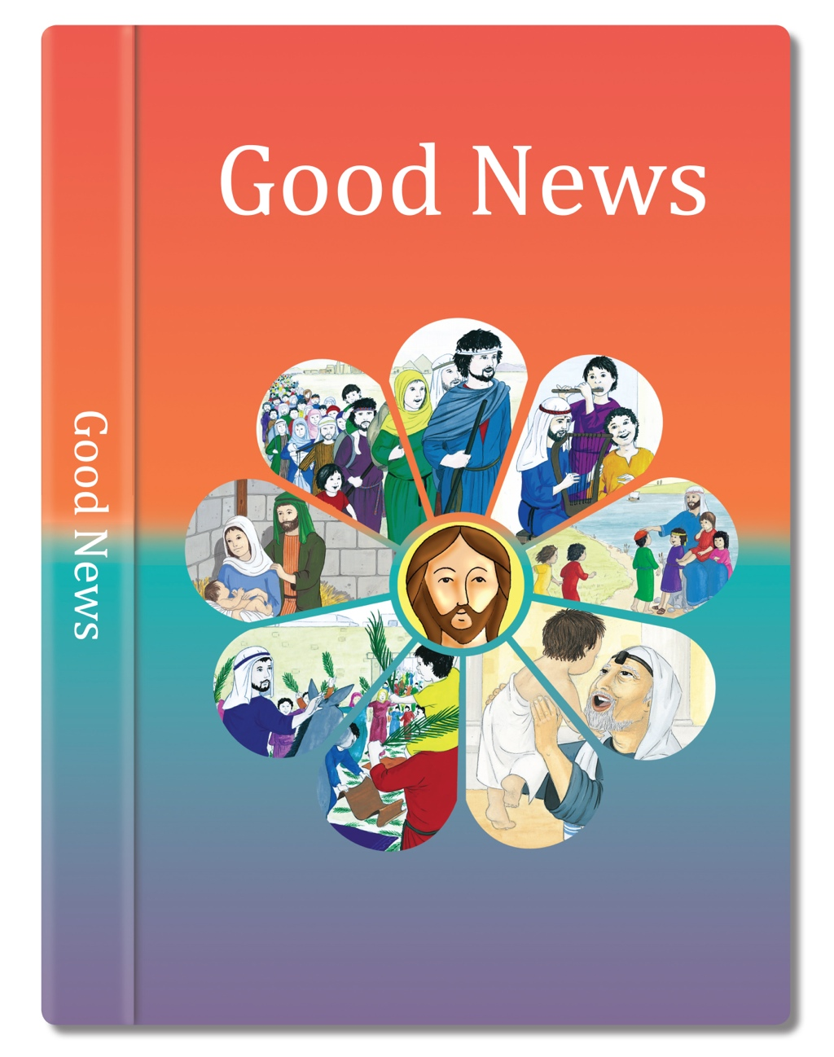

Slide 2
Moses said to the people, “Remember this day – the day on which you left Egypt, the place where you were slaves.
This is the day the Lord brought you out by his great power. No leavened bread is to be eaten.
Exodus 13: 3
(Come and See)

