Slide 1
Mental Mathematics

Slide 2
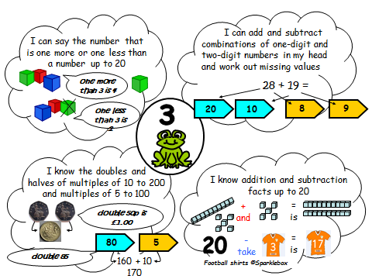

Slide 3
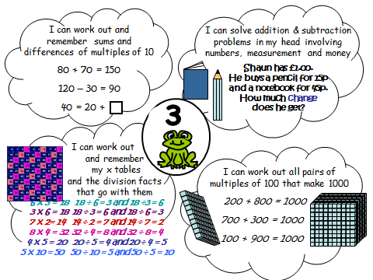

Slide 4
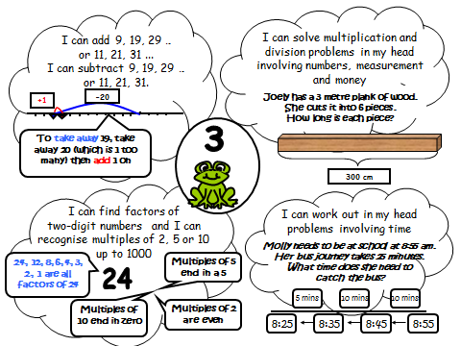

Slide 5
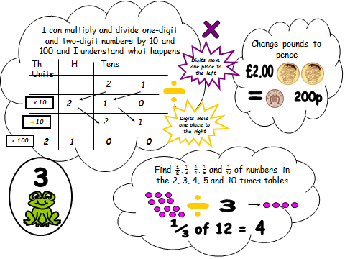

Slide 7
Written Methods

Slide 8
Addition – End of Year Expectations
Add numbers with up to three digits
Eventually children will be confident in using the column method.
To partition numbers up to 1000
e.g. 100+ 40 + 6 = 146
Solve problems in different contexts
Including missing number problems

Slide 9
Number Lines

Slide 10
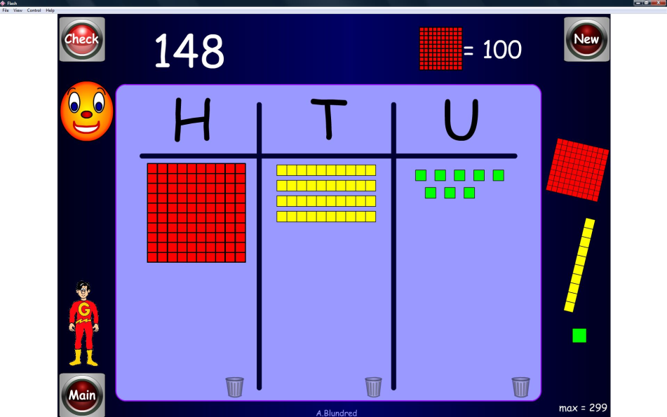
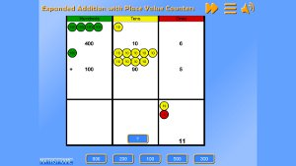
Partitioning
36 + 45 =
30 + 40 + 6 + 5
= 70
= 11
= 81
Diennes and counters help our
more visual learner

Slide 11
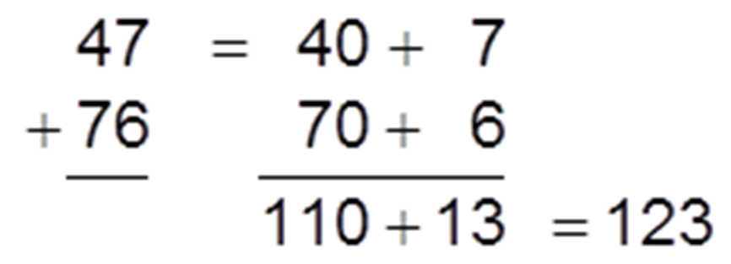
Partitioning continued..
Partitioned numbers are then written under one another. This mirrors the column method and also links mental methods

Slide 12
Column Method

Slide 13
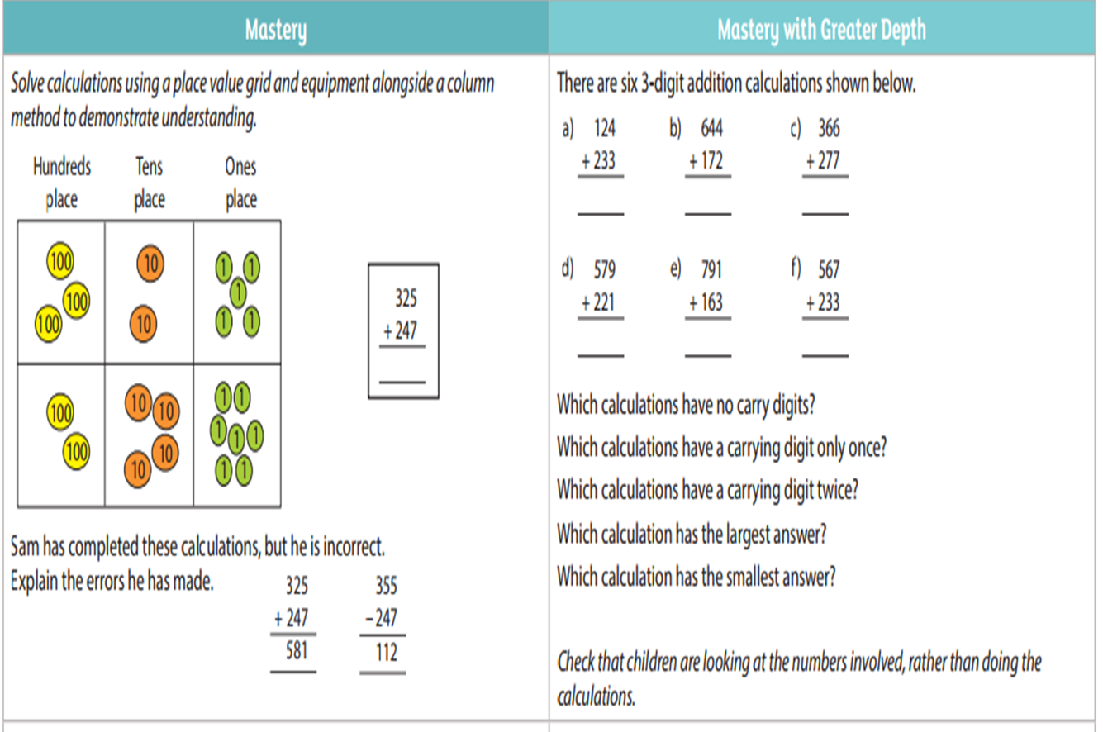

Slide 14
Subtraction End of year expectations Subtract numbers with up to 3 digits Solve problems in different contexts Including missing number problems

Slide 15
Number Lines
73 – 26 =

Slide 16
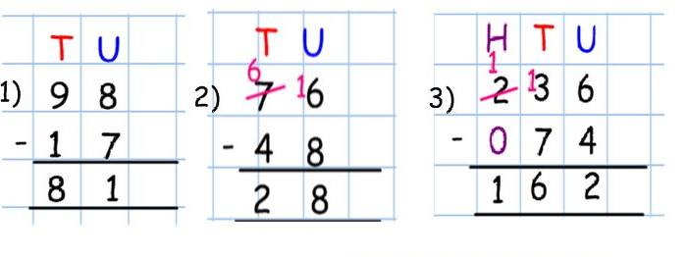
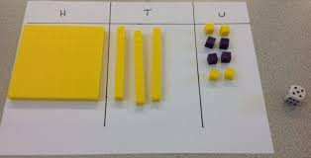
Children use Diennes or counters until they are confident with the method.
Column subtraction with and without exchanging

Slide 17
.
Missing box Subtraction sums

Slide 18
.
Multiplication End of Year expectations:
Children will develop reliable methods
Understand scaling problems
Solve problems involving multiplication

Slide 19
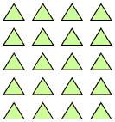
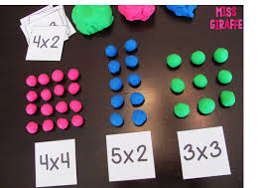
.
Arrays
Number Lines

Slide 20
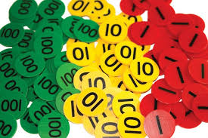
.
Using Diennes and place value counters
13 x 4

Slide 21
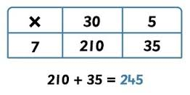
.
Grid Method multiplication

Slide 22
.
Division End of Year expectations:
Develop a reliable written method for division
Solve problems involving scaling and missing numbers
Understand the link between fractions and division

Slide 23
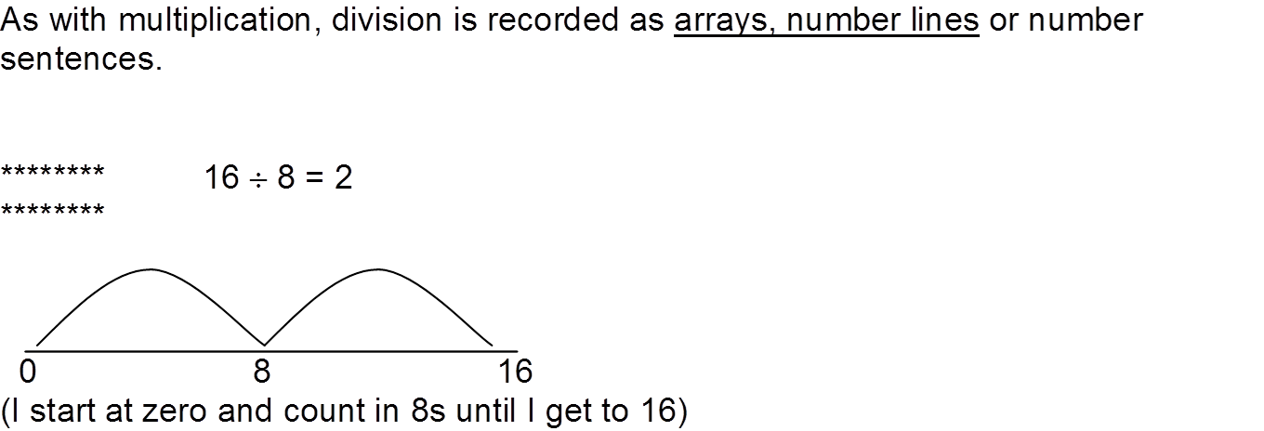
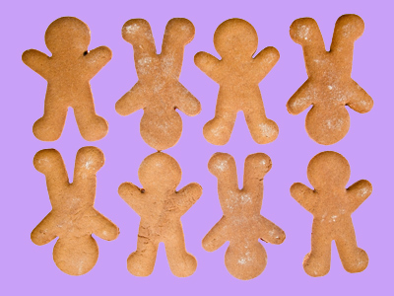
There is no need to divide! Use your tables knowledge!

Slide 27
Thank you for listening We hope you enjoy the Mathematical games and have fun! Thank you for all your support- You are all wonderful because you are here!

